Slide 1
Types of Cellular Transport
Weeee!!!
Passive Transport
cell doesn’t use energy
  Diffusion
  Facilitated Diffusion
  Osmosis
Active Transport
cell does use energy
  Protein Pumps
  Endocytosis
  Exocytosis
high
low
This is gonna be hard work!!
high
low
Notes:
1

Slide 2
Passive Transport
Cell uses no energy
Molecules move randomly
Molecules spread out from an area of high concentration to an area of low concentration.
(High→Low)
Notes:
2

Slide 3
Vocabulary
Concentration Gradient: When you have an area of greater concentration and an area of lesser concentration.
Equilibrium: When the concentration is the same throughout.
  Solvent – Dissolving agent (ex. Water)
  Solute – Substance that is dissolved (ex. Kool aid mix)

Slide 4
3 Types of Passive Transport
Diffusion – movement of any substance
Facilitated Diffusion – diffusion with the help of transport proteins
Osmosis – diffusion of water
Notes:
4

Slide 5
Diffusion Through Cell Boundaries
  What happens during diffusion?
  - Molecules MOVE!!!!
  - Molecules are always in motion. They move around and bump into each other.

Slide 6
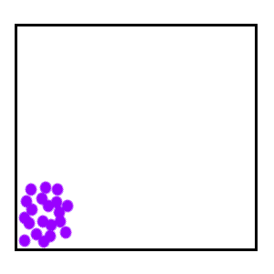
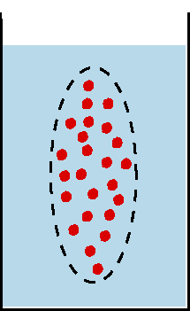
Passive Transport:
Diffusion
Simple Diffusion Animation
Diffusion: random movement of particles from an area of high concentration to an area of low concentration.
(High to Low)
Diffusion continues until all molecules are evenly spaced
When the concentration of the solute inside the cell is the same as the concentration outside the cell, the cell and its environment has reached equilibrium.
(equilibrium is reached)-Note: molecules will still move around but stay spread out.
http://bio.winona.edu/berg/Free.htm
Notes:
6

Slide 7
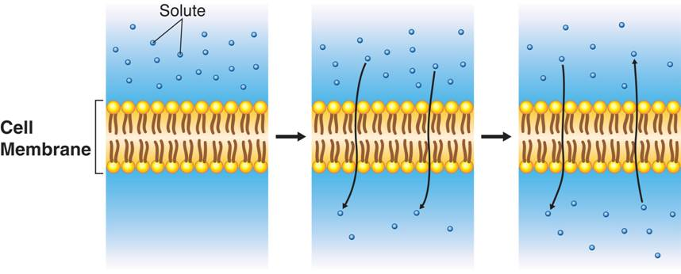
Diffusion Through Cell Boundaries
Notes:
Diffusion is the process by which molecules of a substance move from areas of higher concentration to areas of lower concentration. Diffusion does not require the cell to use energy.

Slide 8
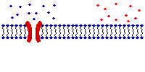
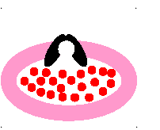
Passive Transport:
Facilitated Diffusion
A
B
requires no energy because molecules still move from a higher to a lower concentration.
Each protein channel is specific for the type of molecule that it allows to enter the cell.
  Transport Proteins are specific – they “select” only certain molecules to cross the membrane
  Transports larger or charged molecules
Facilitated diffusion (Channel Protein)
Diffusion (Lipid Bilayer)
Carrier Protein
Notes:
8

Slide 9
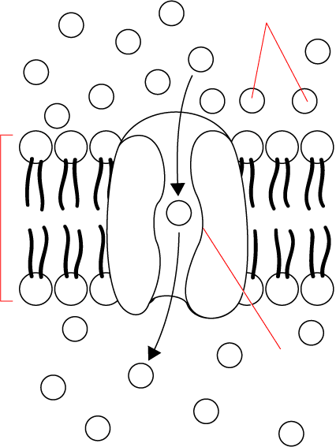
Passive Transport: Facilitated Diffusion
Glucose
molecules
Cellular Transport
High
High Concentration
Channel Protein animations
Cell Membrane
Low Concentration
Protein
channel
Low
Transport Protein
Through a →
Go to Section:
Notes:
9

Slide 10

Osmosis
Osmosis
  Osmosis is the diffusion of water through a selectively permeable membrane.
  Whenever water moves, into or out of the cell, we call it osmosis.

Slide 11
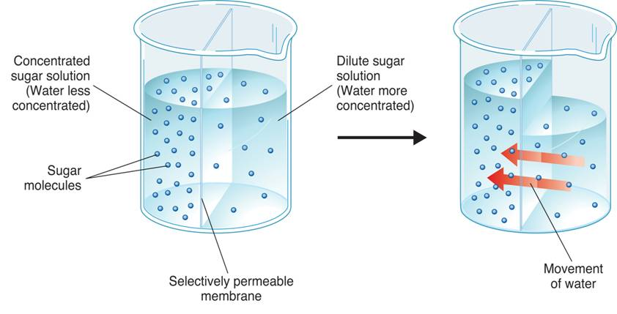
Osmosis
  How Osmosis Works
Dilute sugar solution (Water more concentrated)
Concentrated sugar solution (Water less concentrated)
Sugar molecules
Movement of water from high concentration to low concentration
Selectively permeable membrane (only water can move)
Notes:
Osmosis is the diffusion of water through a selectively permeable membrane. In the first beaker, water is more concentrated on the right side of the membrane. As a result, the water diffuses (as shown in the second beaker) to the area of lower concentration.

Slide 12
Osmosis
In osmosis, water tends to diffuse from a highly concentrated region to a less concentrated region.
If you compare solutions, three terms can be used to describe the concentrations of the solution due to the amount of solute dissolved in the water:
- hypertonic (“above strength”)more solute/less water.
- hypotonic (“below strength”)less solute/more water.
- isotonic (”same strength”)same amount of solute

Slide 13
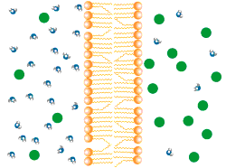
Passive Transport:
Osmosis
Osmosis animation
Osmosis: diffusion of water through a selectively permeable membrane
Water moves from high to low concentrations
Water moves freely through pores.
Solute (green) to large to move across.
Notes:
13

Slide 14
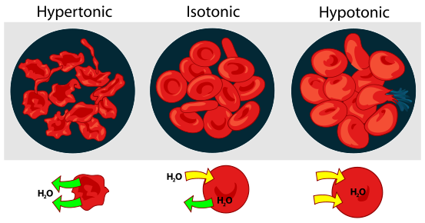
Osmosis
  Osmotic Pressure
    Osmosis exerts a pressure known as osmotic pressure on the cell compared to its environment. Remember both inside the cell and outside the cell there is a concentration. It is the water that moves!!

Slide 15
Effects of Osmosis on Life
Osmosis- diffusion of water through a selectively permeable membrane
Water is so small and there is so much of it the cell can’t control it’s movement through the cell membrane.
Notes:
15

Slide 16
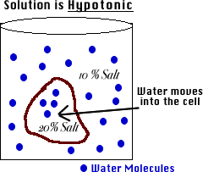
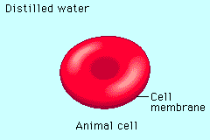
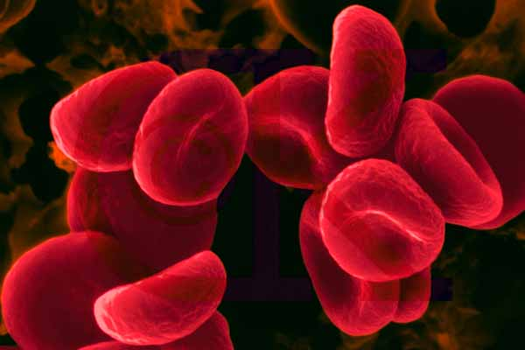
Hypotonic Solution
Hypotonic: The solution has a lower concentration of solutes and a higher concentration of water than inside the cell. (Low solute; High water)
Result: Water moves from the solution to inside the cell): Cell Swells and bursts open (cytolysis)!
Notes:
16

Slide 17
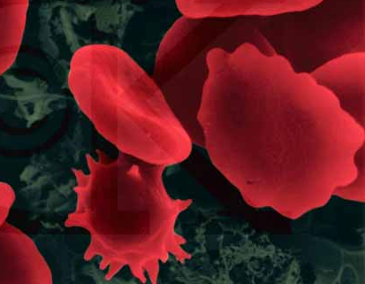
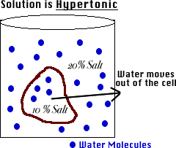
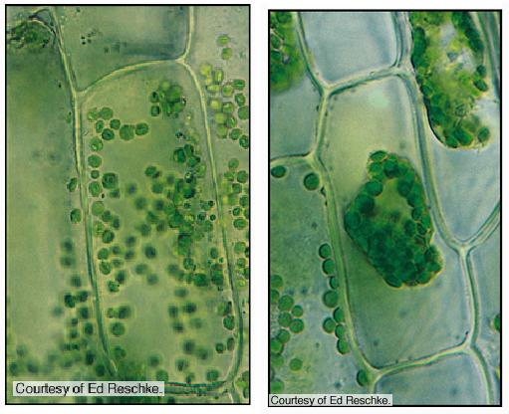
Hypertonic Solution
Hypertonic: The solution has a higher concentration of solutes and a lower concentration of water than inside the cell. (High solute; Low water)
shrinks
Result: Water moves from inside the cell into the solution: Cell shrinks (Plasmolysis)!
Notes:
17

Slide 18
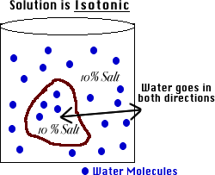
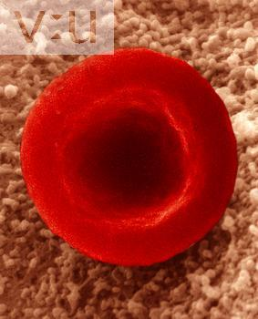
Isotonic Solution
Isotonic: The concentration of solutes in the solution is equal to the concentration of solutes inside the cell.
Result: Water moves equally in both directions and the cell remains same size! (Dynamic Equilibrium)
Notes:
18

Slide 19
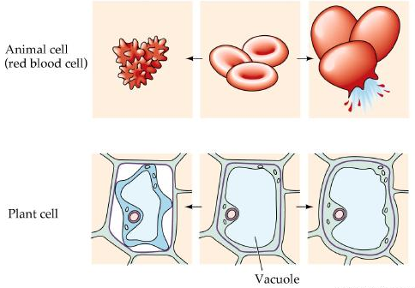
What type of solution are these cells in?
A
B
C
Hypertonic
Isotonic
Hypotonic
Notes:
19

Slide 20
How Organisms Deal with Osmotic Pressure
Salt water fish pump salt out of their specialized gills so they do not dehydrate.
Animal cells are bathed in blood. Kidneys keep the blood isotonic by remove excess salt and water.

