Slide 1
The Creation of New Species Through Evolution

Slide 2
Speciation vocabulary
First off, how do we define a species?
Speciation → splitting of one species into 2 different species
Species → a group of organisms that interbreed under natural conditions to produce fertile offspring
Natural conditions: not artificially inseminated or forced into the same location
To maintain a population as a single species, genes must freely flow through the entire population

Slide 3
Morphological Species Concept – internal and external structures are used to group organisms into species
Biological Species Concept– defines a species as a population of organisms that can successfully interbreed

Slide 4
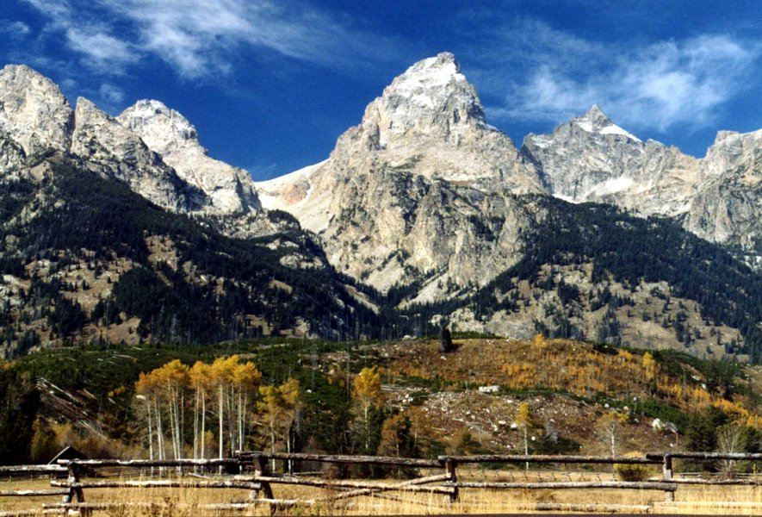
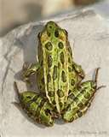
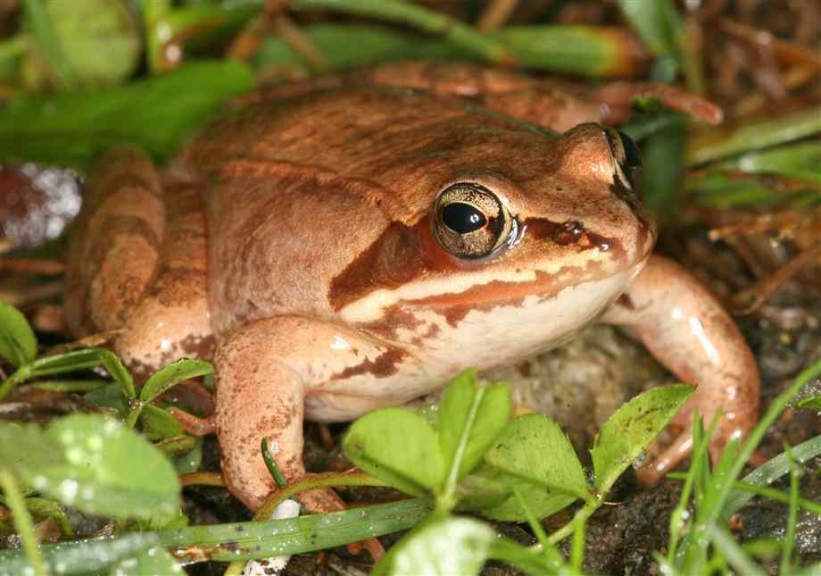
Speciation = formation of a new species
Reasons for Speciation
1) Geographic Isolation
2) Reproductive Isolation -prezygotic (before fertilization)
-postzygotic (after fertilization)
Notes:
Wood frog and leopard frog – different mating calls

Slide 5
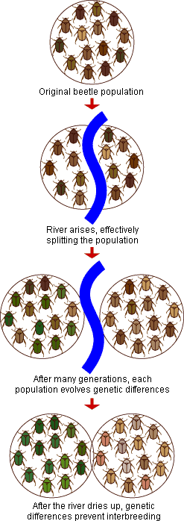
Mechanisms of Speciation
Geographic isolation → members of a species are isolated from one another due to a geographic barrier (mountains, rivers).
e.g., a few members of a species leave their original location and are separated from the rest of the species (Darwin's finches)
e.g., barrier develops slowly (formation of Grand Canyon split a population of squirrels into 2 isolated groups that have evolved into separate species, the Kaibab and Albert squirrels)

Slide 6
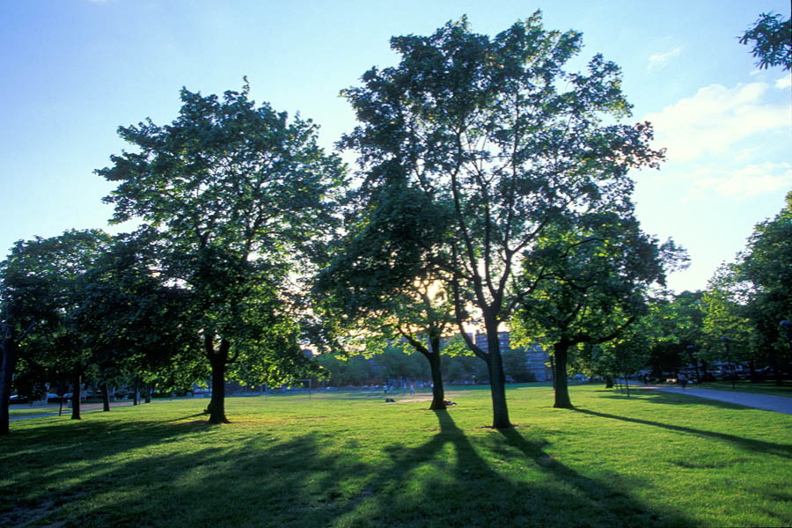
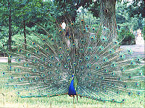
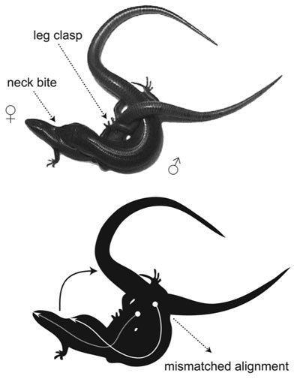
Mechanisms of Speciation
Reproductive isolation →
Before mating:
Different breeding times (e.g., trees release pollen at different times)
Different behaviors
(e.g., courtship rituals of peacocks)
Mechanical problems
(e.g., genitalia doesn’t fit together)

Slide 7
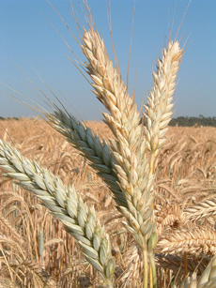
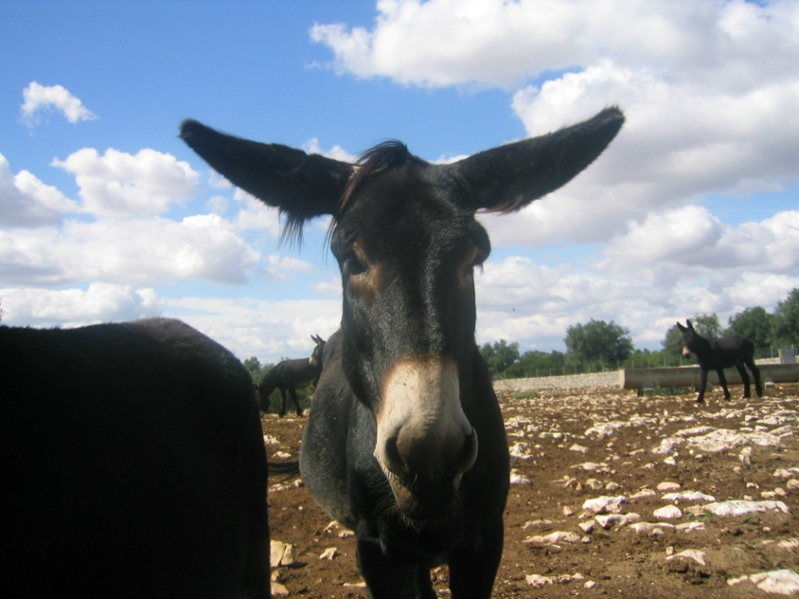
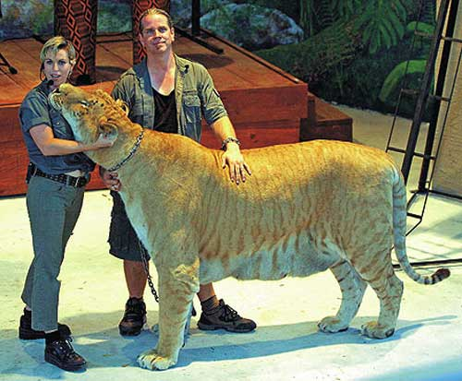
Mechanisms of Speciation
Reproductive isolation →
After mating:
Hybrids don’t survive
Hybrids are sterile
Triticale
Liger
Mule

Slide 8
Pre-zygotic Isolation
Sperm never gets a chance to meet egg
Geographic isolation: barriers prevent mating
Ecological isolation: different habitats in same region
Temporal isolation: different populations are fertile at different times
Behavior Isolation: they don’t recognize each other or the mating rituals
Mechanical isolation: morphological differences
Gamete Isolation: Sperm and egg do not recognize each other
Notes:
Sea urchins release sperm & eggs into surrounding waters where they fuse & form zygotes. Gametes of different species— red & purple —are unable to fuse.

Slide 9
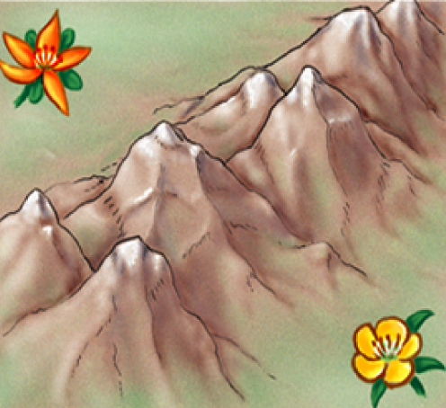
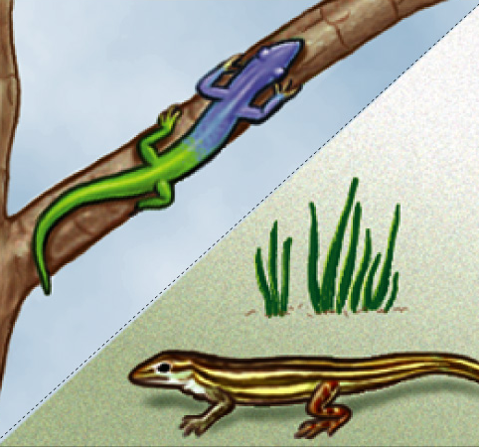
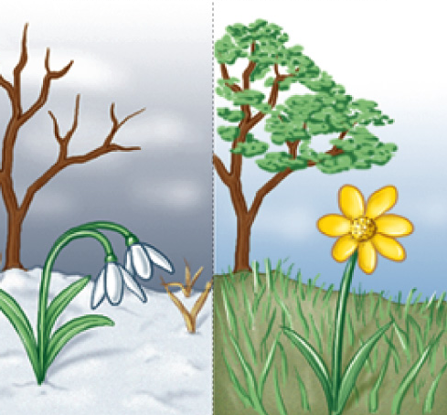
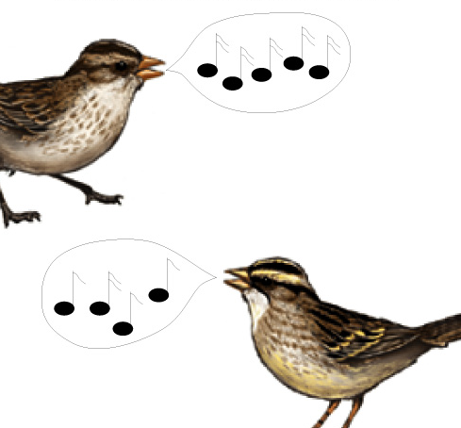
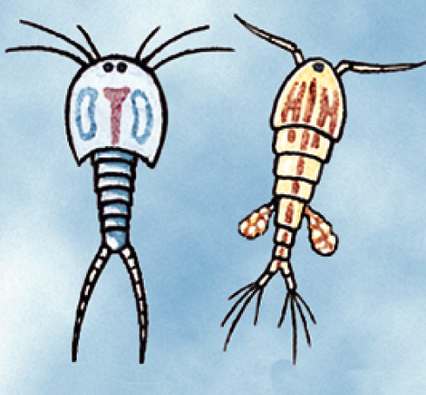
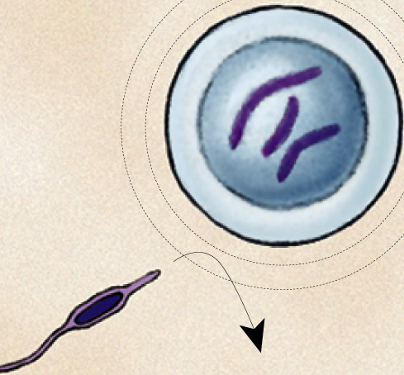
PRE-Zygotic barriers
Obstacle to mating or to fertilization if mating occurs
geographic isolation
ecological isolation
temporal isolation
behavioral isolation
mechanical isolation
gametic isolation

Slide 10
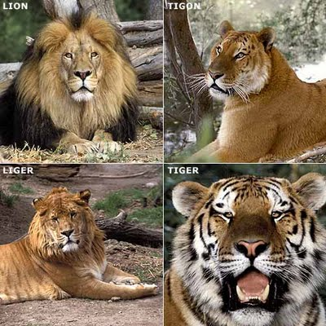
Post Zygotic Isolation
Hybrid Inviability – the embryo cannot develop inside the mothers womb
Hybrid Sterility – Adult individuals can be produced BUT they are not fertile
Hybrid Breakdown – each successive generation has less fertility than the parental generation
Notes:
Species of salamander genus, Ensatina, may interbreed, but most hybrids do not complete development & those that do are frail.
Even if hybrids are vigorous they may be sterile; chromosomes of parents may differ in number or structure & meiosis in hybrids may fail to produce normal gametes Horse(64) x donkey(62) = mule (63 chromosomes)
In strains of cultivated rice, hybrids are vigorous but plants in next generation are small & sterile.
On path to separate species.

Slide 11
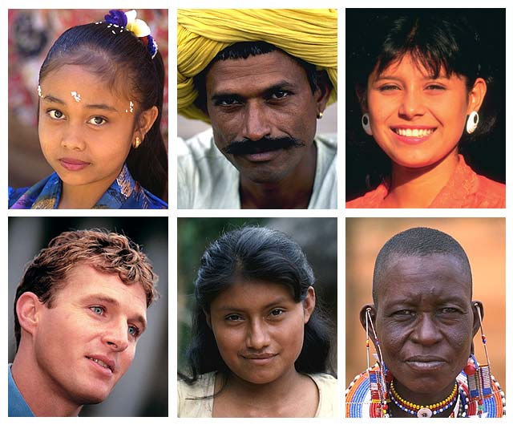
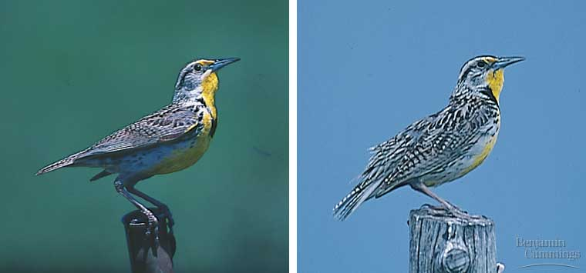
So…what is a species?
Population whose members can interbreed & produce viable, fertile offspring
Reproductively compatible
Distinct species: songs & behaviors are different enough to prevent interbreeding
Eastern Meadowlark
Western Meadowlark
Notes:
11
Humans re so diverse but considered one species, whereas these Meadowlarks look so similar but are considered different species.
Meadowlarks Similar body & colorations, but are distinct biological species because their songs & other behaviors are different enough to prevent interbreeding

Slide 12
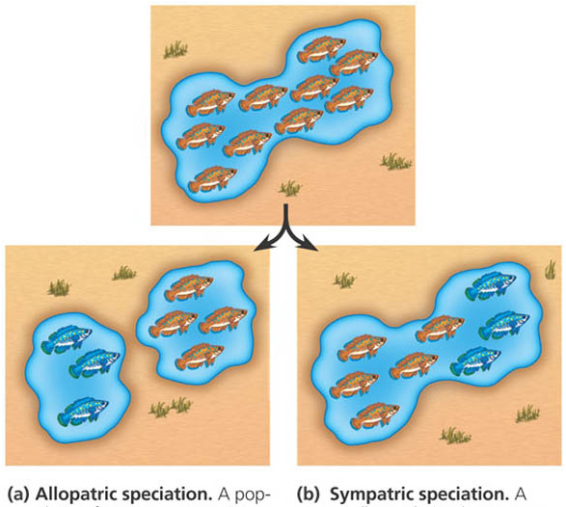
How do new species originate?
When two populations become reproductively isolated from each other.
Speciation Modes:
allopatric
geographic separation
“other country”
sympatric
still live in same area
“same country”

Slide 13
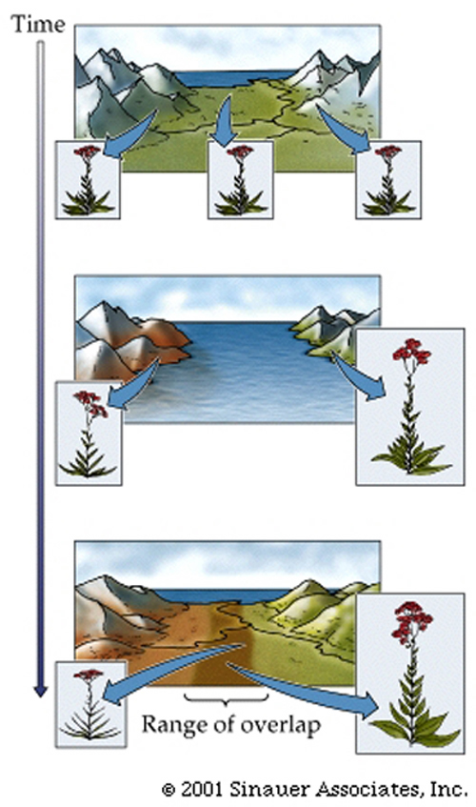
Allopatric Speciation
Physical/geographical separation of two populations
Allele frequencies diverge
After a length of time the two population are so different that they are considered different species
If the barrier is removed interbreeding will still not occur due to pre/post zygotic isolation

Slide 14
Sympatric Speciation
Formation of a new species without geographic isolation.
Causes:
Pre-zygotic barriers exist to mating
Polyploidy (only organism with an even number of chromosomes are fertile…speciation occurs quickly)
Hybridization: two different forms of a species mate in common ground (hybrid zone) and produce offspring with greater genetic diversity than the parents….eventually the hybrid diverges from both sets of parents

Slide 15
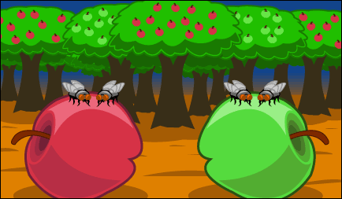
Sympatric Speciation
Gene flow has been reduced between flies that feed on different food varieties, even though they both live in the same geographic area.

Slide 16
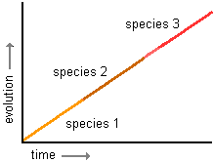
There are two models of speciation, or how populations change over time
Model #1: Gradualism (change happens
slowly, and new species are made at a
constant rate)

Slide 17
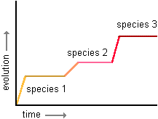
Model #2: Punctuated Equilibrium (there are times of little or no change followed by times of rapid change – often due to major changes in the environment)
Stephen Jay Gould came up with this model!

Slide 18
Gradualism Punctuated Equilibrium

Slide 19
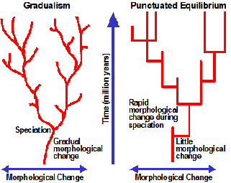
Another Way of Looking at It!

Slide 20
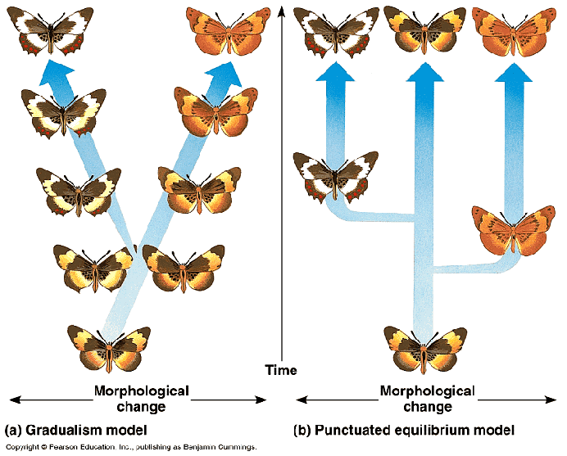
And yet another way of looking at it!

Slide 21
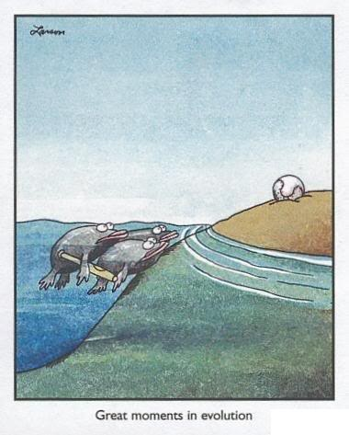
Patterns of Evolution

Slide 22
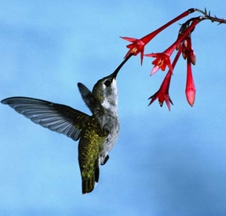
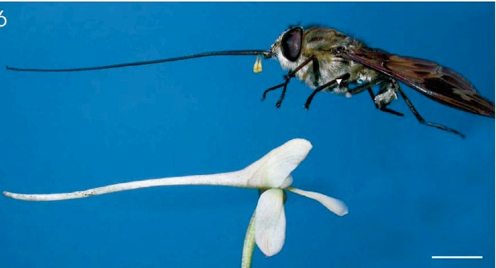
A) Coevolution = change of two or more species in response to one another. Two species evolve together in response to their environment.
(Ex: predator/prey relationships; hummingbird beak/trumpet flower; dogs/humans)
Orchid Fly
Notes:
Also mention evolutionary arms race between humans and bacteria

Slide 23
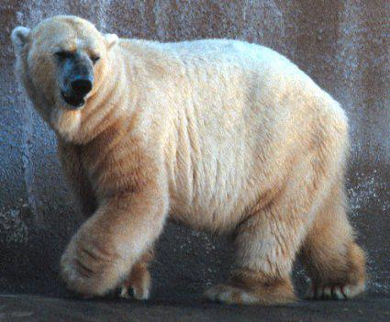
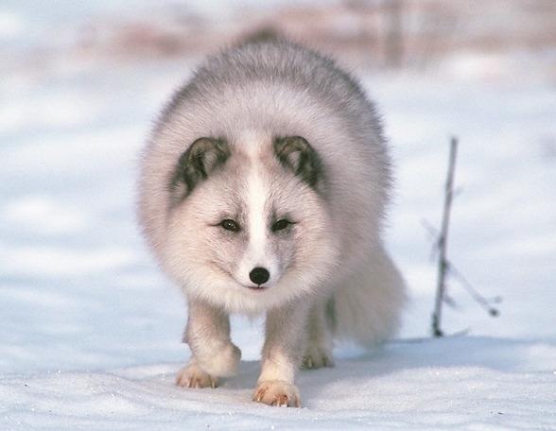
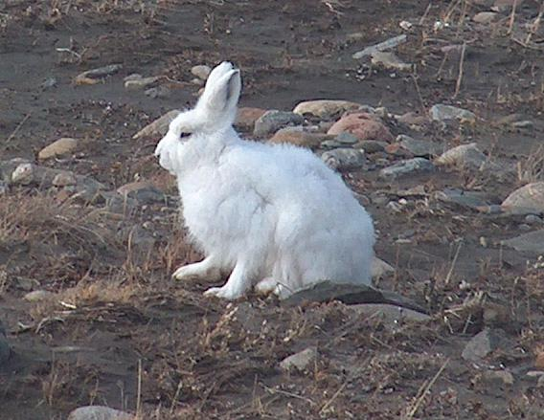
B) Convergent Evolution = organisms with different ancestors (not related) become very similar due to environment (Ex: sharks and dolphins)
C) Divergent Evolution = two or more related populations/species become different (Ex: Darwin’s finches)

Slide 24
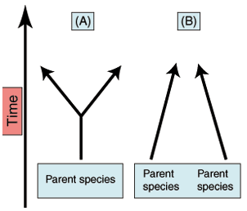
Divergent
Evolution
Convergent Evolution

Slide 25
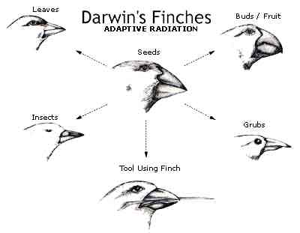
D) Adaptive Radiation = an extreme form of divergent evolution where many related species evolve from a single ancestor species

Slide 26
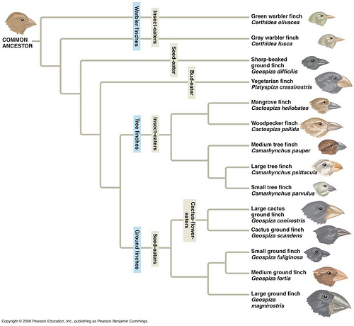

Slide 27
1. Overproduction- a population produces more offspring than can survive.
2. Genetic Variation- within a population individuals have different traits.
3. Struggle to Survive- if there is no competition there is no impetus to change.
4. Differential Reproduction- if you are better adapted, you will live longer an reproduce more.

Slide 28
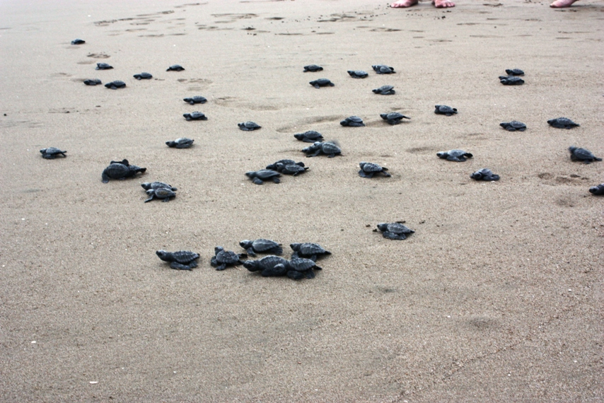

Slide 29
The genes within a population contains differences.
Are you exactly the same as the person next to you?

Slide 30
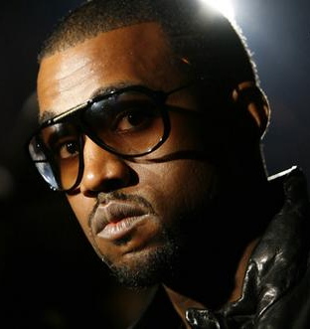
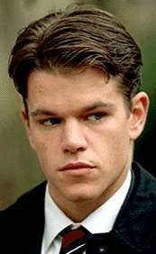
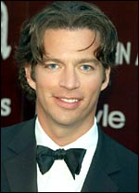
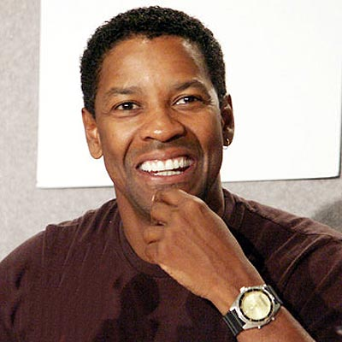
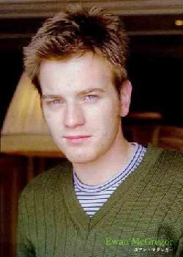
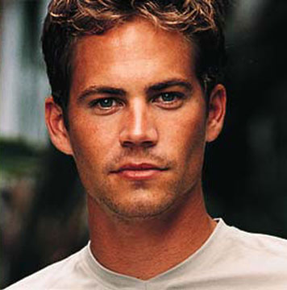
Notes:
30

Slide 31
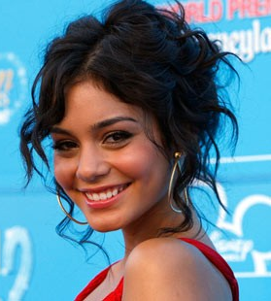
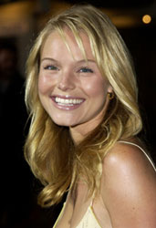
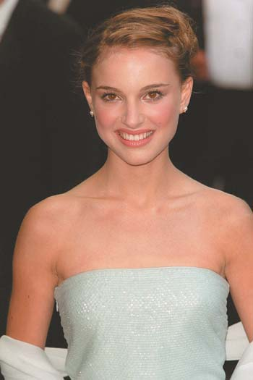
Notes:
31

Slide 32
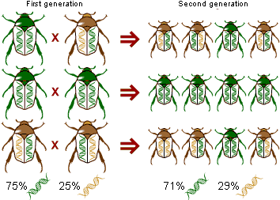
The proportion of gene copies of a given allele in a population.
A change in allele frequency results in small evolutionary changes (microevlolution)

Slide 33
All of the genes of the reproductively active members of a population.

Slide 35
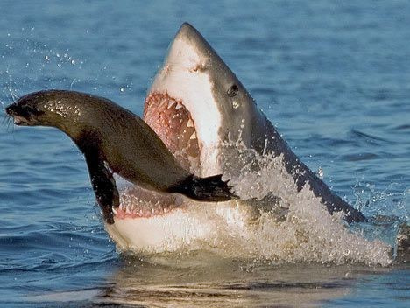

Slide 36
Individuals must compete with each other for resources.
Food, water, mates, etc.
Male Caribou fight for the right to breed with a female Caribou.

Slide 37
Only the individuals with the best adaptations to their environment will survive competition.
Only the survivors will be able to reproduce and pass on their genes.

Slide 38
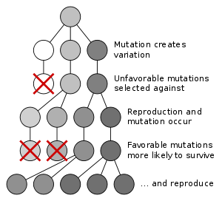
Moths who were darker were better adapted to live on sooty trees.

Slide 40
Genetic variation vocabulary
Gene pool → all the alleles of all the genes in a population
Gene (allele) frequency → proportion of particular type of alleles in a population
Variation has two sources:
mutation → change in DNA that leads to new alleles (harmful or beneficial)
sex (gene shuffling) → meiosis (recombination of alleles during crossing over) and fertilization
Gene flow → new alleles (or frequencies) from one population enter another due to migration
e.g., native Americans and “recent” immigrants

Slide 41
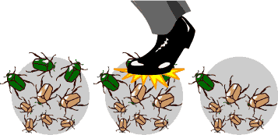
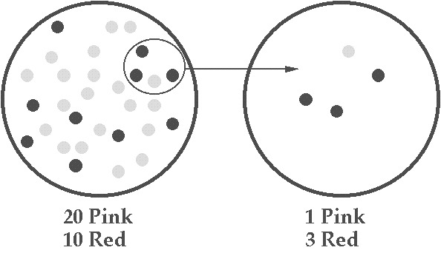
Gene tic drift
Genetic drift → random changes in allele frequencies of a gene pool
Has a great effect when…
Bottleneck → random event radically decreases population size (and allele frequencies)
e.g., Earthquake in Haiti
Founder effect → a new population started by a small number of individuals (and their allele frequencies)
e.g., American Amish

