Slide 1
The Chemical Context of Life

Slide 2
Think of chemistry from 9th grade. (I know it was ages ago) Write down 3 things you remember about chemistry in your notebooks.

Slide 3
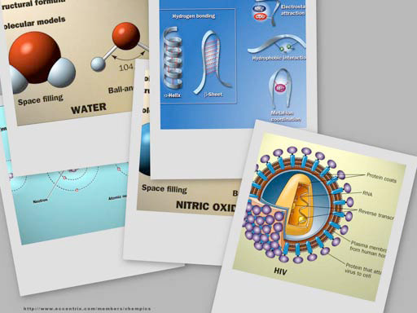
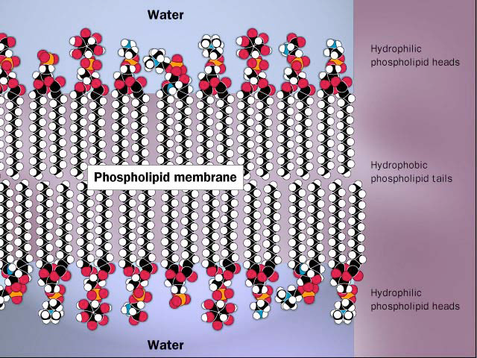
Why are we studying Chemistry? Chemistry is what Biology is made of.

Slide 4
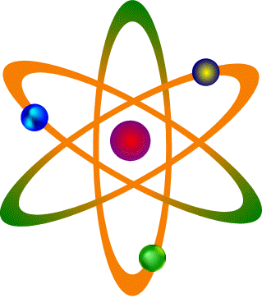
The Basics Everything is made of matter Matter is made of atoms Atoms are made of:
PROTONS (+)
NEUTRONS (0)
ELECTRONS (-)
Different kinds of atoms = elements

Slide 5
About 25 elements are essential for life
Four elements make up 96% of living matter: Carbon (C), Oxygen (O), Hydrogen (H), and Nitrogen (N)
Four elements make up most of remaining 4%: Sulfur (S), Phosphorus (P), Potassium K),and Calcium (Ca)
The most common elements
found in living things:
____________
____________
____________
____________
____________
____________
Carbon - C
Oxygen - O
Hydrogen - H
Nitrogen - N
Sulfur - S
Phosphorus - P
Meet the Elements – They Might Be Giants: Video

Slide 6
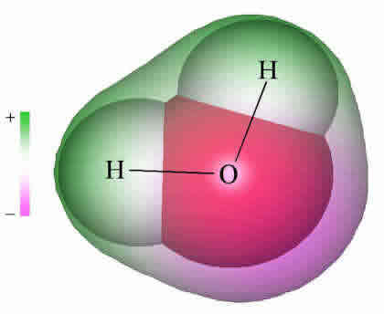
ATOMS CAN JOIN TOGETHER TO Make Molecules
Ex:
Joining 2 HYDROGEN atoms with 1 OXYGEN atom makes one WATER molecule.
A chemical formula tells what kind of and how many atoms are in a molecule
EX: ________
H₂O

Slide 7
A chemical equation tells what happens in a chemical reaction
when molecules interact.
NaOH + HCl → NaCl + H₂0
_______________ _______________
Molecules that react Molecules that are
produced
→
REACTANTS
PRODUCTS

Slide 8
ALL the chemical reactions that happen in cells = METABOLISM
Chemical reactions can join molecules together.
Chemical reactions can break molecules apart.

Slide 9
Living things use BOTH of these kinds of reactions (and MORE) to get the materials they need.

Slide 10
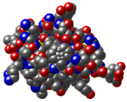
VERY, VERY LARGE
MOLECULES
= MACROMOLUCULES
EXAMPLE:
Insulin =
C₂₅₄ H₃₇₇ N₆₅ O₇₆ S₆

Slide 11
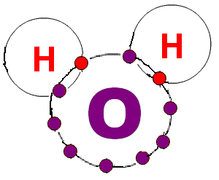
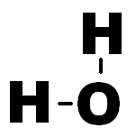
MOLECULES CAN BE SHOWN IN DIFFERENT WAYS
H₂O

Slide 12
CARBON is the most important atom found in living things
It can join to four
other atoms at same time
It can form rings or chain
so it can make lots of
different kinds of molecules.

Slide 13
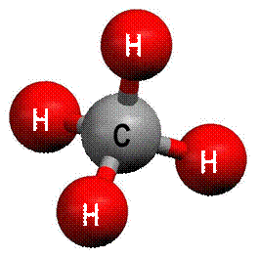
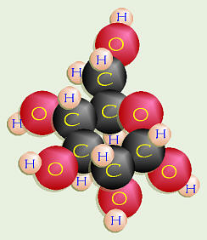
ORGANIC molecules are found in living things and contain CARBON atoms

Slide 14
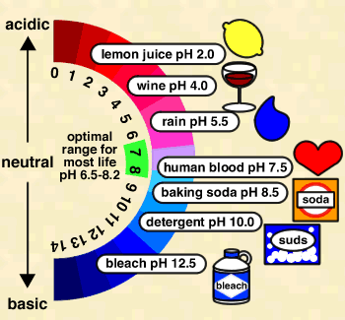
Hydrogen Ions (H⁺)
Ph is a measure of how acidic or basic something is
Less H+ = more basic
More H⁺ = more acidic

Slide 15
Think, Pair Share:
What are some things that are acidic?
What are some things that are basic?

Slide 16
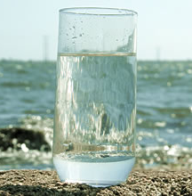
WATER is important for all living things
Average person ~~ 60-70% water
Babies ~~ 78%
Human brain ~~ 90%

Slide 17
WHY Water is important to cells:
1. It’s POLAR so it can DISSOLVE lots of different substances.
2. It can absorb lots of HEAT WITHOUT changing temperature very much. (That helps with homeostasis)
3. HYDROGEN BONDS form between water
molecules so they stick together.
4.Water is an important REACTANT/PRODUCT
in many CHEMICAL REACTIONS.

Slide 18
Make a T chart on a ½ piece of notebook paper:
Things I get about chemistry
Things I don’t get about chemistry

