Slide 1
Part C: Sex Linkage

Slide 2
Sex linkage = the presence of genes on a sex chromosome (X or Y)
X-linked Genes = genes found on the X chromosome
Y-linked Genes = genes found on the Y chromosome
Sex linkage was discovered by Thomas Morgan

Slide 3
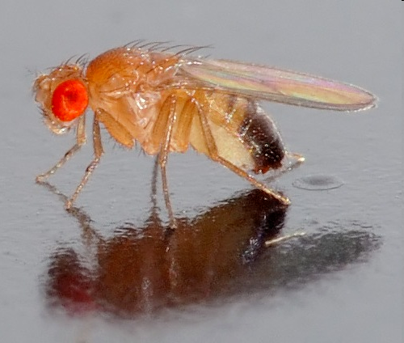
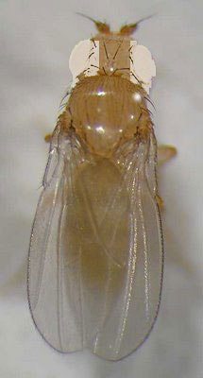
Morgan’s Fruit Flies
Morgan worked with fruit flies…tiny and easy to mate!
Fruit flies can have red or white eyes
Morgan noticed that there were a few white eyed males, but almost no white-eyed females… Must be sex linkage!

Slide 4
Thomas’s Conclusion
The gene for fruit fly eye color is on the X chromosome
Red Eye Allele: X^{R}
White Eye Allele: X^{r}

Slide 5
Example 1: X^{R}X^{R} x X^{r}Y
Red eyed female x white-eyed male
X^{R}
X^{R}
X^{r}
X^{R}X^{r}
X^{R}X^{r}
Phenotype Ratio:
50% red-eyed females
50% red-eyed males
Y
X^{R}Y
X^{R}Y

Slide 6
Example 2: X^{R}X^{r} x X^{R}Y
Red-Eyed Female (HETEROZYGOTE) x Red-Eyed Male
Phenotype Ratio:
50% Red-eyed females
25% Red-eyed males
25% White-eyed males
X^{R}
X^{r}
X^{R}
X^{R}X^{R}
X^{R}X^{r}
Y
X^{R}Y
X^{r}Y

Slide 7
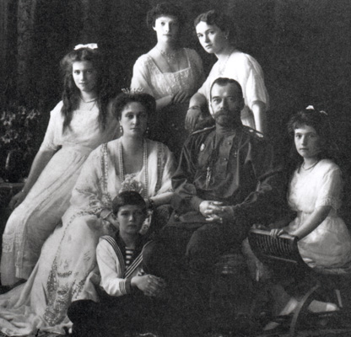
A Human Example of Sex Linkage
Hemophilia is a human X-linked disorder that causes blood to clot incorrectly → patient “bleeds out” after a minor cut
Normal Allele: X^{H}
Hemophilia Allele: X^{h}
Common in Anastasia’s Family…just the men!

Slide 8
Hemophilia
Situation: Carrier Mother X Normal Father
Parent Genotypes:
X^{H}X^{h} x X^{H}Y
Phenotype Ratio:
50% normal females
25% normal males
25% hemophilic males
X^{H}
X^{h}
X^{H}
X^{H}X^{H}
X^{H}X^{h}
Y
X^{H}Y
X^{h}Y

Slide 9
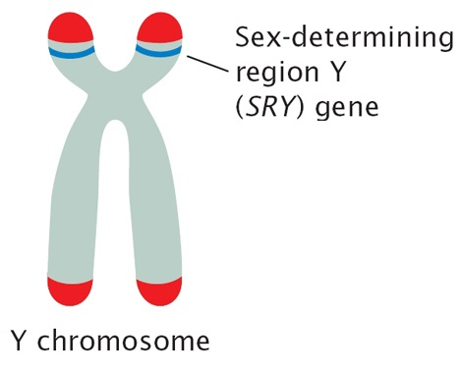
Y chromosome-small & carries only a few genes
http://pageofmystery.com/ALPHAS/genetics/earhairbig.jpg
Y linked traits show up ONLY in MALES EX: hairy pinna
SRY gene Master control gene turns on other genes Creates a cascade of activation to make developing embryo into a MALE
http://www.nature.com/scitable/content/18935/pierce_4_10_large_2.jpg

Slide 10
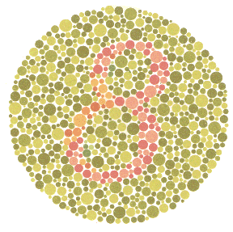
X-Linked Genes
Recessive genes carried on the X chromosome
Red-green colorblindness Mutation in protein receptors in eye that distinguish colors
Hemophilia
Inability to make blood clotting factors
Duchenne Muscular Dystrophy
Change in muscle proteins; results early death
http://gizmodo.com/gadgets/peripherals/samsung-develops-lcd-for-colorblind-036306.php

Slide 11
X-linked traits show up more frequently in males
The X chromosome in males . . .
flies WITHOUT a copilot!

Slide 12
What’s the pattern:
X-LINKED RECESSIVE traits ~ Show up more frequently in males
because they have no back up X
~ Females need two recessive alleles to show the trait.
~ Females can be carriers for X linked traits
~ Male can never be carriers of X linked recessive traits
AUTOSOMAL RECESSIVE traits
~ Both males and females can be carriers for autosomal recessive traits.

Slide 13
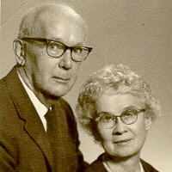
• Some traits are sex limited • Expression depends on the sex of the individual Ex: milk production in female mammals pattern baldness in males.
MALE PATTERN BALDNESS SEX LIMITED (SEX INFLUENCED) AUTOSOMAL- NOT ON A SEX CHROMOSOME BUT . . . SHOWS DIFFERENT PATTERN IN MALES & FEMALES
MALES BB or Bb = bald bb= not bald
FEMALES BB = bald Bb or bb= not bald
Almost like B is dominant in males and b is dominant in females

