Slide 1
Scientific Investigation

Slide 2
When would we use scientific investigation?
Notes:
We use this in EVERYTHING…. Research economics, fashion( what your wearing) , science, food, ect. Don’t think about the scientific method that is something that is isolated to science!!!
What is Biology talk about in characteristics of life

Slide 3
Observations & Inferences
A test of your observation skills…

Slide 4
Note the Differences
In laboratory exercises, record observations NOT inferences
Inferences may be used when writing the conclusion in your lab report
Let’s test your observation skills…

Slide 5
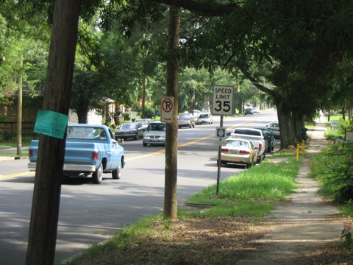
Take a good look at this picture

Slide 6
Question 1
Are there cars parked on the sides of the road?

Slide 7
Question 2
What color is the pickup truck driving in the road?

Slide 8
Question 3
Any minivans around?

Slide 9
Question 4
What's the speed limit?

Slide 10
Question 5
Are there any pedestrians on the road?

Slide 11
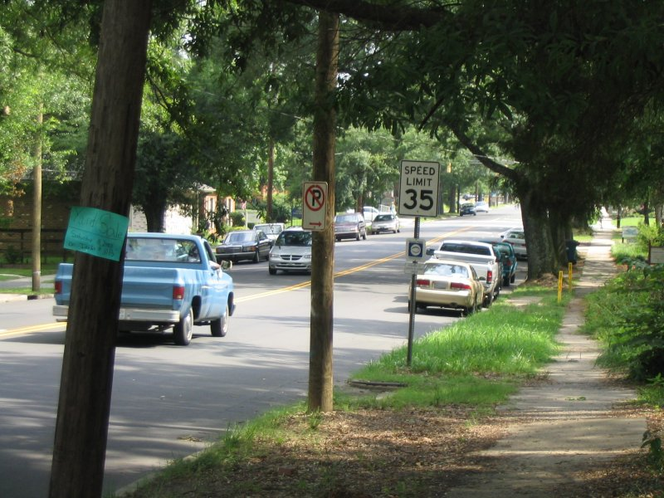

Slide 12
Answers
Yes
Blue
Yes
35 mph
No

Slide 13
Find 3 Differences..

Slide 14
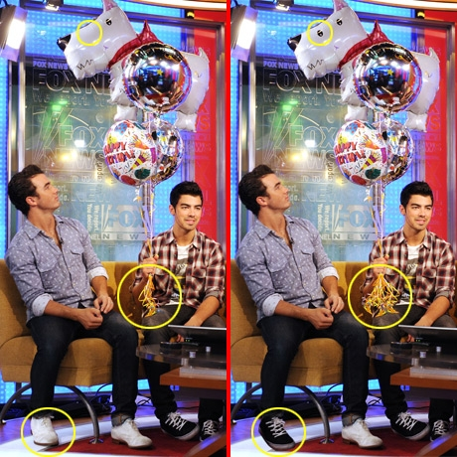

Slide 15
Qualitative Quantitative Data
Qualitative → Quality
Deals with descriptions.
Data can be observed but not measured.
Colors, textures, smells, tastes, appearance, beauty, etc.
Quantitative → Quantity
Deals with numbers.
Data which can be measured.
Length, height, area, volume, weight, speed, time, temperature, humidity, sound levels, cost, members, ages, etc.

