Slide 1
Part D: Inheritance of Human Genetic Disorders

Slide 2
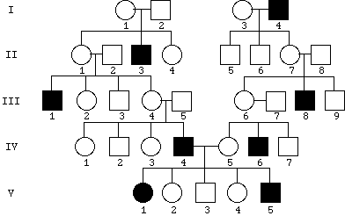
Studying Pedigrees: How are traits inherited???
Pedigree= a family history that shows how a trait is inherited over several generations
Individuals either have the trait, do not have the trait, or are a carrier for the trait

Slide 3
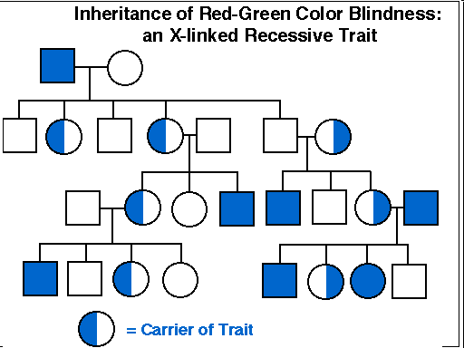
Sometimes we show carriers as half-shaded circles or square
Carrier = individual who has ONE copy of a recessive allele

Slide 4
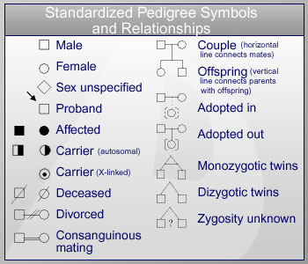
Pedigree Symbols

Slide 5
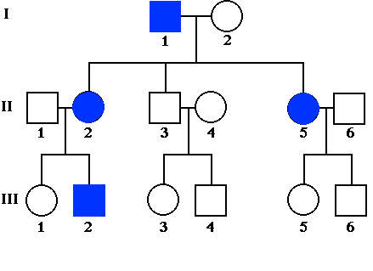
Pedigree Numbers
Roman numerals (I, II, III, IV) represent = Generations
Regular numbers (1,2,3,4) represent = Individuals in each generation

Slide 6
Pedigree Symbols – Male and Female
= Normal Male
= Normal Female
= Male with trait
= Female with trait
Horizontal line between a male and female indicates MATING/MARRIAGE
Branching vertical lines point to OFFSPRING

Slide 7
Autosomal vs. Sex-linked Traits
Autosomal Trait = appears in both sexes equally, alleles appear on the autosomal chromosomes
Sex-linked Trait = a trait whose allele is located on the X chromosome
Appears mostly in males
Mostly recessive
Female only exhibits the condition if she inherits two recessive alleles

Slide 8
Human Chromosomes
Humans have 46 chromosomes:
1 pair of sex chromosomes (X and Y)
22 pairs of autosomes
Females have 2 X chromosomes (XX).
Males have an X chromosome and a Y chromosome (XY)

Slide 9
How do we study human genes and how do genetic disorders come about?

Slide 10
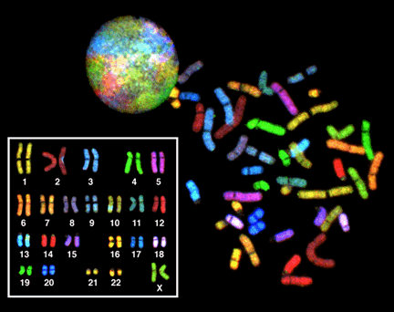
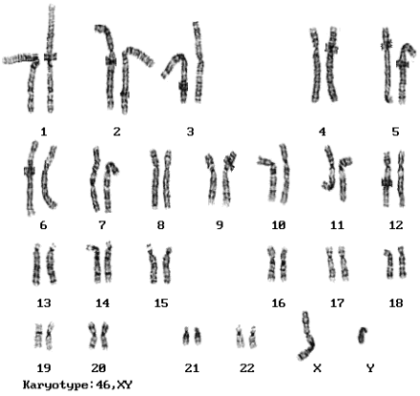
Can we see a picture of human chromosomes?
A Karyotype is a test to identify and evaluate the size, shape, and number of chromosomes in a sample of body cells.
A picture of all the chromosomes in a cell is called a karyotype
Homologous chromosomes pair up

Slide 11
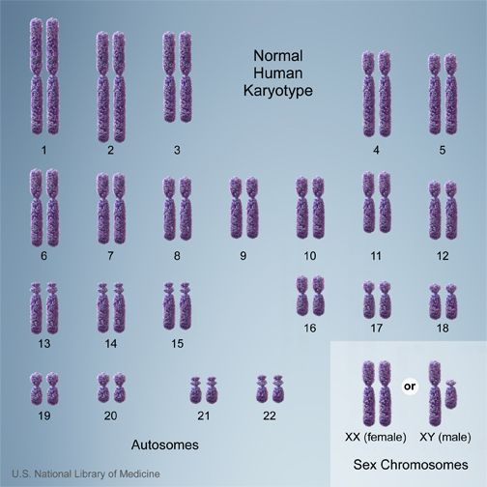

Slide 12
Why are pedigrees helpful/useful?
Pedigrees are helpful if couples are concerned that they might be carriers of genetic disorders
Common Genetic Disorders:
Angelman Syndrome
Canavan Disease
Charcot-Marie-Tooth Disease
Cri du Chat Syndrome
Duchenne Muscular Dystrophy
Fragile X Syndrome
Gilbert's Syndrome
Joubert Syndrome
Klinefelter Syndrome
Krabbe Disease
Lesch–Nyhan Syndrome
Myotonic Dystrophy
Neurofibromatosis
Noonan Syndrome
Pelizaeus-Merzbacher Disease
Phenylketonuria
Porphyria
Prader-Willi Syndrome
Retinoblastoma
Rubinstein-Taybi Syndrome
Spina bifidia
Smith-Magenis Syndrome
Stickler Syndrome
Turner Syndrome
Variegate Porphyria
Von Hippel-Lindau Syndrome
Wilson's Disease
Wolf-Hirschhorn Syndrome
XXXX Syndrome
YY Syndrome

Slide 13
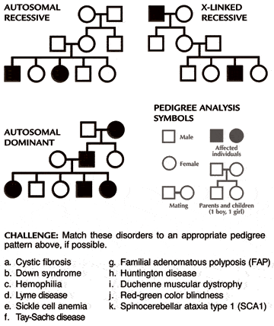
Dominant vs. Recessive Trait
Autosomal Dominant Traits = each individual with the trait will have a parent with the trait
Autosomal Recessive Traits = an individual with the trait can have one, two, or neither parent who exhibit the trait

Slide 14
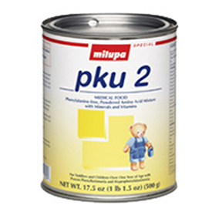
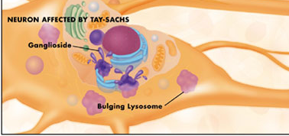
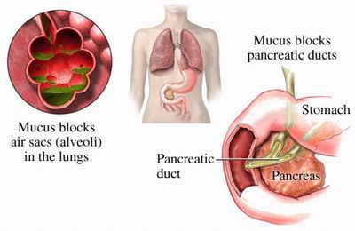
AUTOSOMAL RECESSIVE
Phenylketonuria-PKU Enzyme to break down phenylalanine is missing Build up in brain causes mental retardation Need diet low in proteins
TAY SACHS Lysosomal storage disorder Fats aren’t broken down; build up in brain Cause blindness, retardation; early death More common in Jewish populations
CYSTIC FIBROSIS Mutation in gene for Cl⁻ ion transport Build up of mucous in body organs Digestive/respiratory problems
More common in Caucasian populations
http://stores.pkuperspectives.com/catalog/PKU2web.jpg http://tay-sachs-disease.wikispaces.com/file/view/bb_feb2007_large.jpg/34183391/bb_feb2007_large.jpg
http://www.medicalook.com/diseases_images/cystic_fibrosis.jpg

Slide 15
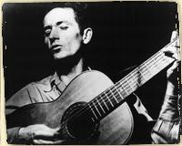
AUTOSOMAL DOMINANT (Homozygous Dominant = LETHAL)
ACHONDROPLASIA “Dwarfism” Growth plates in long bones fuse too early
HUNTINGTON’S Multiple CAG repeats result in neurological degeneration in middle age
Hear song

Slide 16
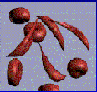
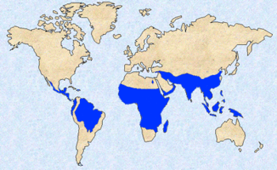
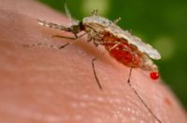
AUTOSOMAL CODOMINANT
SICKLE CELL ANEMIA Mutation in hemoglobin gene Causes red blood cells to change shape in low oxygen conditions More common in African Americans
HETEROZYGOTE ADVANTAGE: 1 sickle cell allele/1 normal allele provides protection against MALARIA
Watch a video about
sickle cell and malaria

Slide 17
DOMINANCE ? CODOMINANCE? INCOMPLETE DOMINANCE ? Depends on how you look at it!
CLOSER LOOK AT RELATIONSHIP
BETWEEN DOMINANCE AND PHENOTYPE REVEALS AN INTRIGUING FACT:

Slide 18
TAY-SACHS DISEASE
Image from: http://www.djsfoundation.org/images/Steeler%20pics%20Dylan.jpg
Human genetic disorder in which brain cells are
unable to metabolize certain lipids because
a crucial enzyme does not work properly.
As these lipids build up in brain infant suffers seizures, blindness, loss of motor & mental function > > > leads to early death.
At ORGANISMAL LEVEL acts as a recessive trait. Child with two copies of Tay-Sachs allele (tt-homozygous) has the disorder. Child with Tt or TT does not (COMPLETE DOMINANCE)
At BIOCHEMICAL LEVEL- Tt individual has enzyme activity level
in between the TT and tt person (INCOMPLETE DOMINANCE ?)
At the MOLECULAR LEVEL – Tt individual makes equal number of normal and dysfunctional enzyme molecules (CODOMINANT ?)

Slide 19
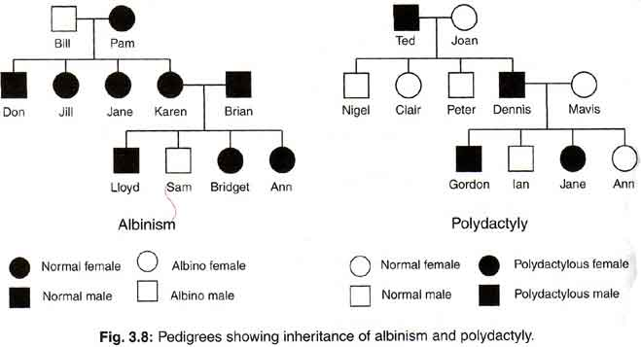
Recessive Disorder: Albinism
Albinism = a genetic disorder in which the body is unable to produce an enzyme necessary for the production of melanin (dark color to hair, skin, scales, eyes, and feathers)

Slide 20
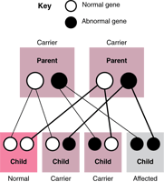
Genetic Disorders = Carriers
Carriers = individuals who are heterozygous for a recessive inherited disorder, but do not show symptoms of the disorder
Can pass the recessive allele for the disorder to their offspring

Slide 21
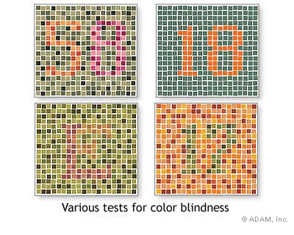
Red-Green Color Blindness: A Sex-Linked Recessive Disorder
X-linked recessive disorder
Among Caucasian individuals:
8% of males
0.5% of females
Difficulty distinguishing between shades of green and red

Slide 22
Red-Green Color Blindness: A Sex-Linked Recessive Disorder
Males have the disorder more often than females because they only have one X chromosome.
Unaffected female = X^{R}X^{R}
Affected female = X^{r}X^{r}
Carrier female = X^{R}X^{r}
Unaffected male = X^{R}Y
Affected male = X^{r}Y

Slide 23
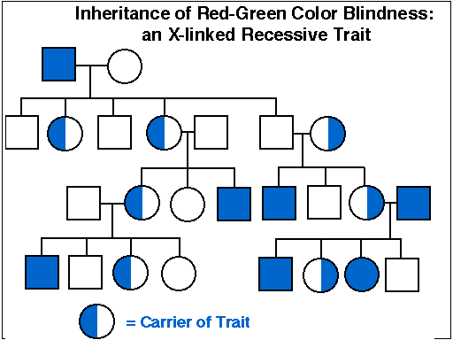
Red-Green Color Blindness: A Sex-Linked Disorder

Slide 24
Heterozygous vs. Homozygous
Homozygous Dominant or Heterozygous individuals = phenotype will show the dominant characteristic
Homozygous Recessive individuals = phenotype will show the recessive characteristic
***Heterozygous carriers of a recessive mutation will not show the mutation, can produce children who are homozygous for the recessive allele

Slide 25
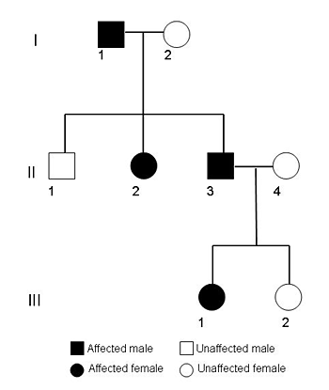
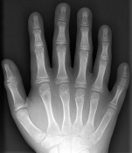
Let’s look at a pedigree for polydactyly: a dominant trait

Slide 26
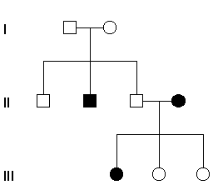
Let’s look at a pedigree for phenylketonuria (PKU): a recessive disorder
The trait skips a generation!!

