Slide 1
Part 2: Evolutionary Theories

Slide 2
There are several scientists who observed and predicted the causes behind evolution.
Evolution- the development of new organisms from pre-existing organisms over time.
Evolution = changes in a population of organisms over a period of time.
Population = is a group of members of a single species living in a particular area.
Why does evolution happen?

Slide 3
There are several scientists who observed and predicted the causes behind evolution.
Evolution- the development of new organisms from pre-existing organisms over time.
Evolution = changes in a population of organisms over a period of time.
Population = is a group of members of a single species living in a particular area.
Why does evolution happen?
So that organisms can survive changing environments (food, shelter, reproduction).

Slide 4
A. Jean Baptiste Lamarck (1744-1829)
Theory of Use and Disuse: body parts that get used become larger and stronger; Unused parts become smaller
Theory of Inheritance of Acquired Characteristics: modifications acquired during the life of an organism could be passed to offspring
Theory of Acquired characteristics-
If an organism changes during life in order to adapt to its environment, those changes are passed on to its offspring
He said that change is made by what the organisms want or need
Example: Lamarck believed that elephants used to have short trunks, and they had to stretch their trunks to get their food.

Slide 5
Jean Baptiste Lamarck
Summary of Theories
1) Organisms constantly try to improve
2) This effort causes changes in body parts
3) Once a structure is modified, it is passed on to future generations
The BEST traits/structures survive!

Slide 6
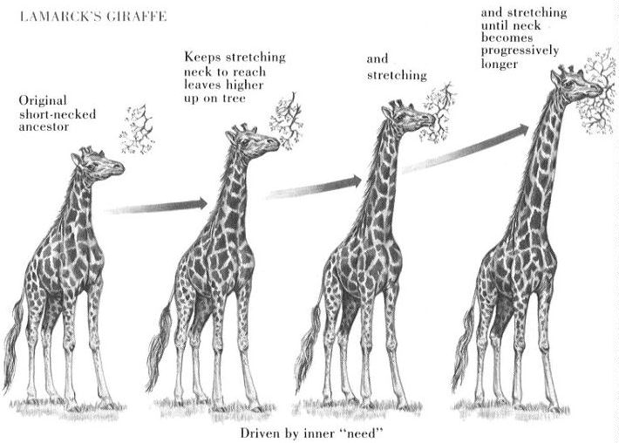
Example for Lamarck’s Theory of Acquired Characteristics: Giraffe Necks
Hypothesis: giraffe necks are long because ancestor giraffes had to stretch to reach their food

Slide 7
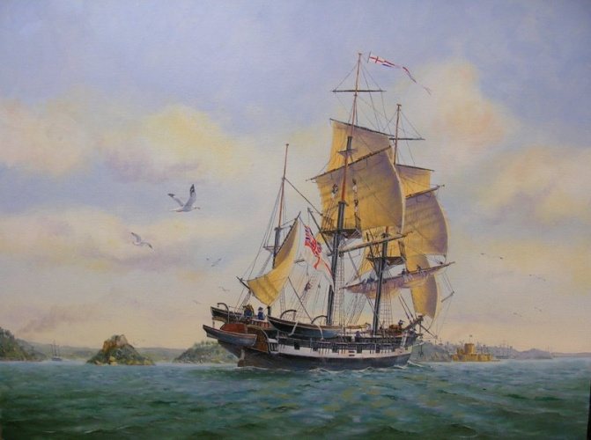
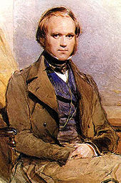
B. Charles Darwin “Father of Evolution”
Geologist and biologist
Sailed to South America and the Galapagos Islands on the H.M.S. Beagle
Recorded observations of exotic plants and animals for the Queen
Studied finches and their beaks
Concluded that beak shape is related to food type
Developed the Theory of Evolution by “Natural Selection” and “Descent with Modification”

Slide 8
Descent with Modification
Supposed that all organisms were related to an ancient ancestor

Slide 9
“Descent with Modification”
Variations that increase reproductive success will be more common in the next generation, slowly changing the generations over time.
Example: giraffe’s long neck.
Common descent: All organisms on Earth decended from a common ancestor 4 billion years ago.

Slide 10
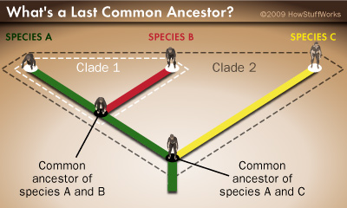
Common Ancestor
An organism that is a shared ancestor (relative) between two or more different species.

Slide 11
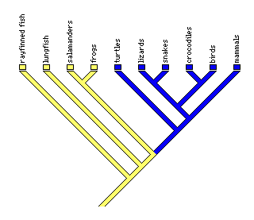
Cladogram/Phylogenetic Tree
A
B
C

Slide 12
Cladogram/Phylogenetic Tree A diagram showing the evolution of species, including common ancestors.
Where is the common ancestor between crocodiles and birds?
Where is the common ancestor among birds, reptiles, and mammals?
Where is the common ancestor among all of the organisms?
A
B
C
What does this remind you of?

Slide 13
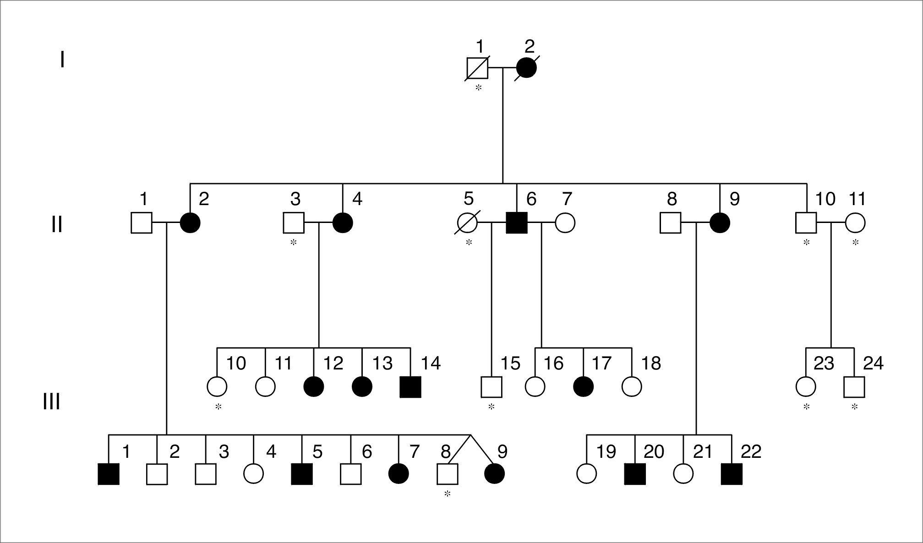
Family Pedigree
Human Evolution-
When and where did Humans Evolve - video

Slide 14
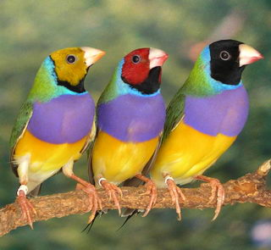
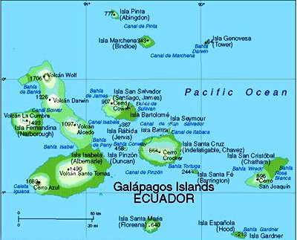
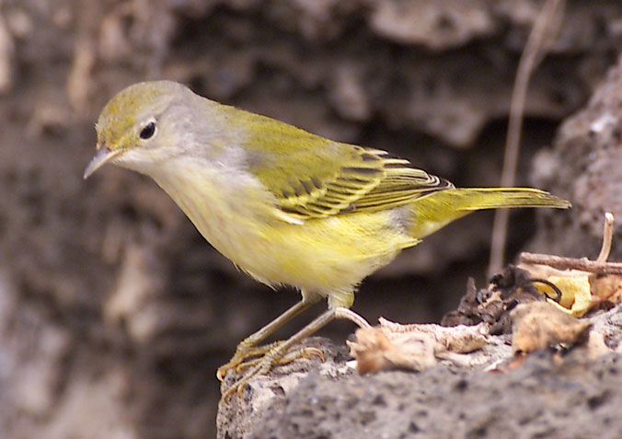
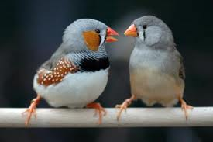
Darwin’s Finches

Slide 15
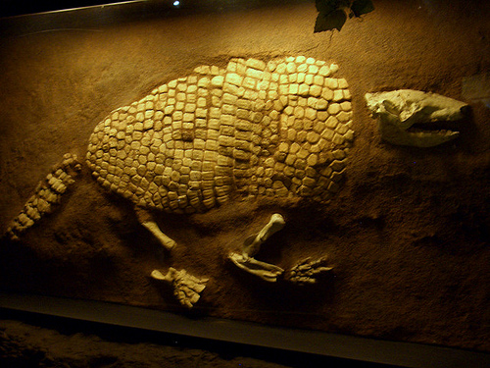
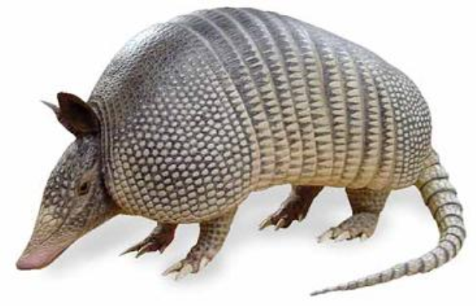
Darwin Saw Evidence of Evolution on His Voyage
Found fossils of extinct armadillos
Similar, but not identical to living armadillos

Slide 16
Darwin: More Signs That Species Evolve
Plants and animals of the Galapagos Islands resemble those of the nearby coast of South America
Why is this?
Species from South America migrated to the Galapagos Islands and changed after they arrived…THEY EVOLVED
http://www.pbs.org/wgbh/evolution/educators/teachstuds/svideos.html

Slide 17
Summary of the Natural Selection Theory
The animals (or plants) best suited to their environment are more likely to survive and reproduce, passing on the characteristics which helped them survive to their offspring.
Gradually the species changes over time.

Slide 18
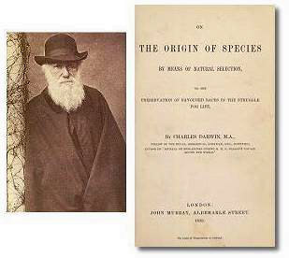
Darwin’s Book
Wrote “On the Origin of Species” which demonstrated how natural selection might work.

Slide 19
Darwin’s Theory of Natural Selection
There is variation in every population (Genetic Variation)
Some variations are favorable
More young are produced in each generation than can survive (Overproduction)
There is competition for resources (Struggle to Survive)
Those that are successful go on to reproduce
(Differential Reproduction)
Overtime, small changes accumulate in a population because the best traits continue to be passed on

Slide 20
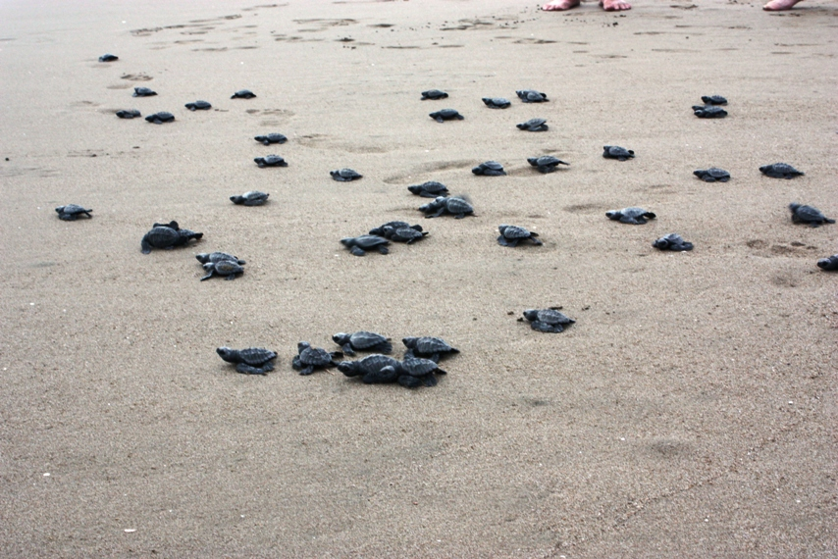
Overproduction A population produces more offspring than can survive
Sea Turtles Hatching

Slide 21
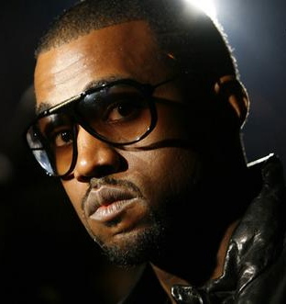
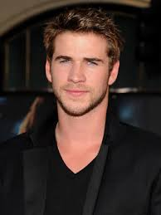
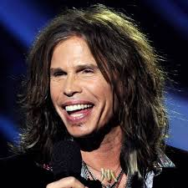
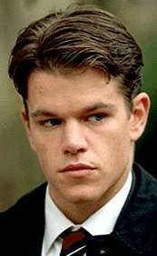
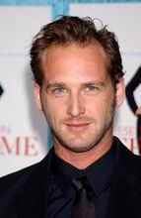
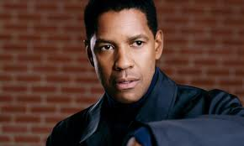
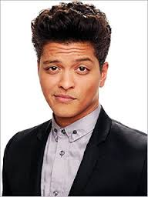
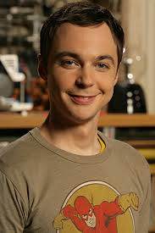
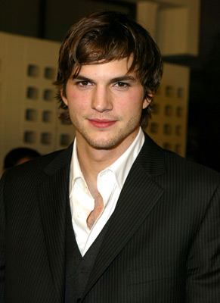
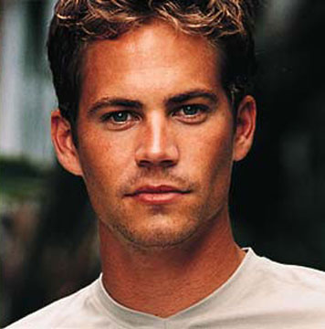
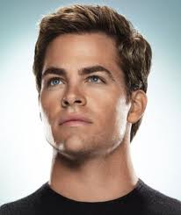
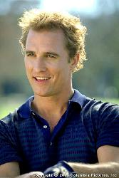
Variation exists among members of a species.

Slide 22
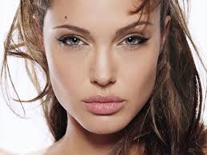
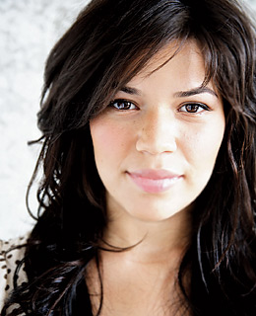
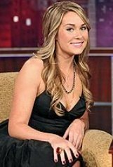
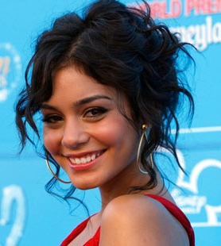
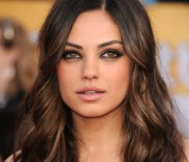
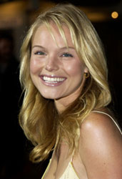
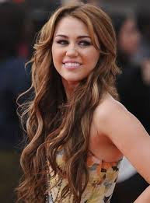
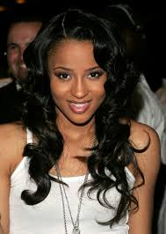
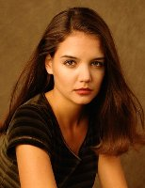
Again. . . why does variety persist?

Slide 23
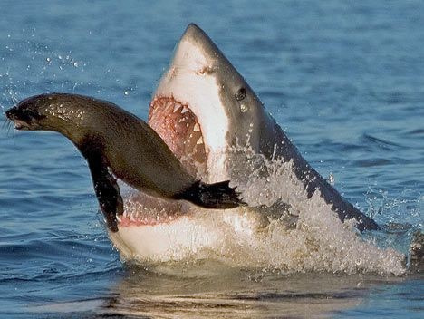
Struggle to Survive

Slide 24
Struggle to survive
Individuals must compete with each other for resources.
Food, water, mates, shelter, etc.
Male Caribou fight for the right to breed with a female Caribou.
Caribou - Video

Slide 25
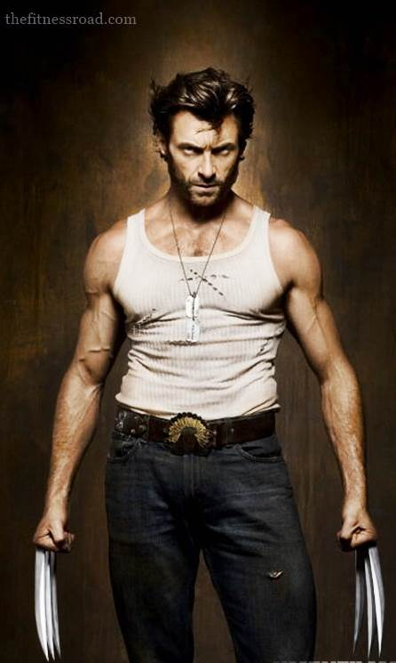
Differential Reproduction
Only the individuals with the best adaptations to their environment will survive competition.
Only the survivors will be able to reproduce and pass on their genes.

Slide 26
Is this survival of the fittest?
No! To be fit means more than just to survive…you have to be able to reproduce
Fitness = a single organism’s genetic contribution to the next generation
Over time, a population adapts as the number of favorable traits increases

Slide 27
Evolution by Natural Selection
Adaptation: a characteristic that increases an individual’s fitness.
Adaptive characteristics become more common in a population.
It is a gradual process that takes place over many, many generations.
Results in population level changes (strong survive, weak die off).
Adaptation depends on an animal’s environment

Slide 28
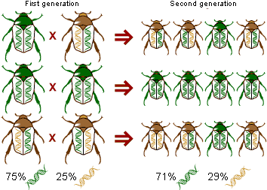
Allele Frequency
The proportion of gene copies of a given allele in a population.
A change in allele frequency results in small evolutionary changes (microevlolution)

Slide 29
All of the genes of the reproductively active members of a population. Out of the gene pool?

Slide 30
How do we get variation in a population?
Mutations in the DNA create different gene forms
Natural selection “chooses” individuals with favorable mutations to reproduce
Individuals can’t evolve…they are born with all the genes they are ever going to have! Populations can evolve as the % of good mutations increases over time

Slide 31
Examples of Natural Selection
A. Peppered Moths: (Discuss with a neighbor) – There are two forms of peppered moth, light and dark. Before the Industrial Revolution, light moths survived and reproduced more effectively. After the Industrial Revolution, dark moths survived and reproduced more effectively.
WHY WAS THIS THE CASE?

Slide 32
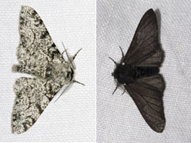
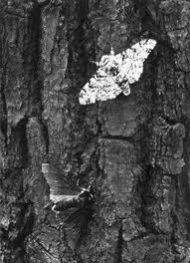
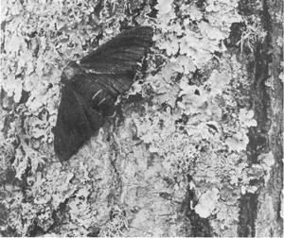
2 Forms of Moth: Light and Dark
After
Industrialization
Before Industrialization

Slide 33
Examples of Natural Selection
B. Darwin’s Finches: Darwin noticed that different species of finches on different Galapagos Islands had differently shaped beaks. There were also different types of seeds found on each island.
WHY DO THE DIFFERENT SPECIES HAVE DIFFERENT BEAK SHAPES?

Slide 34
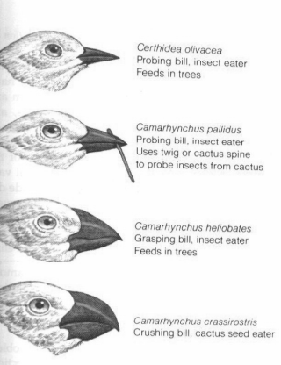

Slide 35
