Slide 1
Do-Now: Review from Mitosis
A human body cell has 46 chromosomes. In a human body cell, mitosis produces
  A) two cells with 46 chromosomes in each.
  B) two cells with 23 chromosomes in each.
  C) four cells with 23 chromosomes in each.
  D) four cells with 46 chromosomes in each.

Slide 2
Explanation
Explanation: Once chromatids split during anaphase of mitosis, they are considered full daughter chromosomes. The parent cell contains 46 chromosomes, each with two chromatids. The daughter cells contain 46 chromosomes, each with only one chromatid.

Slide 3
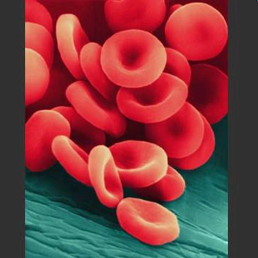
Mitosis Review
In mitosis, a parent body cell divides to make two daughter body cells
#1: New daughter cells are diploid, which means they have two sets of chromosomes (46 total in humans)
Example: one blood cell divides to make two blood cells

Slide 4
Mitosis Review
Only DIPLOID cells are made in mitosis
 | Diploid | Haploid
Sets of Chromosomes | 2 | 1
Total # of chromosomes in humans | 46 | 23
Type of Cell | Body cell (ex, blood cell, bone cell) | Sex cell (sperm or egg cell)

Slide 5
Meiosis

Slide 6
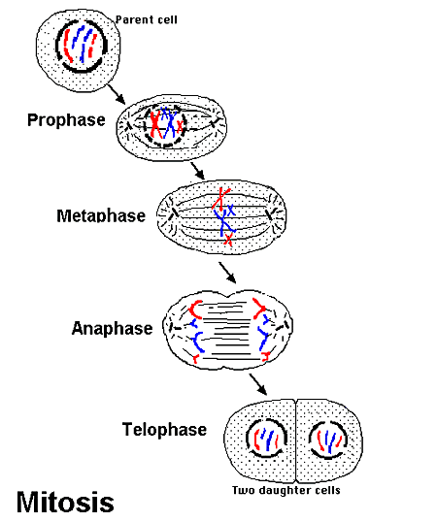
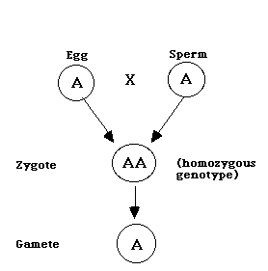
Two Types of Cells
Somatic cells – All of the body cells (muscle, skin, etc).
Gametes – Sex cells
(Egg & Sperm)

Slide 7
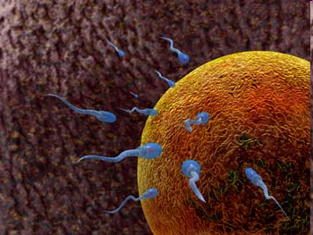
Meiosis- A New Type of Division
During meiosis, new SEX CELLS (eggs and sperm) are created.
2) Eggs and sperm are haploid, meaning they have one set of chromosomes (23 total).

Slide 8
Meiosis
A process where the nucleus divides that splits the original chromosomes into haploid daughter cells
#2: Meiosis creates eggs and sperm with 23 chromosomes, which combine during fertilization to make a zygote (fertilized egg) with 46 chromosomes. That zygote can divide by mitosis to make a baby with body cells containing 46 chromosomes each.

Slide 9
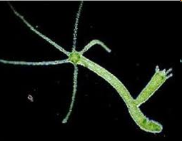
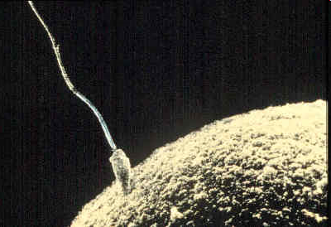
Types of Reproduction
Asexual = makes offspring (children) that are identical to the parent (ex: binary fission in bacteria or “budding” in sponges)
2. Sexual = makes offspring that are different from the parent, meiosis happens and then sperm and egg join
Notes:
Binary fission in unicellular orgs, budding in multicellular

Slide 10
Differences between Asexual and Sexual Reproduction
#3: Asexual reproduction involves one parent and sexual reproduction involves two parents ; Asexual reproduction makes offspring that are identical to the parent and sexual does not

Slide 11
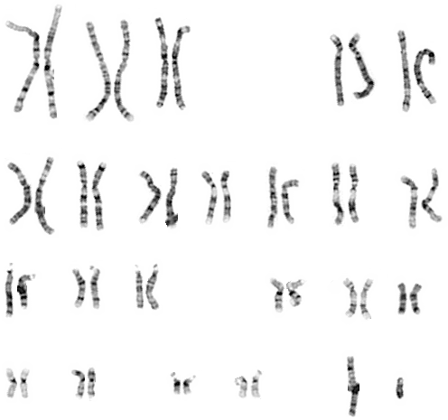
Humans
Have 46 Chromosomes in every cell (except the sperm/egg)
This is 23 pairs or 2 sets.

Slide 12
Homologous Chromosomes
One chromosome from mom
One chromosome from dad
They are similar:
  Size
  Length
  Genes are at the same location
  Exception: Gene for eye color

Slide 13
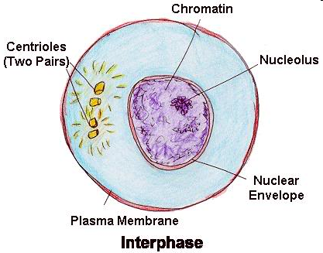
Stages
Before meiosis begins: Interphase
#4:
-G1: Cell grows and matures
-S: Cell makes a copy of its DNA
-G2: Cell prepares for division
During Meiosis: Meiosis I and Meiosis II

Slide 14
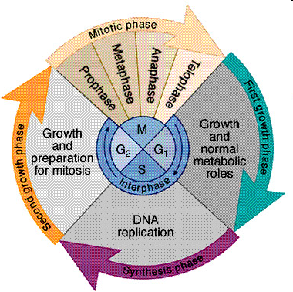
Remember the Cell Cycle?
Meiosis uses the same cycle as mitosis, except meiosis happens in 2 parts.
Interphase must still happen so the cell can grow, copy its DNA, and prepare for division.

Slide 15
Meiosis I
Chromosome number gets cut in half
(1 diploid cell → 2 haploid cells)
4 parts
1) Prophase I
2) Metaphase I
3) Anaphase I
4) Telophase I

Slide 16
Prophase I
Similarities to Mitosis:
DNA coils into chromosomes
Spindle fibers are made
Nuclear Membrane breaks down

Slide 17
Prophase I
Differences from Mitosis
Homologous chromosomes pair up
Homologous chromosomes = pairs of chromosomes (1 from mother and 1 from father) that have the same genes (ex: gene for eye color)

Slide 18
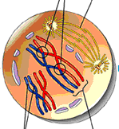
Prophase I
#5: Label:
Homologous Chromosomes
Spindle
Crossing Over

Slide 19
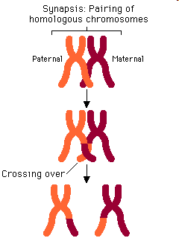
Prophase I: Crossing Over
Crossing over = homologous chromosomes “trade” genes
#6: Trades genes so that offspring look different from either parent and from their siblings.
#7: Tetrad = the pair of chromosomes (tetra means four, and there are four chromatids)
  Homologous Chromosomes pair up (Synapsis)
  Crossing over (Synapsis): Homologous Chromosomes exchange genetic material

Slide 20
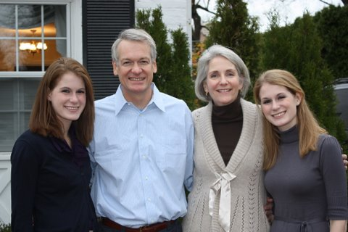
Why does crossing over take place?
Trades genes so that offspring look different from either parent and from their siblings.

Slide 21
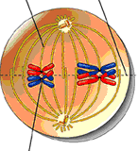
Metaphase I
Tetrads line up in the middle of the cell
Spindle fibers attach to the chromosomes
#8: Label: Metaphase Plate, Centomere, Spindle Fibers
Notes:
Not all the maternals end up on one side of the cell and the paternals on the other

Slide 22
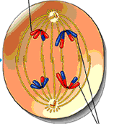
Anaphase I
Homologous Chromosomes move to opposite ends of the cell
#9: Label: Homologous chromosomes

Slide 23
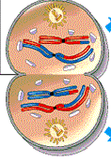
Telophase I and Cytokinesis
Chromosomes reach opposite ends
Cytoplasm divides
End Result = 2 daughter cells with half the original chromosome number
#10: Label: Nuclear membrane, centrioles
Notes:
Humans = 46-23 chromosomes
Each new cell contains one chromosome from each homologous pair
However, each new cell contains 2 copies of the chromosome because the original cell copies its DNA before meiosis I

Slide 24
Meiosis II
DNA is NOT copied again (no interphase)
#11: The DNA was originally copied during the S phase of interphase (before Meiosis I)
Chromatids (identical copies of DNA) separate like they do during mitosis
4 Stages:
1) Prophase II
2) Metaphase II
3) Anaphase II
4) Telophase II and Cytokinesis

Slide 25
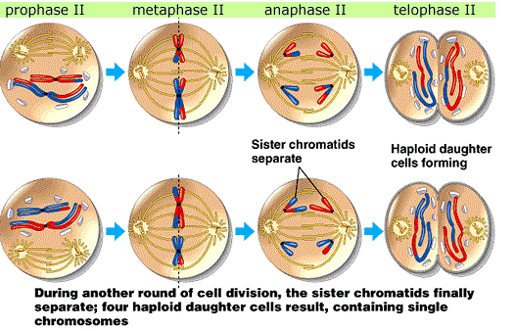
Meiosis II
#12: The end result of meiosis is 4 haploid daughter cells, whereas the end result of mitosis is 2 diploid daughter cells

Slide 26
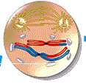
Prophase II
Nuclear membrane breaks down
Spindle is made
#13: Label: Nothing ☺

Slide 27
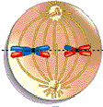
Metaphase II
Spindle fibers move chromosomes to the center of the cell
#14: Label: Chromatids, Centromere

Slide 28
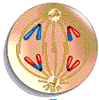
Anaphase II
Chromatids of each chromosome separate at the centromere and move toward opposite ends of the cell
#15: Label: New Chromosomes

Slide 29
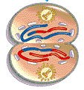
Telophase II and Cytokinesis
Spindle breaks down
Chromosomes uncoil Nuclear envelopes form
Cytoplasm divides
#16: Label: Uncoiling Chromosomes (chromatin)

Slide 30
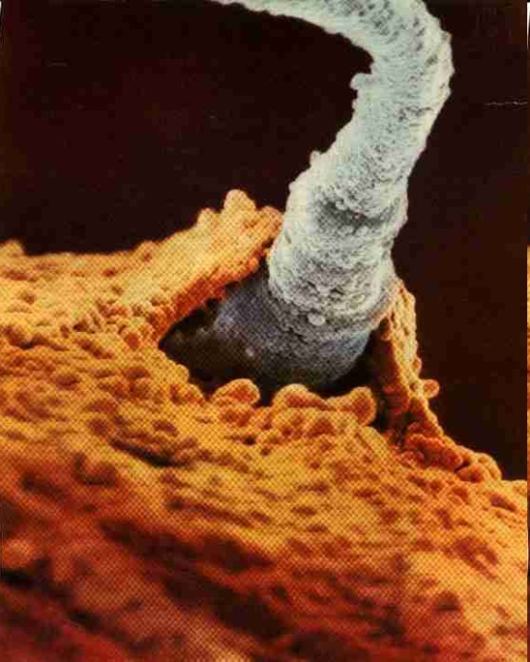
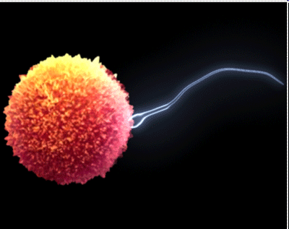
Main Goal: Making Sex Cells!
Gametes = haploid reproductive cells made during meiosis (ex: sperm and egg)
Sex cells are made in the testes and ovaries in humans
Notes:
Figure 8-12 on page 155

Slide 31
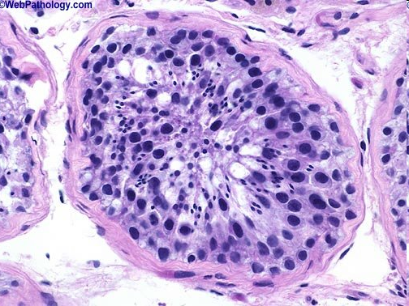
Spermatogenesis
The process of making sperm cells
Diploid cell divides by meiosis to form four haploid sperm cells

Slide 32
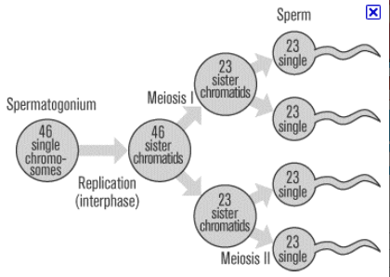
Spermatogenesis

Slide 33
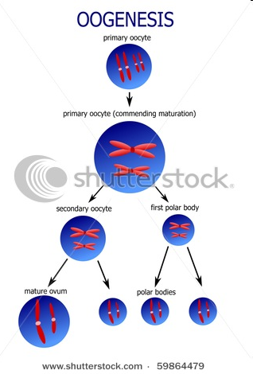
Oogenesis
The process of making egg cells
A diploid cell divides by meiosis to make ONE mature egg cell
Other three haploid cells = polar bodies
#17: The egg cell has more cytoplasm and organelles than the three polar bodies so that it can bring enough nutrients to the zygote (fertilized egg) ; the polar bodies disintegrate / die

Slide 34
Comparing Spermatogenesis and Oogenesis
#18: Spermatogenesis produces four functional sperm cell, and oogenesis only produces one functional egg cell.

Slide 35
Comparing Mitosis and Meiosis
#19: During metaphase I of meiosis, chromosomes line up in homologous pairs along the metaphase plate. During metaphase of mitosis, chromosomes line up single file along the metaphase plate.

Slide 36
Comparing Mitosis and Meiosis
#20: Meiosis II is most like mitosis because chromosomes line up single file along the metaphase plate, chromatids separate during anaphase, and daughter cells have the same number of chromosomes as the parent cell (just with one chromatid instead of two)

Slide 37
Diploid Cells
A cell with a full set of chromosomes
Sometimes referred to as 2n.
In humans, n = 23 (2 X 23 = 46)
All daughter cells produced by mitosis are diploid cells.

Slide 38
Haploid Cells
A cell with ½ set of chromosomes.
Sperm/Egg in humans (23 chromosomes).
Also called gametes.
Sometimes referred to as n or 1n.

Slide 39
Practicing Haploid/Diploid #s
Organism | Haploid # | Diploid #
Amoeba | 25 | 50
Chimp | 24 | 48
Earthworm | 18 | 36
Fern | 505 | 1,010
Hamster | 22 | 44
Honeybee | 28 | 56
Onion | 8 | 16

Slide 40
