Slide 1
Bacteria!
Sprint Notes!

Slide 2
Bacteria: Single-celled microorganisms which can exist either as independent (free-living) organisms or as parasites (dependent upon another organism for life).
The Oldest Living Structures
On The Earth

Slide 3
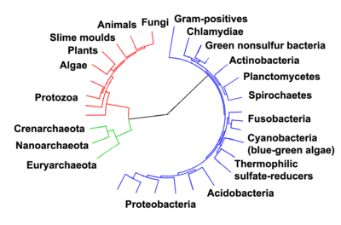
Taxonomy
Domains: Bacteria (Eubacteria)
Archaea (Archaebacteria)
Eukaryota
All bacteria are
prokaryotes

Slide 4
Taxonomy
Bacteria (Eubacteria)
Largest phyla
“True” Bacteria
Contain:
Ribosomes
DNA
Cell Membrane
Cell Wall
Flagella
Archaea (Archaebacteria)
Gram Stain – differentiates bacteria based upon structure and composition of cell wall
Gram⁺: appear purple
Gram–: appear pink

Slide 5
Taxonomy
Archaea (Archaebacteria)
Oldest bacteria on earth
Anaerobic – doesn’t need oxygen
use methane gas, ammonia, hydrogen sulfide for energy
Methanogens: convert H₂ and CO₂ into methane gas
Found in swamps, marshes, guts of animals, sewage treatment
Found everywhere!
1st Discovered in EXTREME Environments (extremophiles)
Halophiles – salt loving
Thermoacidophiles – live in acid environments and high temps.

Slide 6
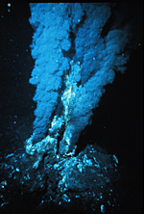
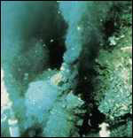
More Deep Sea Vents

Slide 7
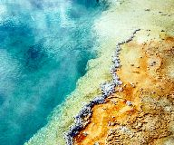
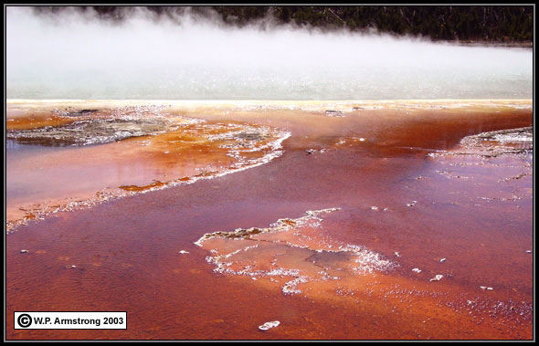
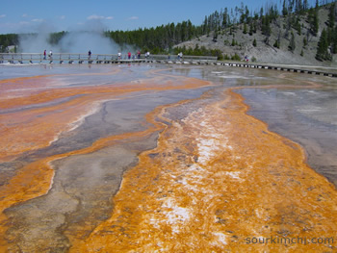
Who lives in hot springs?
Thermoacidophiles!

Slide 8
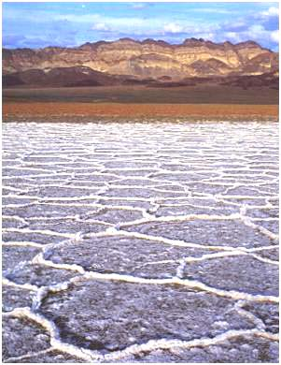
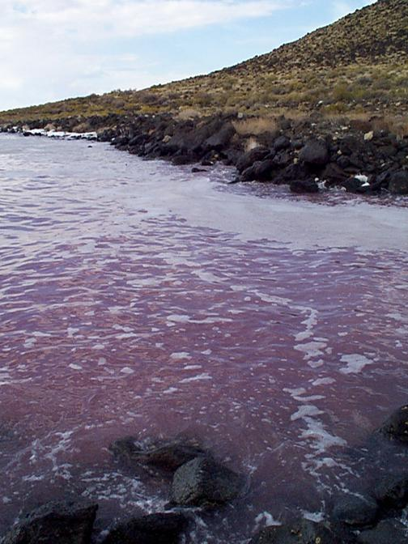
Halophiles love salty environments

Slide 9
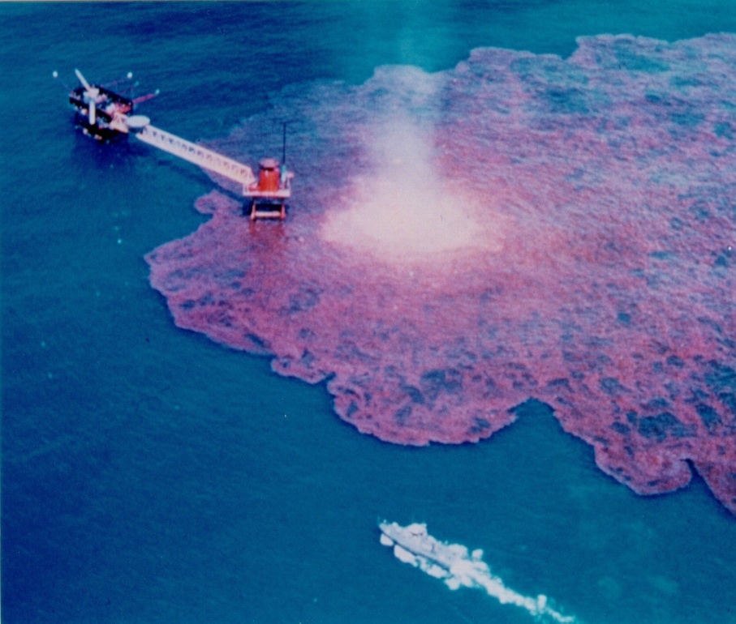
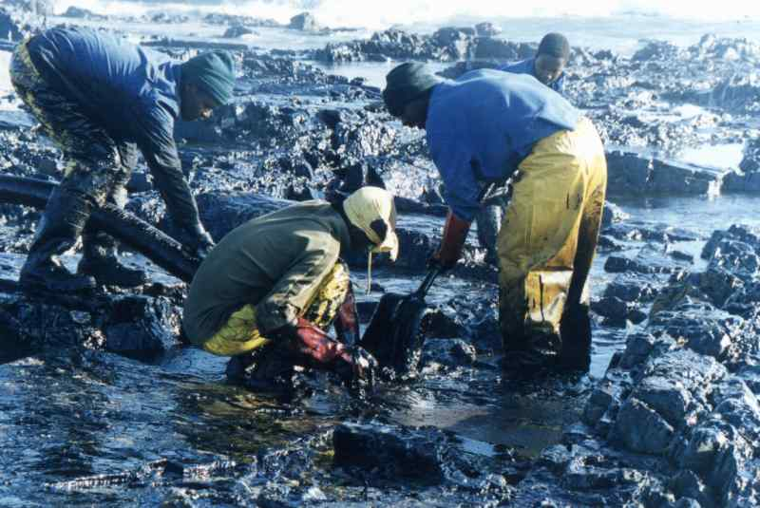
Pseudomona and Penicillium help during oil spill clean-up

Slide 10
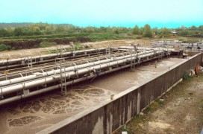
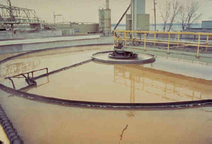
Bacteria in sewage plants help clean our waste!

Slide 11
Structure | Function
Cell Wall | Protects and gives shape
Outer Membrane | Protects against antibodies (Gram Neg. Only)
Cell Membrane | Regulates movement of materials, contains enzymes important to cellular respiration
Cytoplasm | Contains DNA, ribosomes, essential compounds
Chromosome | Carries genetic information
Plasmid | Contains some genes obtained through recombination
Capsule & Slime Layer | Protects the cell and assist in attaching cell to other surfaces
Endospore | Protects cell against harsh environments
Pilus | Assists the cell in attaching to other surfaces
Flagellum | Moves the cell

Slide 12
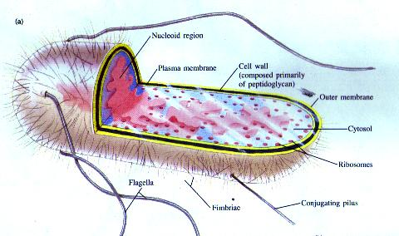
DNA is found in cytoplasm (no nucleus)

Slide 13
Bacteria Morphology
Most bacteria are one of three different shapes:
Bacilli- Rod Shaped
Cocci- Spherical Shaped
Spiralla- Spiral Shaped
Some bacteria take on less common groupings:
Diplo- bacteria occur in pairs
Staphylo- bacteria occur in clumps
Strepto- bacteria occur in chains

Slide 14
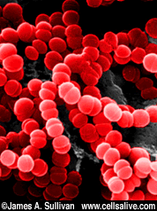
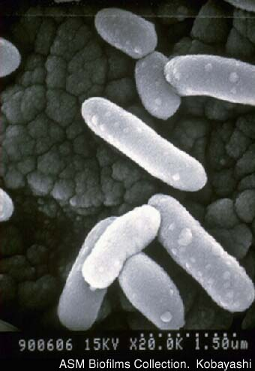
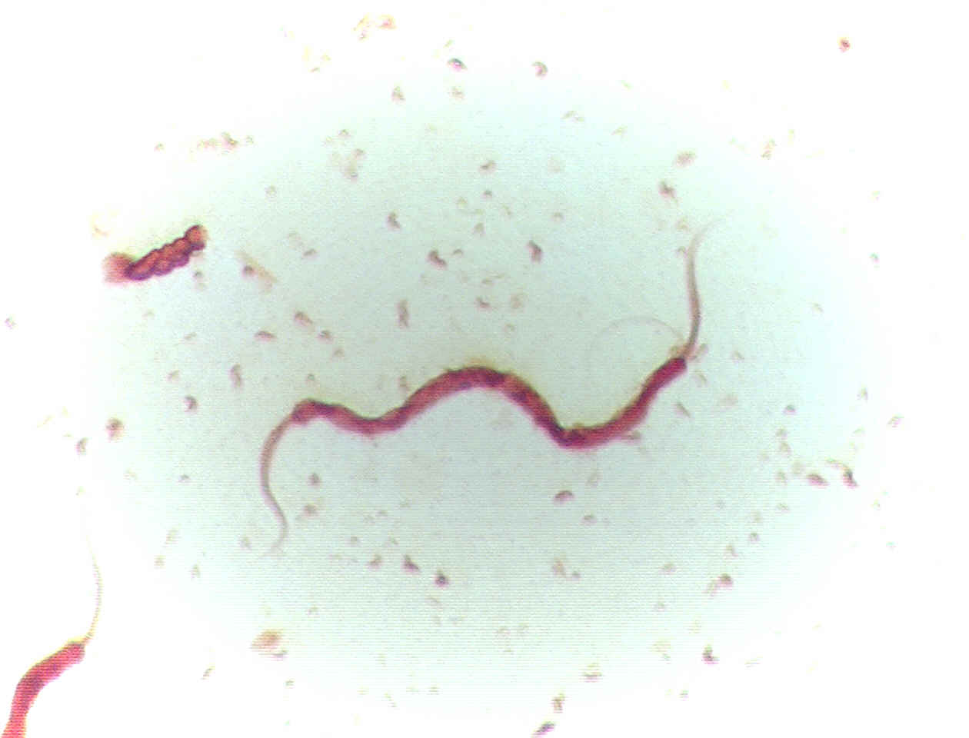
Most bacteria are one of three shapes.
Identify the shapes…
Bacilli - rod shaped
Cocci - spherical
Spirilla - spiral shaped

Slide 15
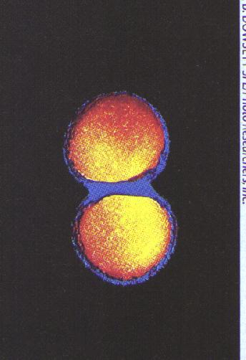
Diplo-bacteria occur in pairs, such as the diplococcus bacteria that causes gonorrhea

Slide 16
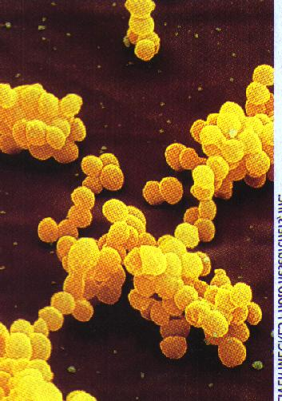
Staphylo-bacteria
occur in clumps,
such as this
staphylococcus
bacteria that
causes common
infections of cuts

Slide 17
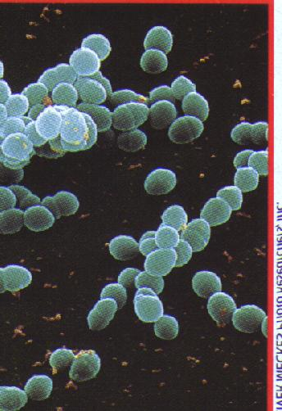
Strepto-bacteria
occur in chains
of bacteria,
such as this
streptococcus
bacteria that
causes some types
of sore throats

Slide 18
Bacteria Growth
How do Bacteria get energy? What are the two ways anything can get energy?
Autotrophs – Make their own food
Heterotrophs – Consume their food
BOTH RESPIRE!!

Slide 19
Bacteria Growth
Types of Eaters
Photoautotrophs – Uses sunlight for energy
Chemoautotrophs – need only CO₂ to obtain energy from inorganic substances
Photoheterotrophs – use light to generate energy BUT must obtain carbon in organic forms
Chemoheterotrophs – uses organic molecules, such as sugar, for energy

Slide 20
Bacteria Growth
Respiration – Aerobic vs. Anaerobic
Aerobic – uses oxygen
Obligate aerobes – MUST live where there is
oxygen present
Anaerobic – do not need oxygen for respiration
Obligate anaerobes – MUST live where there is NO oxygen present
Facultative anaerobes – can live with or without
oxygen

Slide 21
Bacteria Reproduction
Occurs in three main ways:
Binary Fission – each cell is a clone of the parent cell (asexual reproduction)
Recombination– some genetic material is exchanged
(what does this allow for?)
Endospores – formed when bacteria cannot survive. A
dormant phase (hibernation)

Slide 22

BACTERIA REPRODUCTION BY BINARY FISSION
First the DNA replicates

Slide 23

Next the cytoplasm and cell divides
The two resulting cells are exactly the same

Slide 24
Bacteria Reproduction
Recombination– some genetic material is passed between two bacteria
Conjugation – some genetic material is passed between two
bacteria
Transformation – some genes are taken up by the bacteria from the environment
Transduction – some genes are transferred between prokaryotes by viruses

Slide 25
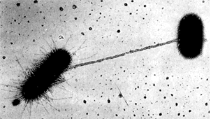
Conjugation

Slide 26
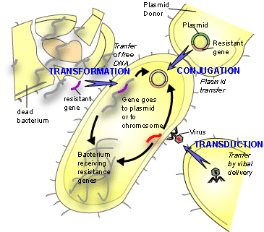

Slide 27
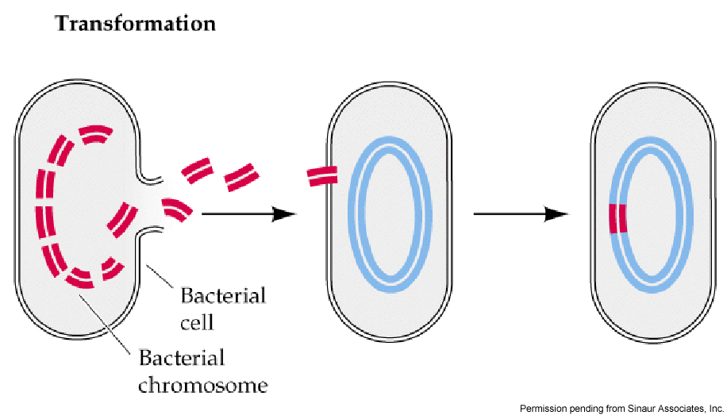

Slide 28
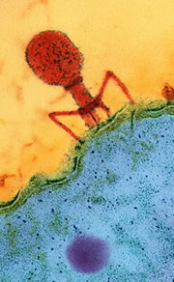
Transduction

Slide 29
Bacteria’s All-Star
Cyanobacteria – “Blue-Green Algae”
Eubacteria
Thought to be the first photosynthetic bacteria
Live anywhere
First to recolonize in a natural disaster area

Slide 30
Pathogenic Bacteria
Pathogenic – Disease causing
Disease | Pathogen | Areas affected | Mode of transmission
Botulism | Clostridium botulinum | Nerves | Improperly preserved food
Cholera | Vibrio cholerae | Intestine | Contaminated water
Dental Caries | Streptococcus mutans, sanguis, salivarius | Teeth | Environment to mouth
Gonorrhea | Neisseria gonorrhoeae | Urethra, fallopian | Sexual contact
Lyme disease | Berrelia burgdorferi | Skin, joints | Tick bite
Rocky Mountain SF | Rickettsia recketsii | Blood, skin | Tick bite
Salmonella | Salmonella | Intestine | Contaminated food, water
Strep throat | Streptococcus pyogenes | URT, blood, skin | Sneezes, coughs, etc.
Tetanus | Costridium tetani | Nerves | Contaminated wounds
Tuberculosis | Mycobacterium tuberculosis | Lung, bones | coughs

Slide 31
Pathogenic Bacteria
How do they harm us?
- Break down cells
- Release toxins
How can we control bacterial infections?
- Antibiotics
- Sterilization
- Food processing
What can we do??
- Washing hands
- Vaccinations (inoculations)
- Medicines (antibiotics)

Slide 32
Pathogenic Bacteria
Antibiotic-Resistant Bacteria
What factors contribute to antibiotic-resistant bacteria?
- Fast reproduction (fission)
- High rate of mutation
- Some bacteria cells are resistant against antibiotics
More “fit”
- Misuse of antibiotics
using antibiotics for viral infections
- Over 50% of all antibiotics end up in animal feed.

Slide 33
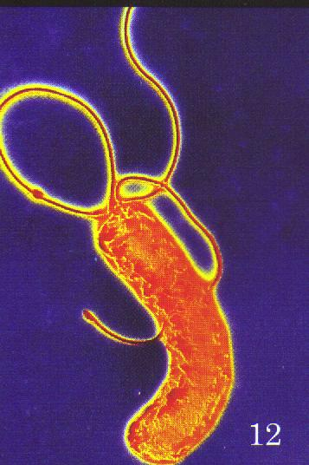
Helicobacterpylori
is the pathogenic
Bacteria that can
causes ulcers

Slide 34
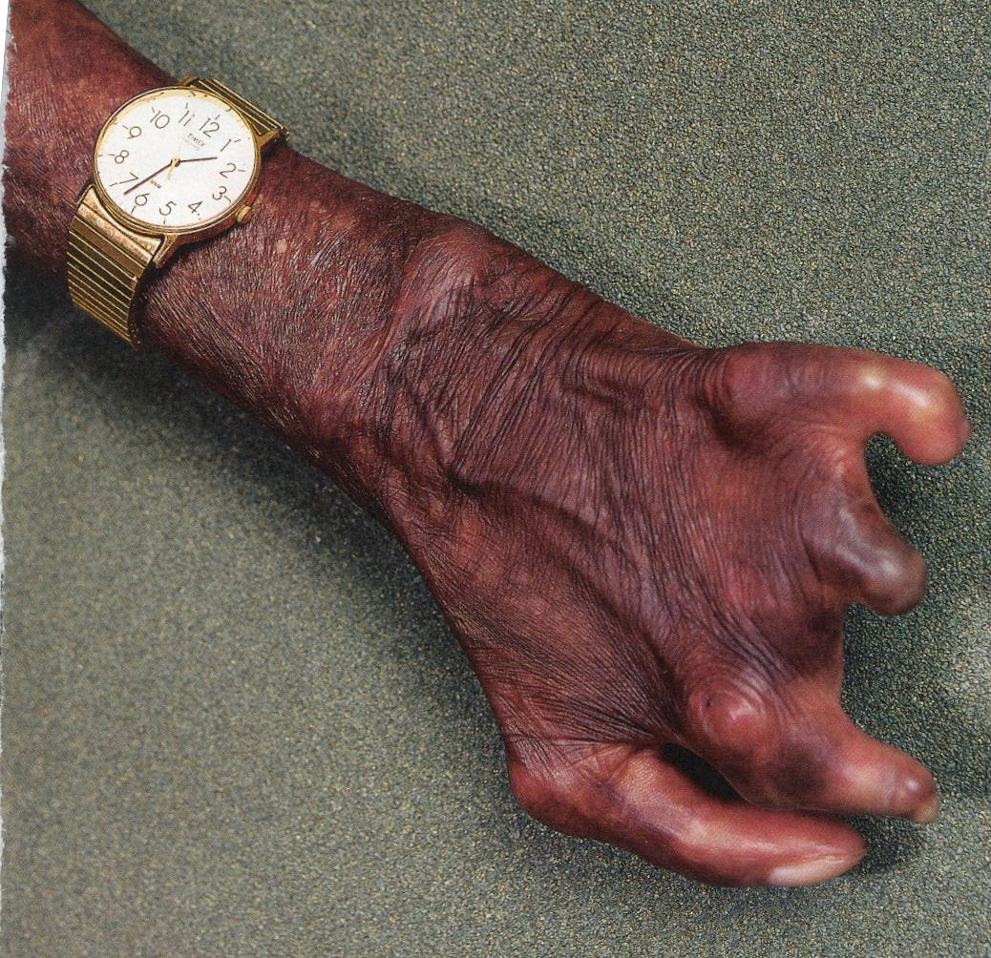
Leprosy
is a bacterial infection that decreases blood flow to the extremities resulting in the deterioration of toes, ears, the nose and the fingers.

Slide 35
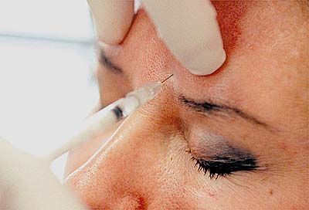
BOTULISM paralyzes the nerves so that the muscles cannot contract

Slide 36
Importance of Bacteria
Industry
- removing toxins
- mining
- synthesizing drugs and other chemicals
Symbiotic Relationships
- E. coli in human digestive tract
Biological Cycles (nitrogen fixing)
- helps plants get nutrients that they couldn’t otherwise
obtain
Food!
- Cheese, yogurt, buttermilk, sour cream, pickles,
sauerkraut, etc.

Slide 37
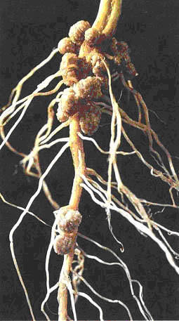
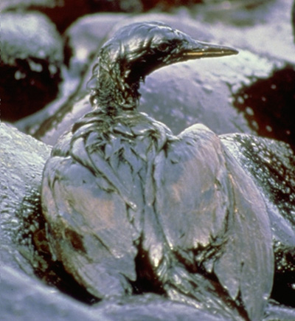
Importance of Bacteria
In other words…
Bacteria help control the Nitrogen Cycle
Bacteria are used in food production
Bacteria can be used to make antibiotics
Bacteria are used to clean up oil spills
Bacteria are used in genetic engineering

Slide 38
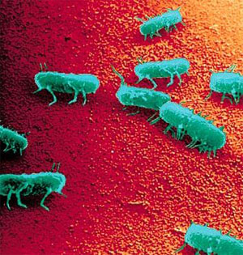
Salmonella

Slide 39

E. coli

