Slide 1
Homeostasis
Homeostasis = The regulation and maintenance of the internal environment.
Examples = Body temperature, fluids, salts, pH, nutrients & gases

Slide 2
Homeostasis
Control systems in the body:
Sensors = receptors that gather information about conditions inside and outside of the body
Control Center = the brain receives information from the sensors and sends messages through a communication system

Slide 3
Homeostasis
Control systems in the body:
Communication Systems = Controlled by the nervous or endocrine systems that send nerve impulses & hormones as messages to all parts of the body
Targets = any organ, tissue or cell that changes its level of activity in response to a message

Slide 4
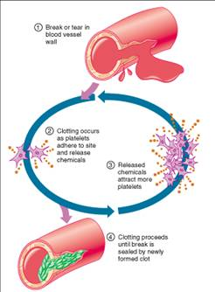
Homeostasis
Types of Feedback:
Positive Feedback = A control center uses information from sensors to increase the rate of change away from the set values.
a. Labor
b. Blood Clotting

Slide 5
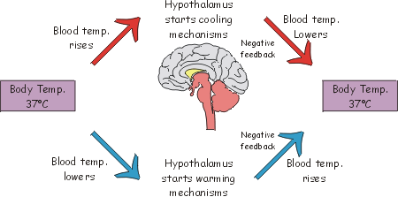
Homeostasis
Types of Feedback:
2. Negative Feedback = A control system counteracts any change in the body that moves conditions above or below a set point.
a. Blood sugar
b. Body temperature

Slide 6
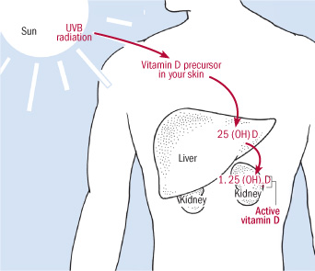
Interactions Among Body Systems
1. Each organ system affects other organ systems
Vitamin D production involves multiple organs & organ systems

Slide 7
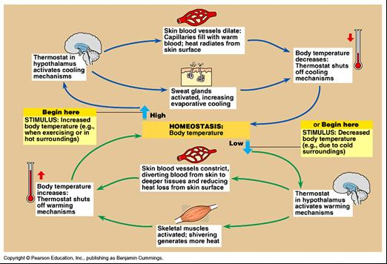
Interactions Among Body Systems
Thermoregulation = Regulation of body temperature

Slide 8
Interactions Among Body Systems
2. Disruption of Homeostasis
Short-Term Effects usually last a few days or weeks
Example = Recovering from the common cold
Long-Term Effects are more damaging to the body systems
Example = Type 1 & 2 Diabetes

