Slide 1
Ecology

Slide 2
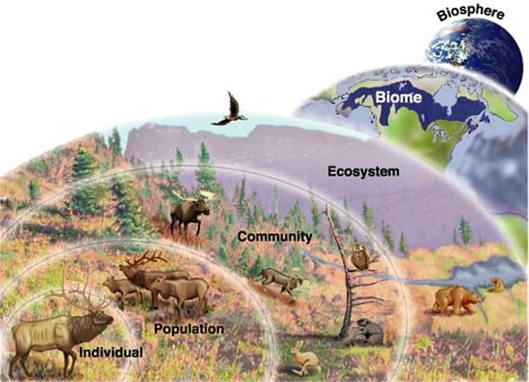
Organisms & Their Relationships

Slide 3
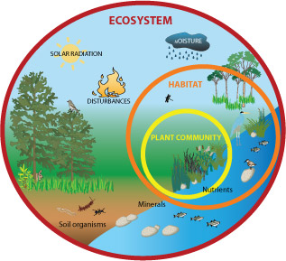
What is Ecology?
Ecology = the study of relationships among living organisms and the interactions with their environments.
Ecologist = a scientist who studies ecology
Perform tests in organisms’ environments

Slide 4
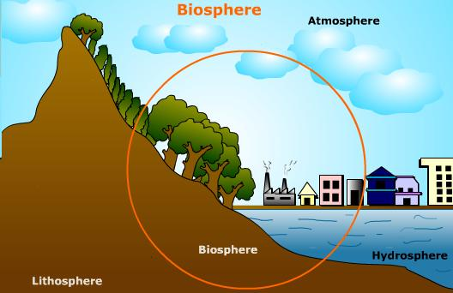
Biosphere
Biosphere = the portion of the earth that supports life.
Extends into the atmosphere and below the Earth’s surface into the deep ocean (deep ocean vent)
Includes land masses, bodies of water, atmosphere, frozen polar regions, deserts, rainforests

Slide 5
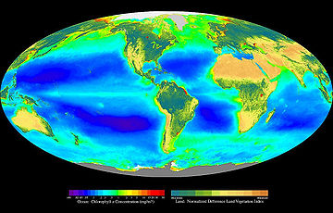
Biosphere
Chlorophyll= a green pigment found in green plants and algae.
Good indicator of the distribution of living things

Slide 6
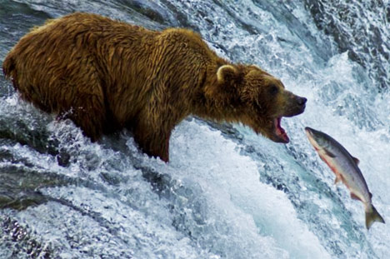
Parts of the Environment
Biotic Factors = All the living factors in an organism’s environment.
Interactions among organisms are necessary for the health of all species in the same geographical area

Slide 7
Parts of the Environment
Abiotic Factors = all the nonliving factors in an organism’s environment.
Organisms that live in the same geographic area might share the same abiotic factors
Examples of abiotic factors:
Temperature, air or water currents, sunlight, soil type, rainfall, or available nutrients

Slide 8
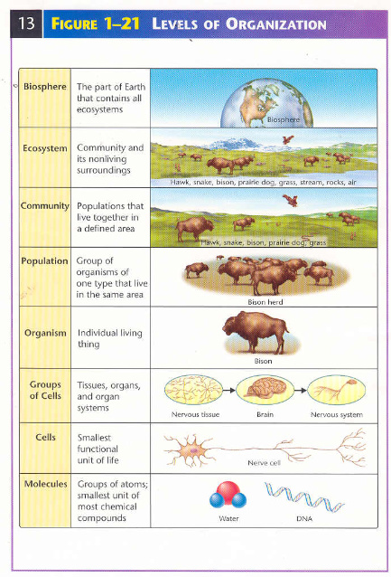
Levels of Organization
Biosphere
Biome
Ecosystem
Community
Population
Organism

Slide 9
Populations
Population = individual organisms of a single species that share the same geographical location.
Dandelions in a field
Students at Apollo High School
Can you think of any other examples of populations?
Organisms within a population compete for resources.

Slide 10
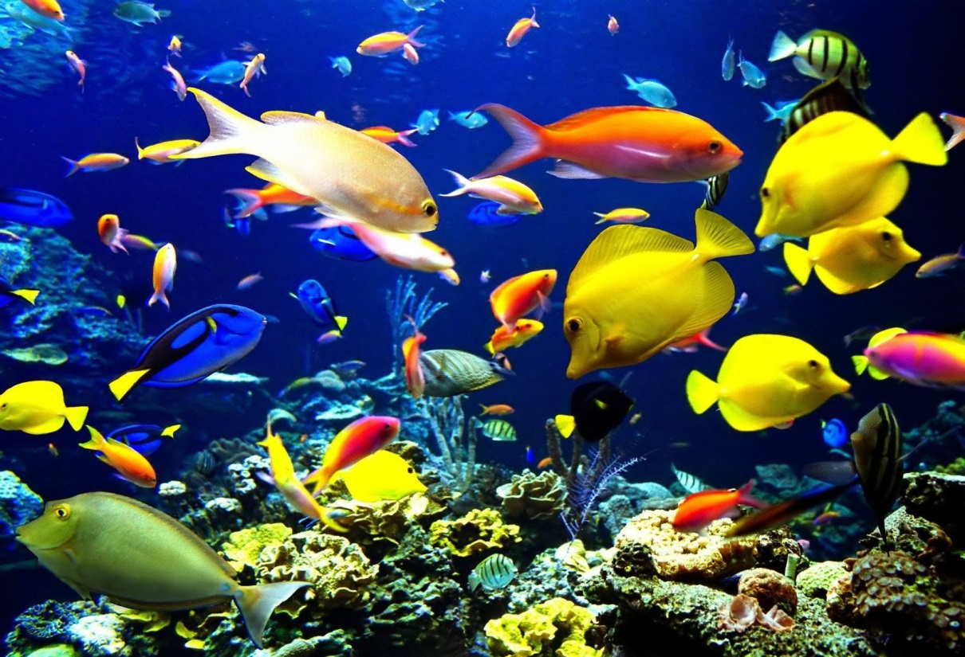
Community
Community = A group of interacting populations that occupy the same geographic area at the same time.
Organisms within a community MAY OR MAY NOT compete for resources

Slide 11
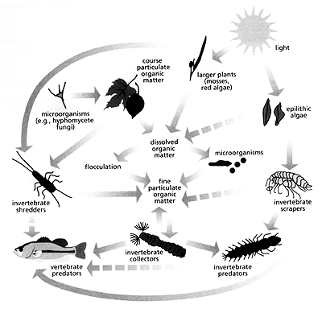
Communities
Community = A group of interacting populations that occupy the same area at the same time.
Not all communities include the same variety of organisms

Slide 12
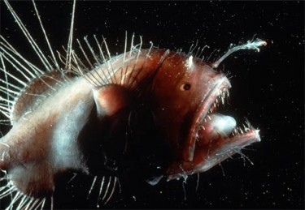
Communities
How do abiotic factors affect biological communities?
Organisms adapt to the conditions in which they live.

Slide 13
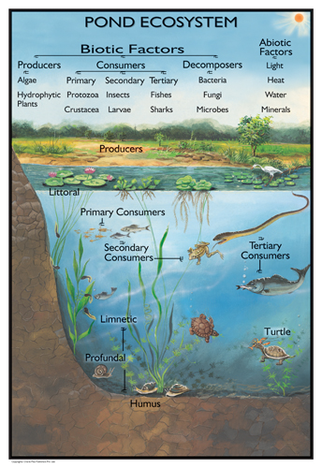
Ecosystem
Ecosystem= a community (living) and all of the abiotic factors that affect it.
Abiotic factors = water, soil, atmosphere, energy transfer

Slide 14
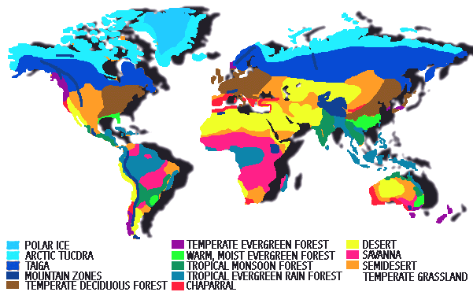
Biomes
Biome = a large group of ecosystems that share the same climate and have similar types of communities.
All of the biomes on earth combined form the biosphere

Slide 15
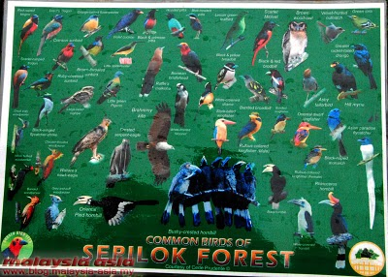
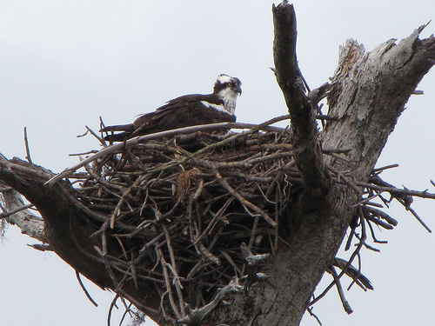
Habitat
Habitat = An area where an organism lives
One tree (for an organism that spends its entire life in a tree)
Grove of trees (for an organism that moves from tree to tree)
What types of resources do species find in their habitats?

Slide 16
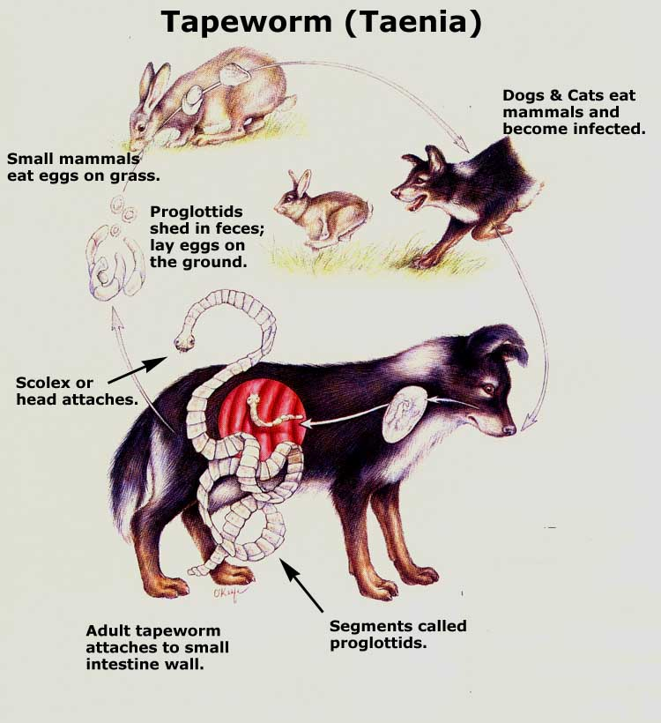
Niche
Niche = the role or position that an organism has in its environment
Requirements for food, shelter (temperature & moisture level) and reproduction conditions

Slide 17
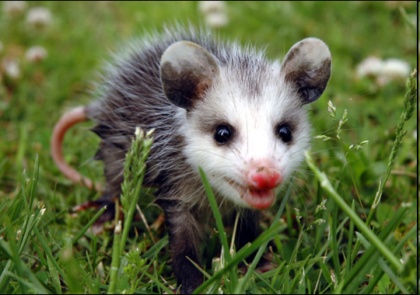
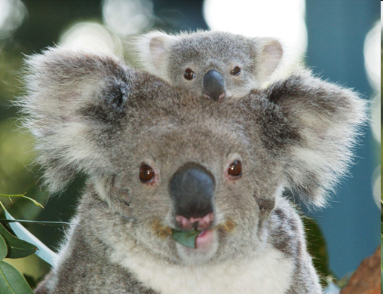
Niche
Generalists = species with broad niches (ex: possums and raccoons)
Specialists = species with narrow niches (ex: koala)

Slide 18
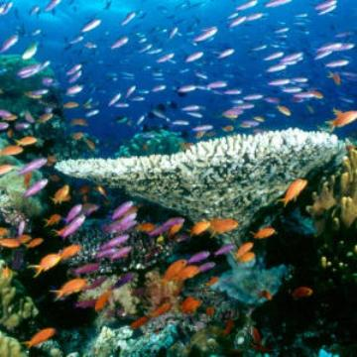
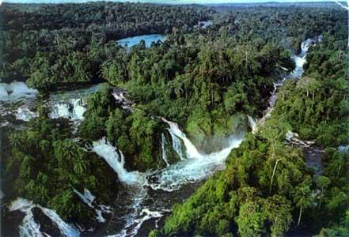
Community Interactions

Slide 19
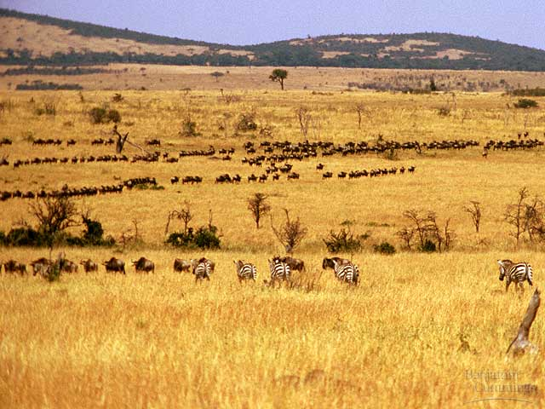
Competition
Competition occurs when more than one organism uses a resource at the same time.
Food, water, space, & light
Animals competing for water during a drought – The strong survive!!!
Competitive Exclusion = one species is eliminated from a community due to competition.

Slide 20
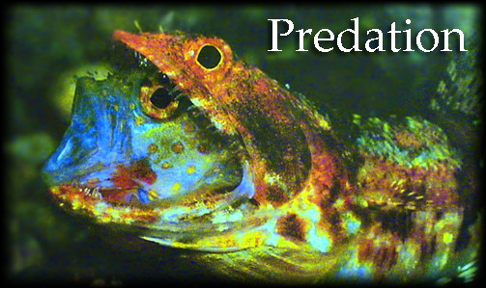
Predation
Predation = the act of one organism consuming another organism for food.
Predator = the organism that pursues another organism
Prey = the organism that is pursued
Lizardfish & Gobey

Slide 21
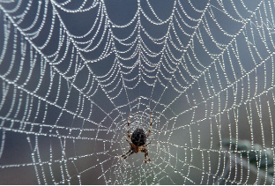
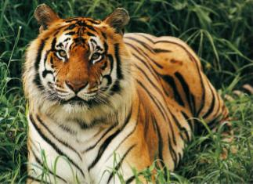
Predation
Predators evolve adaptations to capture prey and prey evolve adaptations to escape/avoid predators.
Predator Adaptations: spider webs ; tiger stripes
Prey Adaptations: mimicry, plant toxins

Slide 22
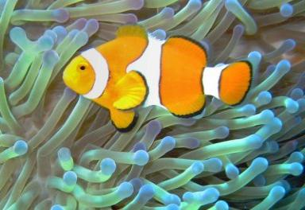
Species Interactions
Symbiosis: the close relationship that exists when two or more species live together.
Types of Symbiosis: Parasitism, Mutualism, Commensalism

Slide 23
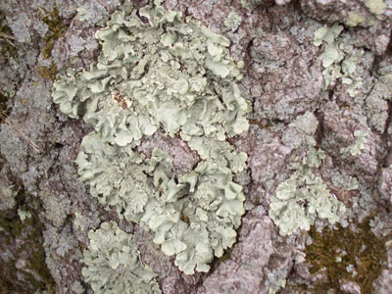
Mutualism
Mutualism = the relationship between two or more organisms that live closely together and benefit from each other.
Example: Lichens = mutualism between fungi and algae
Algae provide food for the fungi
Fungi provide a habitat for the algae

Slide 24
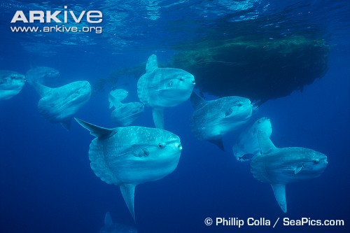
Mutualism
Cleaner Fish & Ocean Sunfish
Ocean Sunfish & Gull
http://www.arkive.org/sunfish/mola-mola/video-11.html

Slide 25
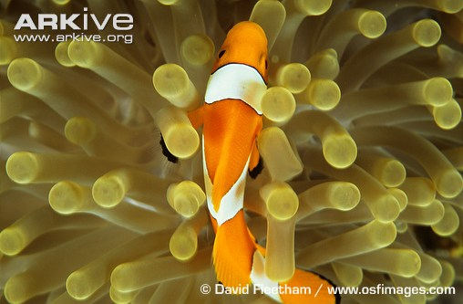
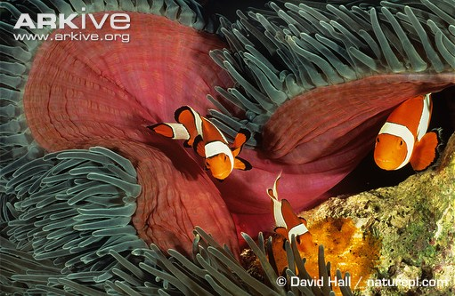
Commensalism
Commensalism = relationship in which one organism benefits and the other organism is not helped or harmed.
Clownfish & Sea Anenome
Clownfish benefits, sea anenome is not harmed

Slide 26
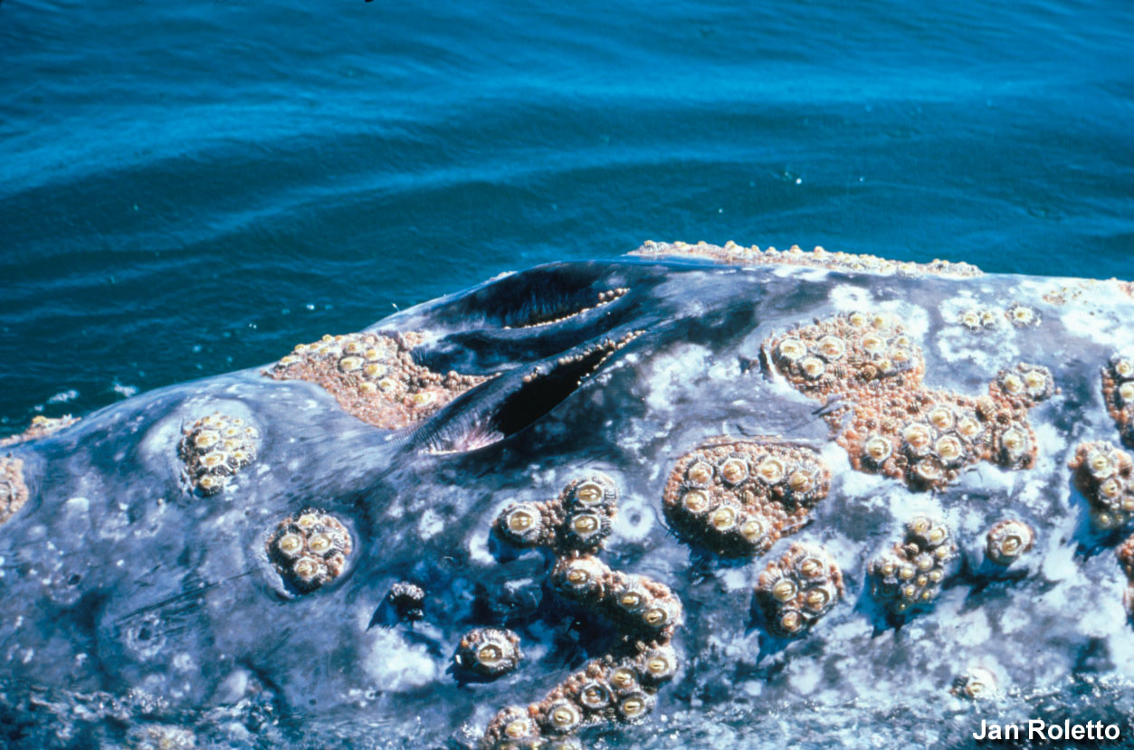
Commensalism
Barnacles

Slide 27
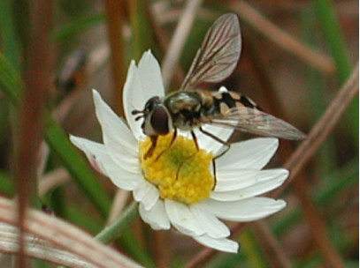
Mutualism and Commensalism
Are plants and pollinators engaged in a mutualistic or commensalistic relationship?

Slide 28
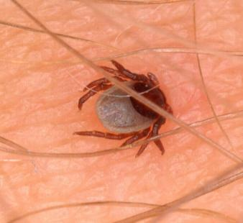
Parasitism
Parasitism = relationship in which one organism benefits and one organism is harmed.
Ectoparasite – external (ex: tick, lice)
Endoparasite – internal (ex: tapeworm, bacteria, roundworms)
Notes:
Adaptations of a parasite vs. host?

Slide 29
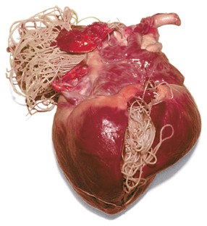
Parasitism: Heart Worm
If host dies:
The parasite must quickly find another host or it will die as well.

Slide 30
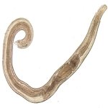
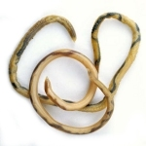
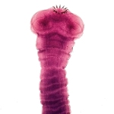
Parasitism: Roundworm
Types of Parasitic Roundworm Diseases
Ascariasis Hookworm Disease Pinworm Infection Strongyloidiasis Trichinosis Whipworm Disease

Slide 31
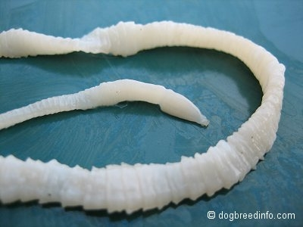
Tapeworm
The beef tapeworm can be up to 25 feet in length in the human intestine!!!

Slide 32
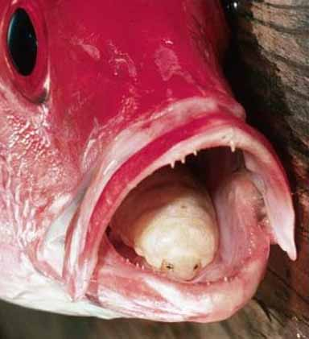
Tongue-Eating Louse
A crustacean that enters through the fish’s gills and then attaches to the fish’s tongue.
Later becomes the tongue & fees on blood or mucus from the fish.
Fish can still use the tongue!!!

Slide 33
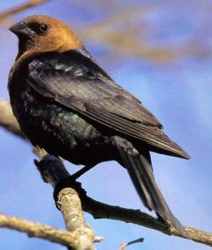
Brood Parasitism
Brown-headed cowbirds demonstrate brood parasitism because they rely on other bird species to:
build their nests
incubate their eggs
Baby cowbirds push the host’s eggs or young from the nest
Lower population of songbirds

