Slide 1
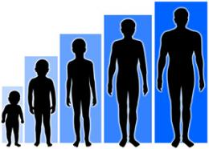
Complex Patterns of Inheritance

Slide 2
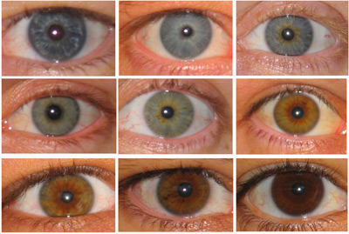
Traits Influenced by Several Genes
Polygenic Trait = when several genes influence a trait
Genes can be:
Scattered along the same chromosome
Located on different chromosomes
Independent Assortment = many different combinations in offspring
Polygenic traits =
Eye color, height, weight, hair and skin color

Slide 3
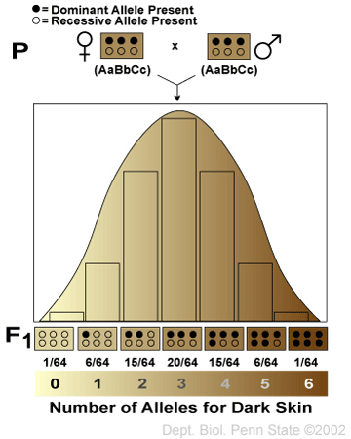
Skin Color

Slide 4
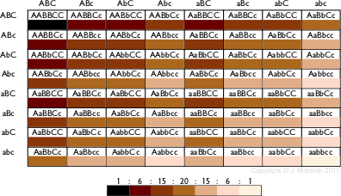
Polygenic Trait – Skin Color

Slide 5
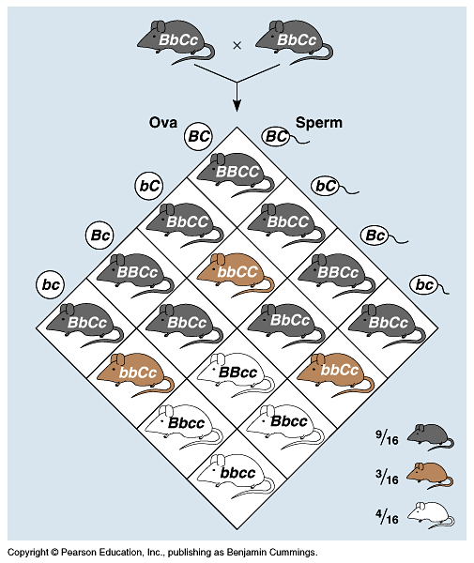
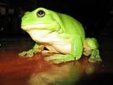
Epistasis
One gene completely masks another gene
coat color in mice = 2 separate genes
C,c: pigment (C) or no pigment (c)
B,b: more pigment (black=B) or less (brown=b)
cc = albino, no matter B allele
9:3:3:1 becomes 9:3:4
B_C_
B_C_
bbC_
bbC_
_ _cc
_ _cc
How would you know that difference wasn’t random chance?
Chi-square test!

Slide 6
Epistasis in Labrador retrievers
2 genes: (E,e) & (B,b)
pigment (E) or no pigment (e)
pigment concentration: black (B) to brown (b)
eebb
eeB–
E–bb
E–B–

Slide 7
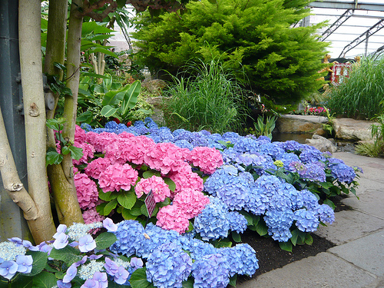
Traits Influenced By The Environment
Phenotype is affected by environmental conditions
Hydrangeas (flowers) range from blue to pink based upon the pH of the soil
Acidic soil = blue flowers
Basic soil = pink flowers

Slide 8
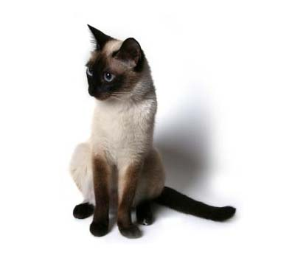
Traits Influenced By The Environment
Siamese Cat
Fur on ears, nose, paws, and tail is darker than the rest of the body
Dark fur at locations which are cooler than normal body temperature

Slide 9
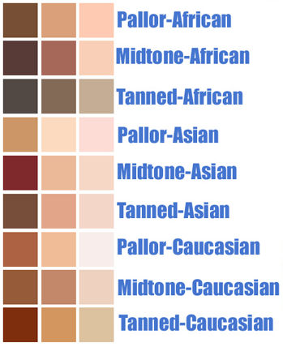
Human Examples: Traits Influenced By The Environment
Height
What can influence height besides genes?
Skin Color
Human Personality

Slide 10
Traits Caused By Mutation
Damaged genes/genes which are copied incorrectly – result in faulty proteins
Mutations are RARE
Inherited Mutations cause Genetic Disorders
Many mutations are carried in recessive alleles
Carrier = heterozygous individual
Carry the recessive allele but do not exhibit the disorder

Slide 11
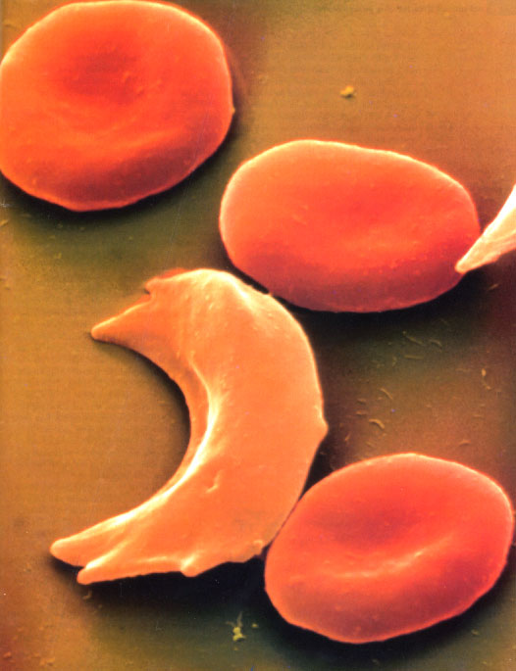
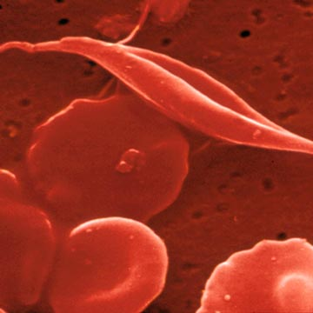
Sickle Cell Anemia
Recessive
Defective hemoglobin
Red Blood Cells
Binds and transports oxygen
Sickle-Cell Shape
Rupture-prone
Clotting in blood vessels
Heterozygote Advantage = protection from malaria

Slide 12
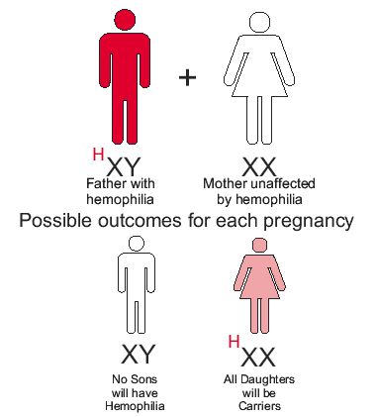
Hemophilia
Recessive
Sex-linked
X chromosome
More males afflicted than females
Impairs blood clotting
English royal family

Slide 13
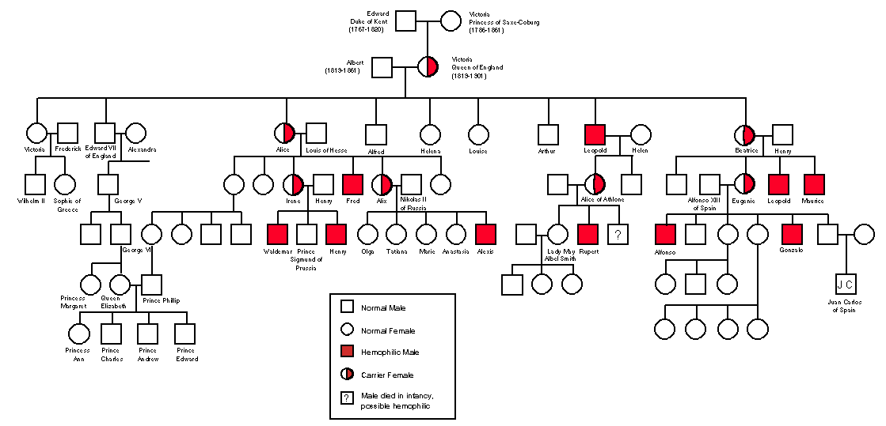
Hemophilia: The Royal Family

Slide 14
Huntington’s Disease
Dominant
First symptoms appear in thirties or forties:
Mild forgetfulness
Irritability
Long-term symptoms:
Loss of muscle control
Chorea (physical spasms)
Severe Mental Illness
Death

Slide 15
Detecting and Treating Genetic Disorders
Genetic Counseling = a form of medical guidance that informs people about genetic problems that could affect them or their offspring
Phenylketonuria (PKU)
Lacks enzyme to convert phenylalanine into tyrosine
Can cause mental retardation
Early intervention involves low-phenylalanine diet
Gene Therapy = replacing defective genes with healthy ones

Slide 16
Disorders from Nondisjunction
Non-disjunction = when chromosomes do not separate properly during meiosis (1 gamete gets 2 chromosomes…the other gets ZERO)
In humans: 1 egg has 24 chromo, other has 22 (normal # = 23)
Ex: Down syndrome (Trisomy 21)
Notes:
Klinefelter = XXY, Turner = XO, not viable = YO

Slide 17
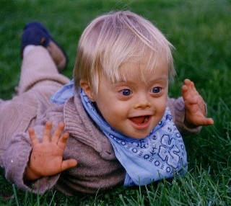
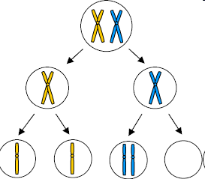
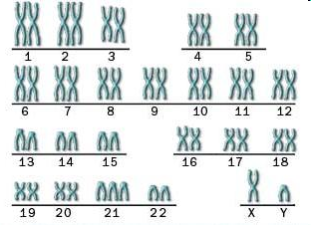
Trisomy 21

Slide 18
If having extra chromosomes causes genetic problems,
how come having two X chromosomes in females and
one X in males is not a problem?

Slide 19
X-chromosome Inactivation
In female cells ONE X chromosome is randomly switched off
It condenses and forms a dense region in the nucleus called a
BARR BODY
http://fig.cox.miami.edu/~cmallery/150/gene/barr.htm

Slide 20
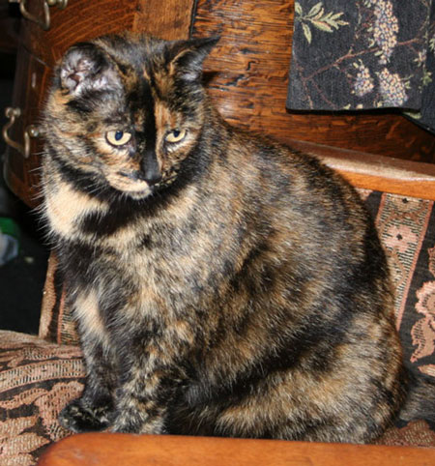
CAT COLOR
In cats the gene that
controls color is carried on the X chromosome Tortoiseshell cats express different alleles in different cells
http://www.eagle.ca/~roda/RodMerArts/SwallowHill/Kiisu.html
FEMALE CATS: Female cat can have BOTH
black and orange spots
See a video
http://www.islandstrolling.com/mainland/peloponnes/photo/mystra_cat_white_orange_black.jpg

Slide 21
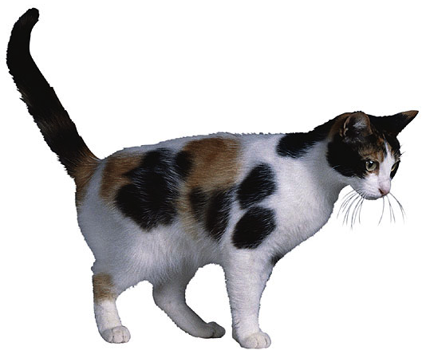
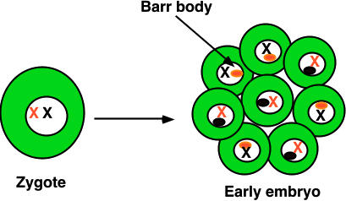
X-inactivation
Female mammals inherit 2 X chromosomes
one X becomes inactivated during embryonic development
condenses into compact object = Barr body
which X becomes Barr body is random
patchwork trait = “mosaic”
patches of black
X^{H}
X^{H}X^{h}
tricolor cats can only be female
X^{h}
patches of orange

Slide 22
CAT COLOR
http://ascensionparish.net/forum/messages/14/2493.jpg
MALE cats have only
one X chromosome, so they can only have
ONE COLOR of spots!
THINK ABOUT IT?
How many colors of spots could a male cat with
Klinefelter syndrome have?

Slide 23
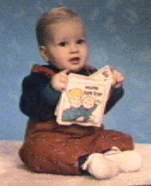
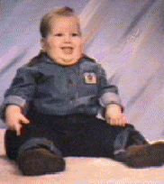
PRADER-WILLI Syndrome
Victor Age 1 / Victor Age 2
Born floppy and pale At first refuse to nurse, but later eat until
they become obese
Tiny hands and feet Underdeveloped sex organs
Mildly retarded
Spectacular temper tantrums especially if
refused food
Exceptional proficiency with Jig-saw puzzles
Missing piece of chromosome #15

Slide 24
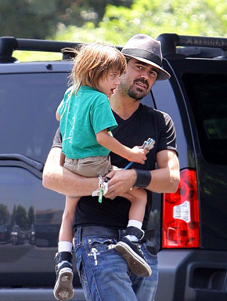
ANGELMAN’S SYNDROME
Taut, not floppy
Thin
Hyperactive
Insomniac
Small head
Move jerkily like puppets
Happy disposition
Severely mentally retarded
Rarer than Prader-Willi
Missing SAME piece of Chromosome #15
Colin Farrell’s son has
Angelman’s syndrome
http://www.usmagazine.com/colin_farrell_and_son

Slide 25
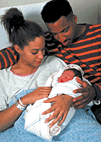
WHAT’S THE DIFFERENCE?
In Prader-Willi missing piece of #15 was from father
In Angelman’s, missing piece of #15 was from the mother
How does a gene “remember”
where it came from?
GENOMIC IMPRINTING

Slide 26
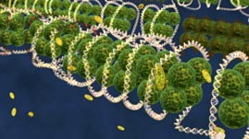
EPIGENETICS “above genetics” Molecules sit on top of the genome
Control which genes are
ON or OFF
http://www.teachersdomain.org/assets/wgbh/biot09/biot09_vid_epigenetics/biot09_vid_epigenetics_l.jpg

Slide 27
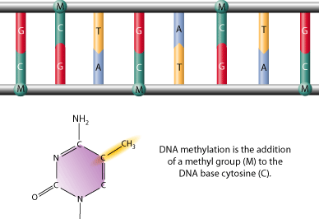
GENOMIC IMPRINTING
Involves the silencing of certain genes that are “stamped” with an imprint during gamete production so same allele (maternal or paternal) is expressed in all body cells
Involves methylation (-CH₃) (turns genes OFF)
or demethylation (turns genes on)
of cytosine nucleotides
Several hundred mammalian
genes, many critical for
development, may be subject
to imprinting.
http://www.scq.ubc.ca/wp-content/uploads/2006/08/methylation%5B1%5D-GIF.gif

Slide 28
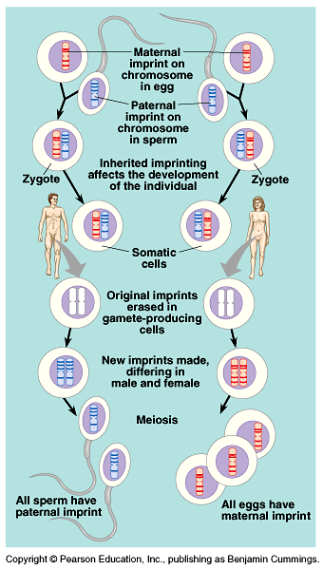
In the new generation, both maternal and paternal imprints are apparently “erased” in gamete-producing cells.
Then, all chromosomes are re-imprinted according to the sex of the individual in which they reside.
Imprinting is critical for normal development.
Copyright © 2002 Pearson Education, Inc., publishing as Benjamin Cummings

Slide 29
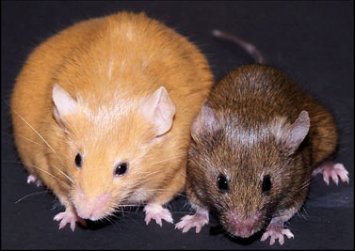
Addition or removal or “methyl tags” may be influenced by environment
Twins start with same methyl tags but become more different with age
Agouti rats – changing diet of pregnant mom can change expression of genes
VIDEO
http://www.precisionnutrition.com/wordpress/wp-content/uploads/2009/12/Figure-3-Agouti-mice.jpg

Slide 30
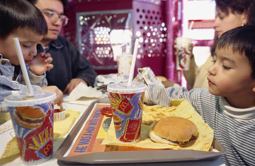
Addition or removal or “methyl tags” may be influenced by environment
DIET
STRESS
EXERCISE
CHEMICALS
http://www.naturepedic.com/blog/wp-content/uploads/2010/11/BPA_free_logo.jpg
http://www.knowabouthealth.com/wp-content/uploads/2010/06/mcdonalds_.jpg
http://emilyscarenhealth.wordpress.com/2011/10/04/attention-a-must-read-for-smokers/

Slide 31
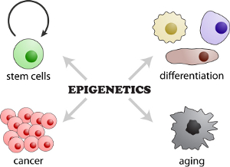
GENOMIC IMPRINTING
Tags Maternal/Paternal chromosomes
Differentiation of cell types (blood, skin, etc)
Embryonic development
Changes in puberty, pregnancy, aging
X chromosome inactivation (Barr bodies)
differences can lead to diseases (cancer)
and genetic disorders
http://www.molekularbiologie.abi.med.uni-muenchen.de/ueber_uns/schotta/index.html

