Slide 1
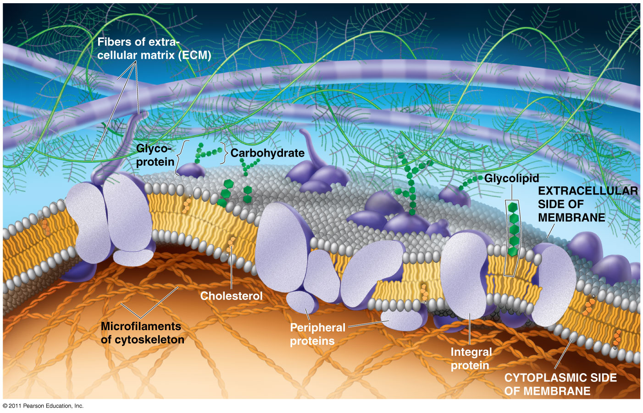
Chapter 7
Membrane Structure and Function

Slide 2
What You Must Know:
Why membranes are selectively permeable.
The role of phospholipids, proteins, and carbohydrates in membranes.
How water will move if a cell is placed in an isotonic, hypertonic, or hypotonic solution.
How electrochemical gradients are formed.

Slide 3
Cell Walls
What is the main function of the cell wall?

Slide 4
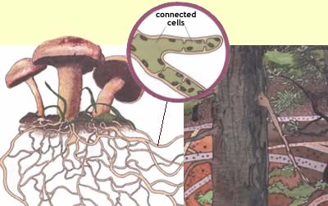
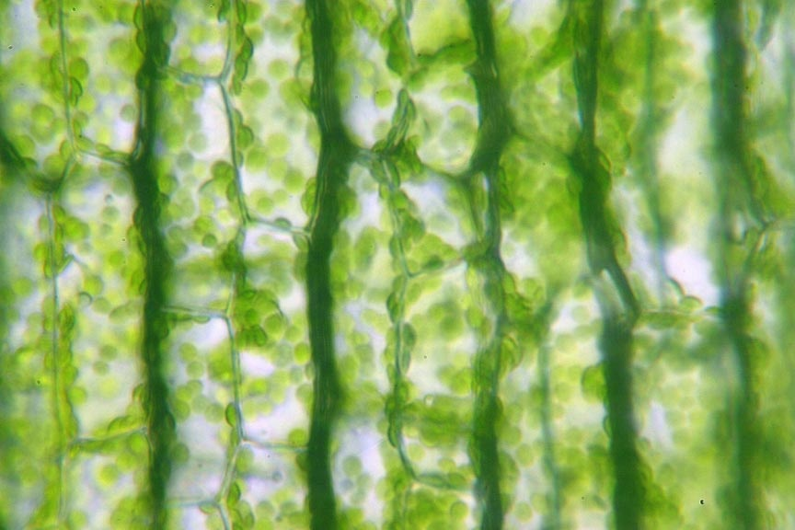
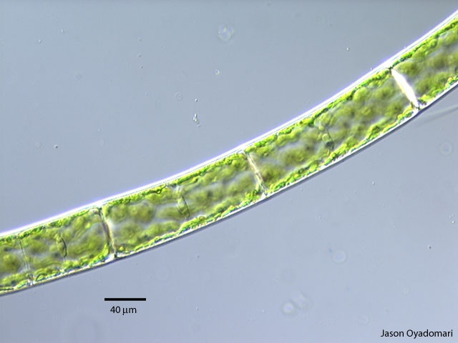
Many cells produce a strong supporting layer around the membrane known as a cell wall.
Cell walls are found in plants (cellulose), algae, fungi (chitin), some protists and many prokaryotes (peptidoglycan).

Slide 5
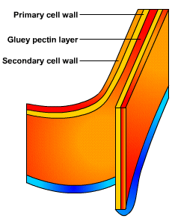
Cell walls have openings or pores to allow water, oxygen, carbon dioxide and other materials to pass through. They lie outside the cell membrane. They give structure and support – the thicker the cell wall the more stiff or rigid the structure will be.

Slide 6
Cell Membrane
Cell Membrane
What is the main function of the cell membrane?

Slide 7
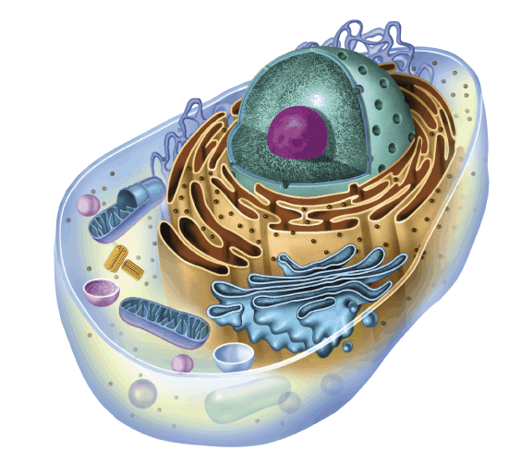
All cells are surrounded by a thin,
flexible barrier known as the
cell membrane.
Functions:
Controls what enters and exits the cell to maintain an internal balance called homeostasis
b. Provides protection and support for the cell
c. Recognizes foreign material
d. Communicates with other cells
Notes:
7

Slide 8
Teach your partner!!
What does selectively permeable mean?

Slide 9
Cell Membrane
Plasma membrane is selectively permeable
Allows some substances to cross more easily than others
Small molecules (polar or nonpolar) cross easily (hydrocarbons, hydrophobic molecules, CO₂, O₂)
Hydrophobic core prevents passage of ions, large polar molecules
Fluid Mosaic Model
Fluid: membrane held together by weak interactions
Mosaic: phospholipids, proteins, carbs

Slide 10
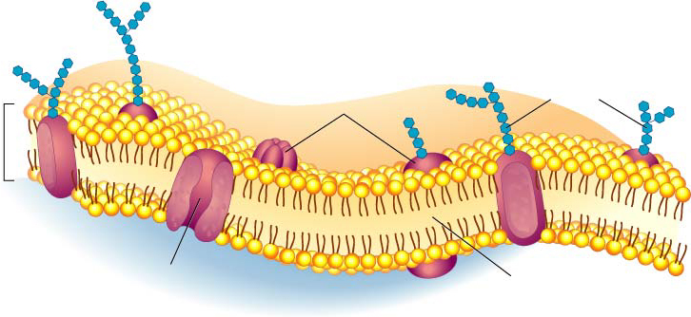
Structure of cell membrane
Lipid Bilayer -2 layers of phospholipids
Phosphate head is polar (water loving) “Hydrophilic”
Fatty acid tails non-polar (water fearing) Hydrophobic”
Proteins embedded
in membrane
Phospholipid
Bilayer
Notes:
10

Slide 11
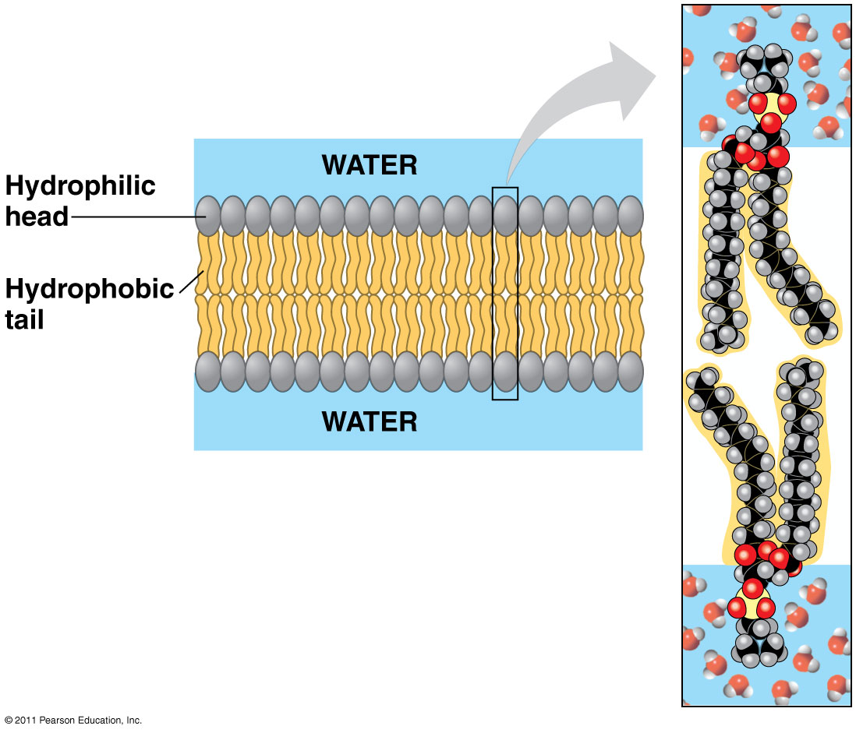
Phospholipids
Bilayer
Amphipathic = hydrophilic head, hydrophobic tail
Hydrophobic barrier: keeps hydrophilic molecules out

Slide 12
Polar heads love water & dissolve.
Fluid Mosaic Model of the cell membrane
Non-polar tails hide from water.
Membrane movement animation
Carbohydrate cell markers
Proteins
Notes:
12

Slide 13
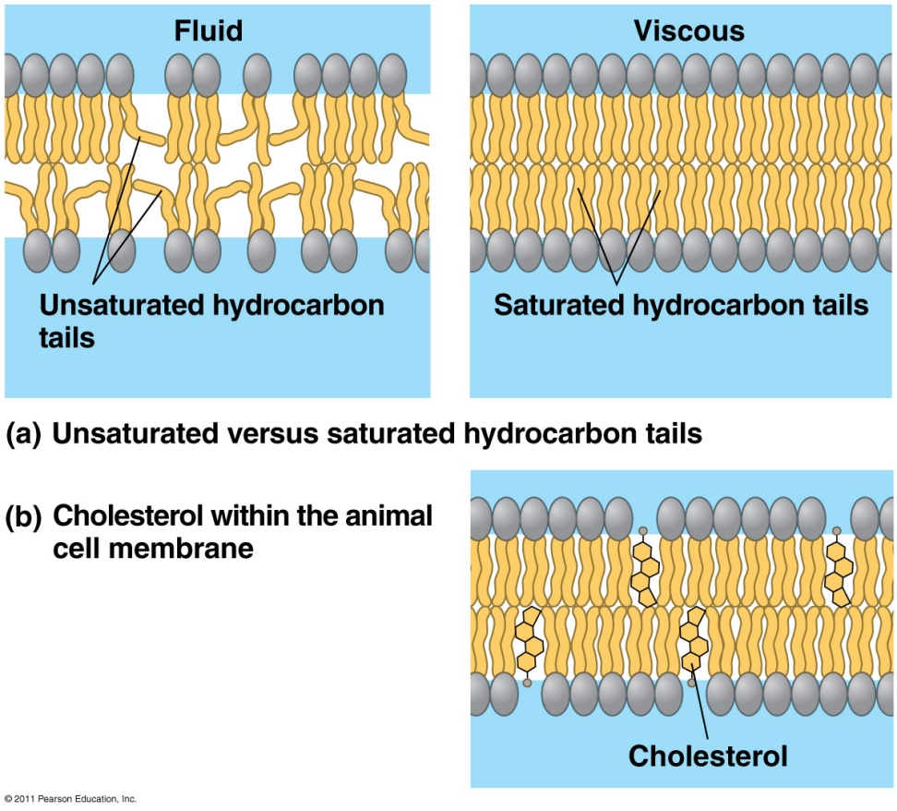
Membrane fluidity
Low temps: phospholipids w/unsaturated tails (kinks prevent close packing)
Cholesterol resists changes by:
limit fluidity at high temps
hinder close packing at low temps
Adaptations: bacteria in hot springs (unusual lipids); winter wheat (↑ unsaturated phospholipids)

Slide 14
Membrane Proteins
Integral Proteins
Peripheral Proteins
Embedded in membrane
Transmembrane with hydrophilic heads/tails and hydrophobic middles
Extracellular or cytoplasmic sides of membrane
NOT embedded
Held in place by the cytoskeleton or ECM
Provides stronger framework

Slide 15
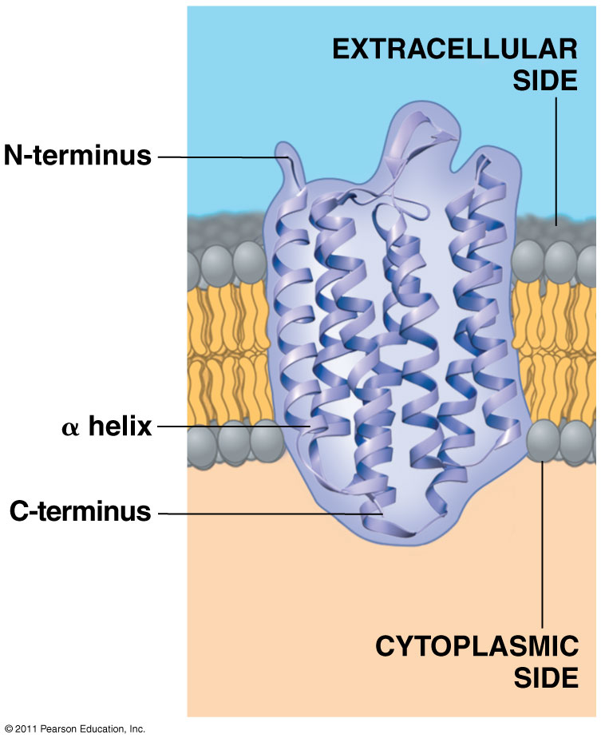
Transmembrane protein structure
Hydrophobic interior
Hydrophilic ends

Slide 16
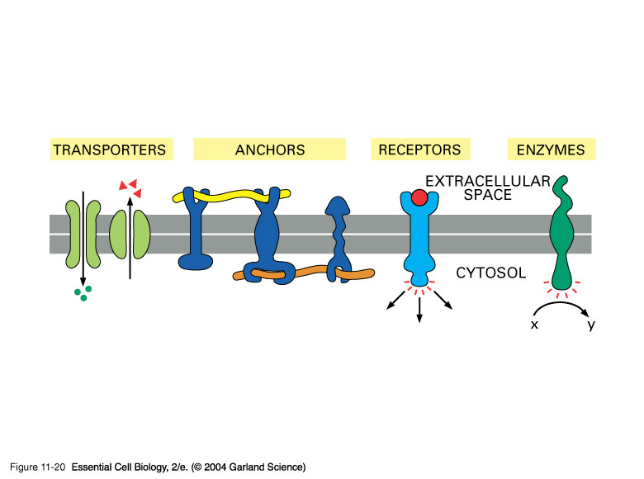
Proteins
Cell-surface markers: (Carbohydrates attached to the proteins act like chemical identification cards) Identify the cell type and help cells work together.
Receptor proteins: Monitor environment
Enzymes: speeds up rate of chemical reactions in cell.
Transport Proteins: (Some proteins form channels and pumps) move materials across bilayer

Slide 17
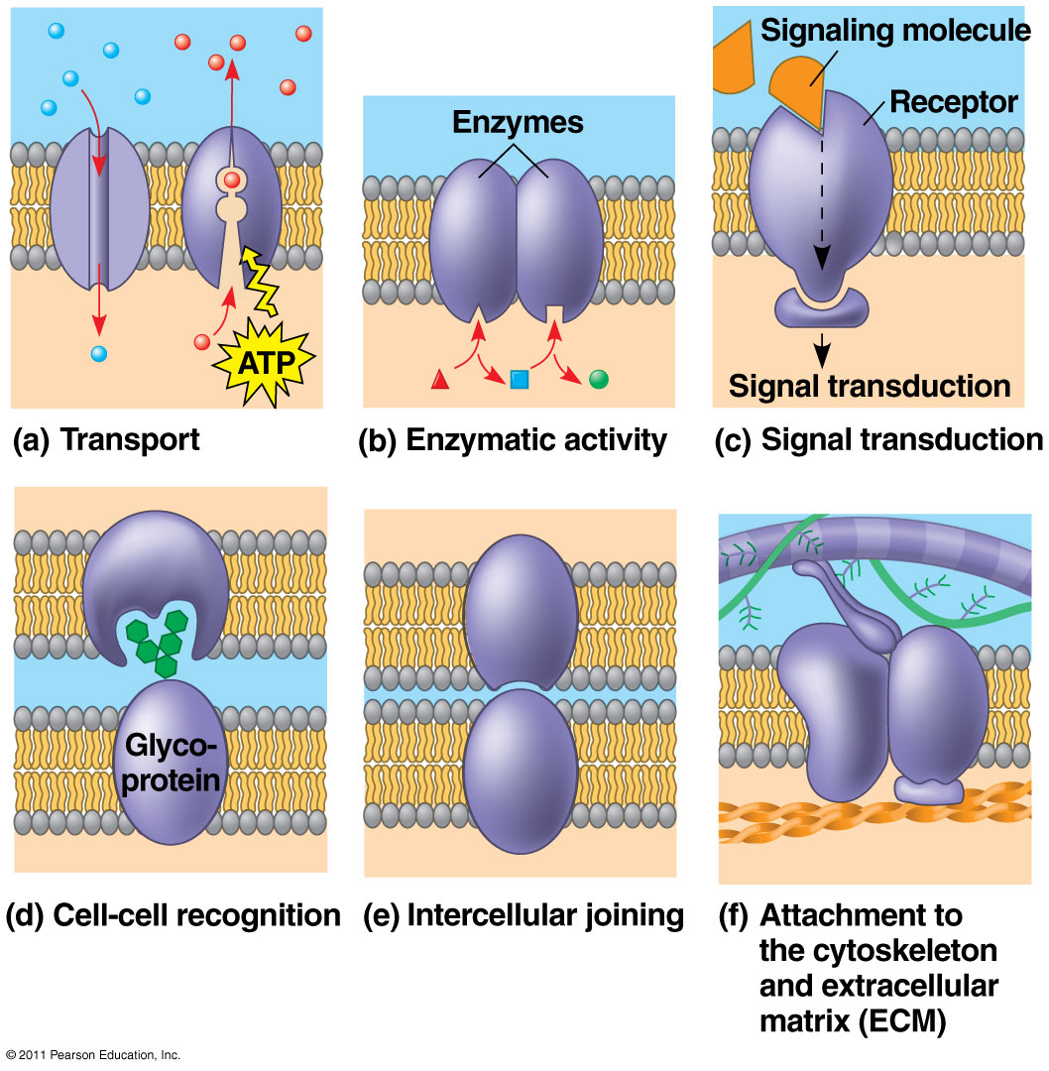
Some functions of membrane proteins

Slide 18
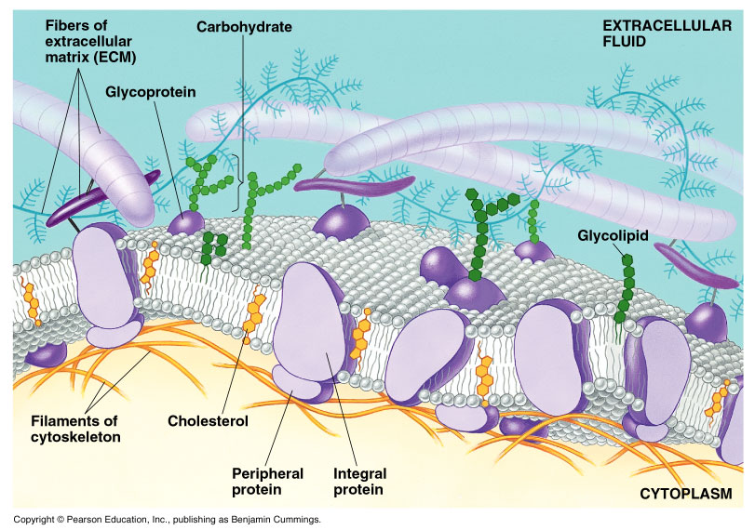
Carbohydrates
Function: cell-cell recognition; developing organisms
Glycolipids, glycoproteins
Eg. blood transfusions are type-specific

Slide 19
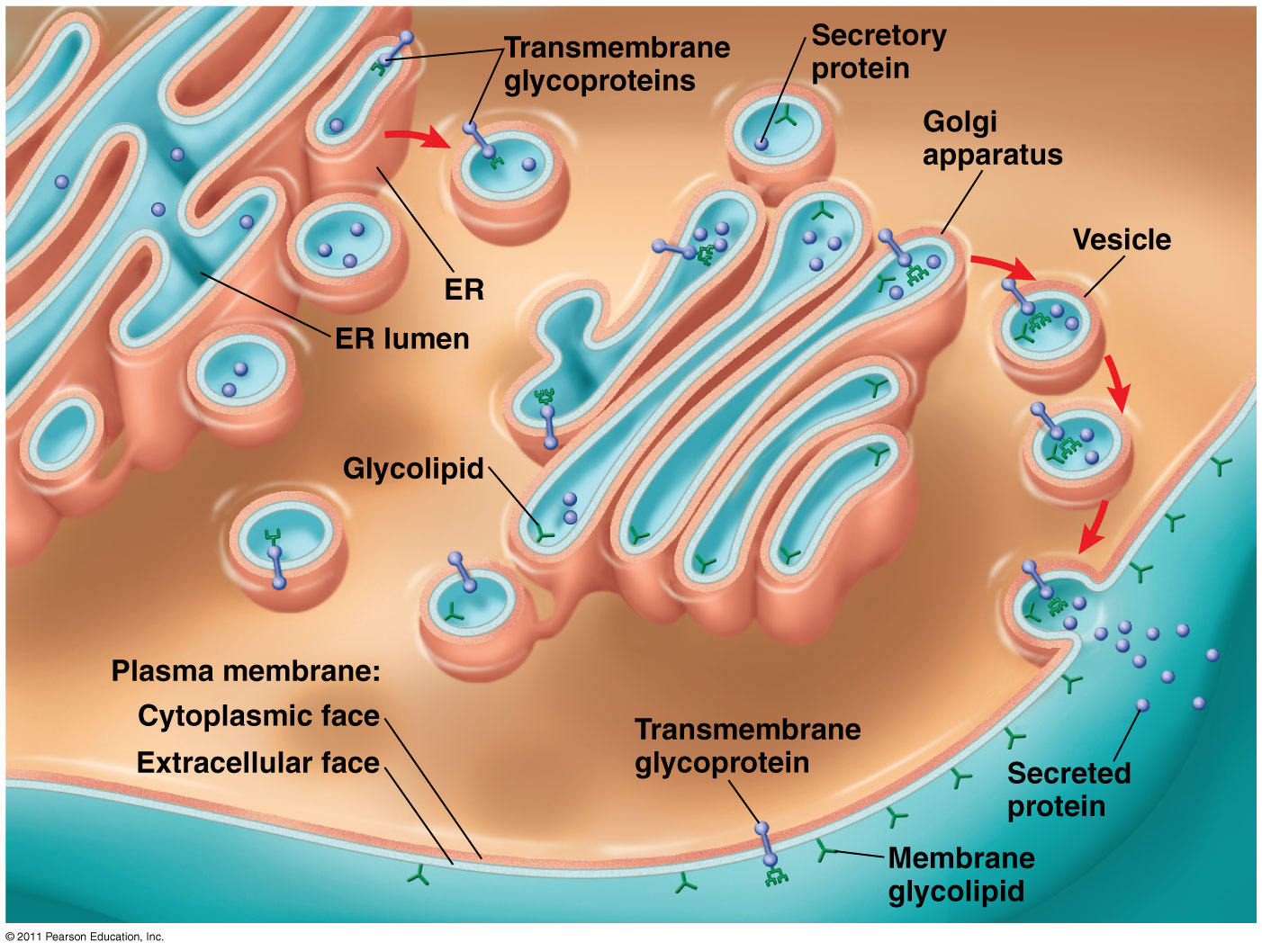
Synthesis and sidedness of membranes

Slide 20
Structure of the Cell Membrane
Outside of cell
Carbohydrate
chains
Proteins
Lipid
Bilayer
Transport
Protein
Phospholipids
Inside of cell
(cytoplasm)
Animations
of membrane structure
Go to Section:
Notes:
20

Slide 21
Integral & Peripheral proteins

Slide 22
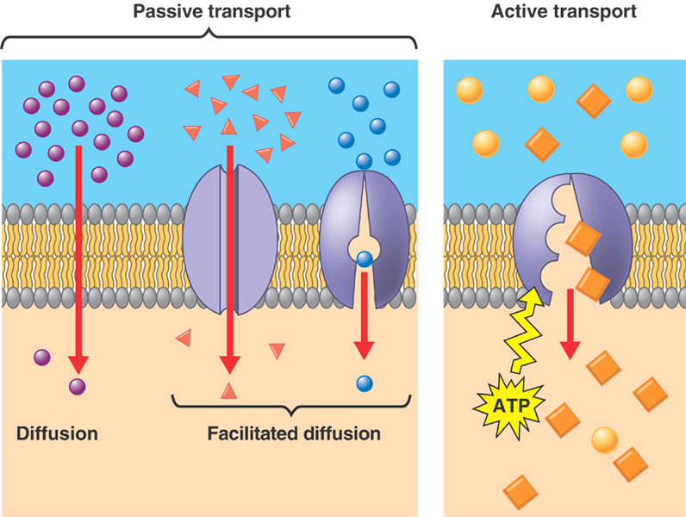

Slide 23
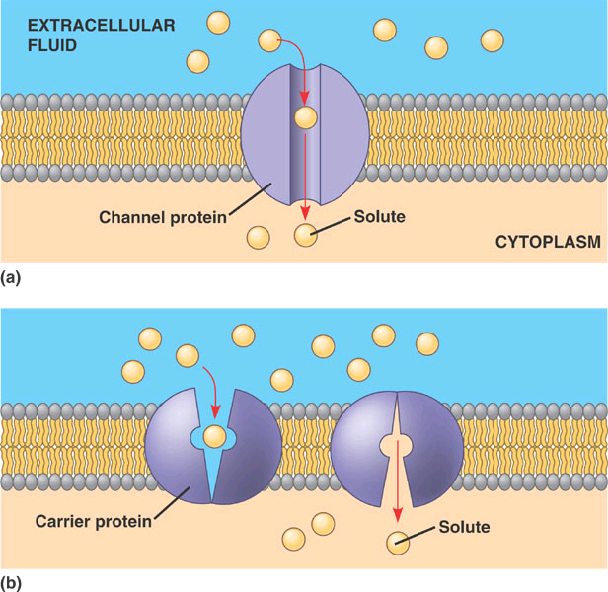
Facilitated Diffusion: diffusion of hydrophilic substances is facilitated by a protein

Slide 24
The cell membrane is much more than a passive barrier of the cell.
Describe in detail the fluid mosaic model of the cell membrane. (6 pt maximum)
__phospholipid description (polar head, nonpolar tails)
__phospholipid bilayer (must explain significance with reference to polarity)
__cholesterol: effects membrane fluidity
__transmembrane proteins span the entire membrane
__role of a transmembrane protein (carrier, receptor, etc.) __peripheral protein
__role of a peripheral protein (anchor, enzyme, etc.)
__glycolipid OR cell surface marker
__role of glycolipid (identify cell as “self” to the immune system, etc)

Slide 25
On a sheet of paper you will need to draw a linear section of cell membrane (you will want a long section of cell membrane and the ability to add on additional structures later).
For Tuesday 11/03/15 you must include: the phospholipid bilayer (show and label the hydrophilic/polar heads and hydrophobic/nonpolar tails)
label which side is extracellular and which side is intracellular
at least one cholesterol molecule (label it & describe what it does)
at least one glycolipid (label it & describe what it does)
at least one glycoprotein (label it & describe what it does)
at least one of each of the following integral proteins (at least one should be transmembrane, label each one, & describe what it does):
channel protein receptor protein carrier protein enzymatic protein cell recognition protein
**it is possible to meet the glycoprotein requirement with one of the above integral proteins depict the types of molecules that can diffuse through the plasma membrane without assistance
You will want to leave plenty of extra space between proteins. As we progress through chapter 5 we will be adding various transport and signaling mechanisms to our cell membrane “map”. I suggest starting your map in pencil – so that changes can be easily made.

Slide 26
AP Biology - The Structure & Functions of the Plasma Membrane Map (part 2) You have already completed a Plasma Membrane Map highlighting the key structural features of the cell membrane. Now we will start adding modes of passive transport. For Thursday 11/05/15 you must add: o Osmosis through the phospholipid bilayer (not through aquaporins) into the cell (net flow). Yes your drawings should correctly depict the concentration gradient that would result in this movement. o Diffusion of a small nonpolar molecule (research a type of molecule that could do this) out of the cell (net flow). Yes your drawings should correctly depict the concentration gradient that would result in this movement. o Facilitated Diffusion/Transport through a channel protein. Select a molecule or ion that would actually engage in this type of transport. The net movement of this molecule or ion should be out of the cell – depict your concentration gradients accordingly. o Facilitated Diffusion/Transport through a carrier protein. Select a molecule or ion that would actually engage in this type of transport. The net movement of this molecule or ion should be into the cell – depict your concentration gradients accordingly. o Somewhere on your map (doesn’t matter where) you must define: osmosis, diffusion, facilitated diffusion, passive transport, and concentration gradient.

