Slide 1
Vocabulary
Concentration Gradient: When you have an area of greater concentration and an area of lesser concentration.
Equilibrium: When the concentration is the same throughout.
Solvent – Dissolving agent (ex. Water)
Solute – Substance that is dissolved (ex. Kool aid mix)

Slide 2
Types of Cellular Transport
Weeee!!!
Passive Transport
cell doesn’t use energy
Diffusion
Facilitated Diffusion
Osmosis
Active Transport
cell does use energy
Protein Pumps
Endocytosis
Exocytosis
high
low
This is gonna be hard work!!
high
low
Notes:
2

Slide 3
Types of Cellular Transport
Weeee!!!
Passive Transport
Cell uses no energy
Molecules move randomly
Molecules spread out from an area of high concentration to an area of low concentration.
(High→Low)
Diffusion – movement of any substance
Facilitated Diffusion – diffusion with the help of transport proteins
Osmosis – diffusion of water
high
low
Notes:
3

Slide 4
Diffusion Through Cell Boundaries
What happens during diffusion?
- Molecules MOVE!!!!
- Molecules are always in motion. They move around and bump into each other.

Slide 5
Diffusion Any molecules, Oxygen, Carbon Dioxide, Water Diffusion will continue until all molecules are evenly spaced = Equilibrium.

Slide 6
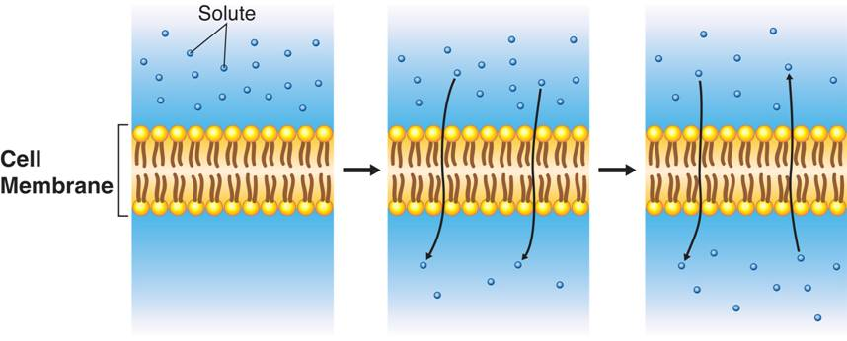
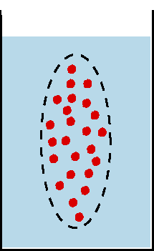
Diffusion Through Cell Boundaries
Notes:
Diffusion is the process by which molecules of a substance move from areas of higher concentration to areas of lower concentration. Diffusion does not require the cell to use energy.

Slide 7
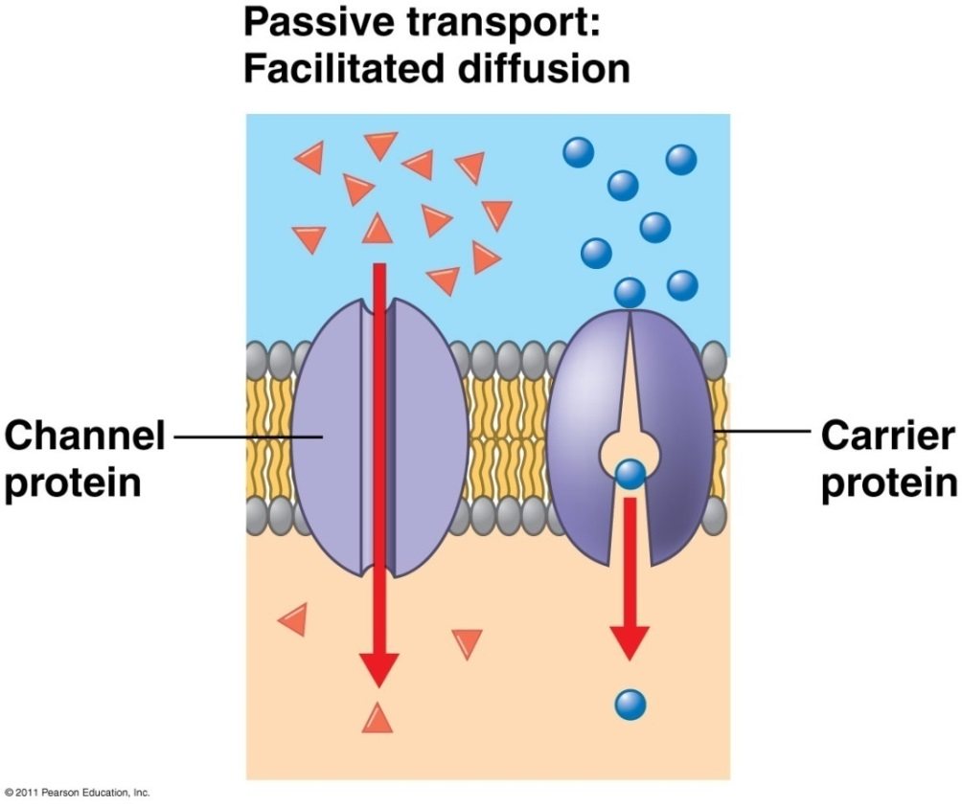
Facilitated Diffusion
Transport proteins (channel or carrier proteins) help hydrophilic substances cross because the inner part of of membrane is hydrophobic
Two ways:
Provide hydrophilic channel
Loosely bind/carry molecule across
Eg. ions, polar molecules (H₂O, glucose, larger molecules)

Slide 8
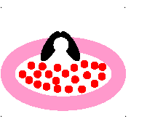
Passive Transport: Facilitated Diffusion
A
B
requires no energy because molecules still move from a higher to a lower concentration.
Each protein channel is specific for the type of molecule that it allows to enter the cell.
Transport Proteins are specific – they “select” only certain molecules to cross the membrane
Transports larger or charged molecules
Facilitated diffusion (Channel Protein)
Diffusion (Lipid Bilayer)
Carrier Protein
Notes:
8

Slide 9
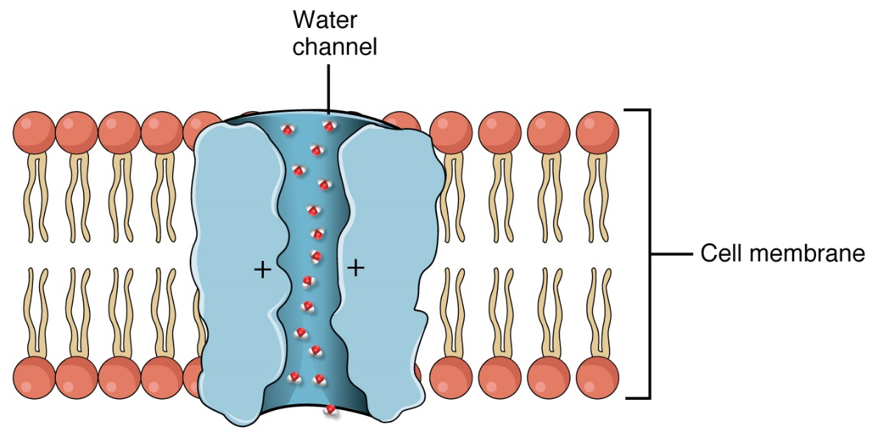
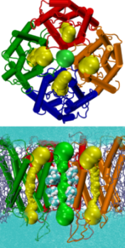
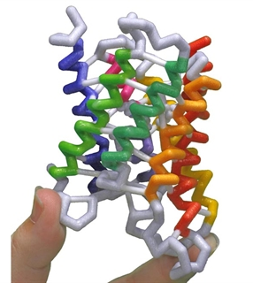
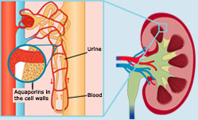
Aquaporin: channel protein that allows passage of H₂O

Slide 10
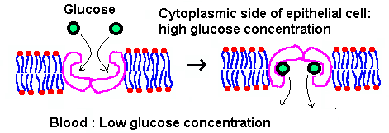
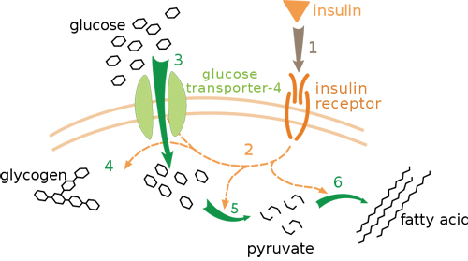
Glucose Transport Protein (carrier protein)

Slide 11
Osmosis
Osmosis
Osmosis is the diffusion of water through a selectively permeable membrane.
Whenever water moves, into or out of the cell, we call it osmosis.

Slide 12
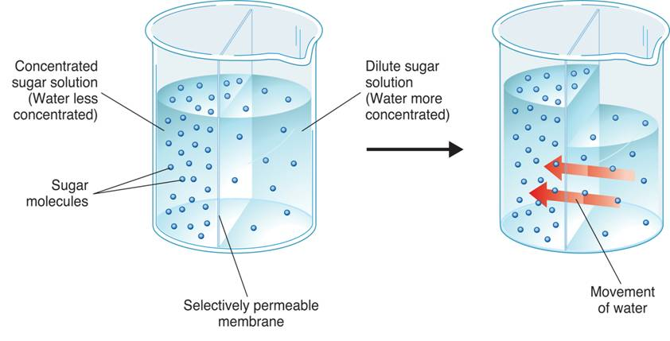
Osmosis
How Osmosis Works
Dilute sugar solution (Water more concentrated)
Concentrated sugar solution (Water less concentrated)
Sugar molecules
Movement of water from high concentration to low concentration
Selectively permeable membrane (only water can move)
Notes:
Osmosis is the diffusion of water through a selectively permeable membrane. In the first beaker, water is more concentrated on the right side of the membrane. As a result, the water diffuses (as shown in the second beaker) to the area of lower concentration.

Slide 13
Water moves freely through pores. Solute (green) to large to move across.

Slide 14
Osmosis
In osmosis, water tends to diffuse from a highly concentrated region to a less concentrated region through a selectively permeable membrane.
If you compare solutions, three terms can be used to describe the concentrations of the solution due to the amount of solute dissolved in the water:
- hypertonic (“above strength”)more solute/less water.
- hypotonic (“below strength”)less solute/more water.
- isotonic (”same strength”)same amount of solute

Slide 15
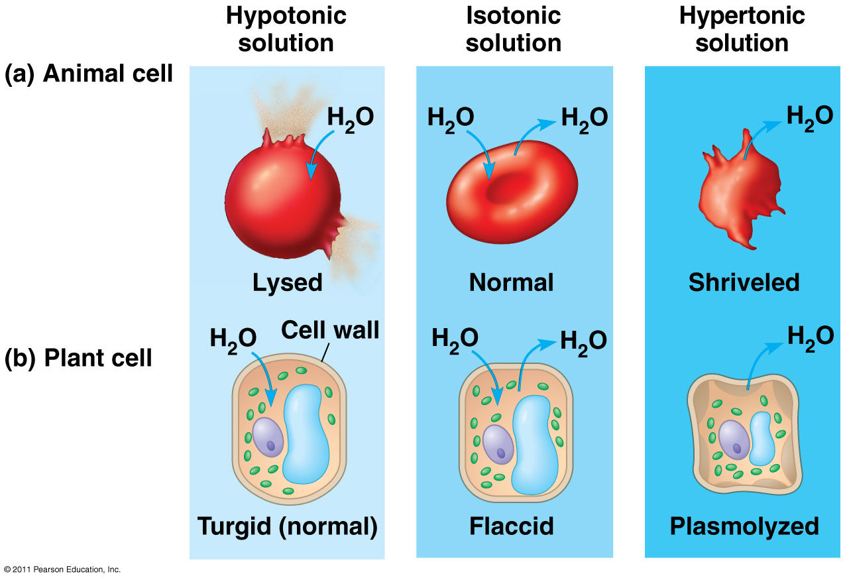
External environments can be hypotonic, isotonic or hypertonic to internal environments of cell

Slide 16
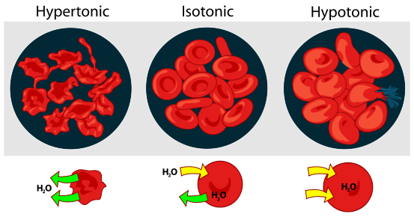
Osmosis
Osmotic Pressure
Osmosis exerts a pressure known as osmotic pressure on the cell compared to its environment. Remember both inside the cell and outside the cell there is a concentration. It is the water that moves!!

Slide 17
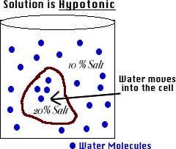
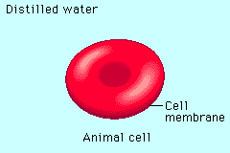
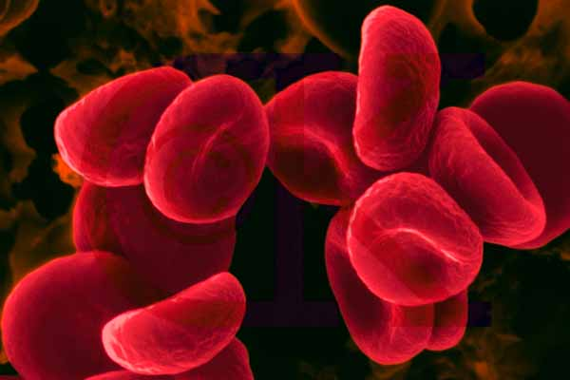
Hypotonic Solution
Hypotonic: The solution has a lower concentration of solutes and a higher concentration of water than inside the cell. (Low solute; High water)
Result: Water moves from the solution to inside the cell): Cell Swells and bursts open (cytolysis)!
Notes:
17

Slide 18
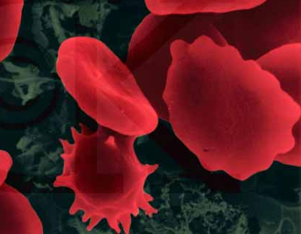
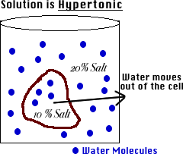
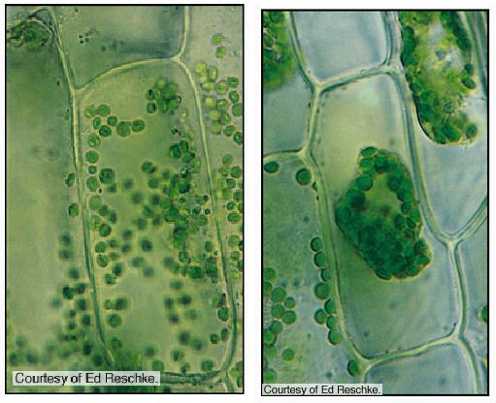
Hypertonic Solution
Hypertonic: The solution has a higher concentration of solutes and a lower concentration of water than inside the cell. (High solute; Low water)
shrinks
Result: Water moves from inside the cell into the solution: Cell shrinks (Plasmolysis)!
Notes:
18

Slide 19
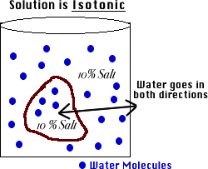
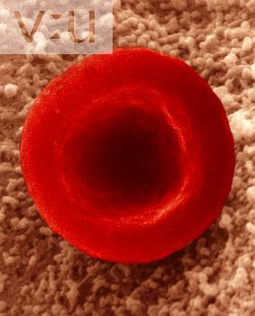
Isotonic Solution
Isotonic: The concentration of solutes in the solution is equal to the concentration of solutes inside the cell.
Result: Water moves equally in both directions and the cell remains same size! (Dynamic Equilibrium)
Notes:
19

Slide 20
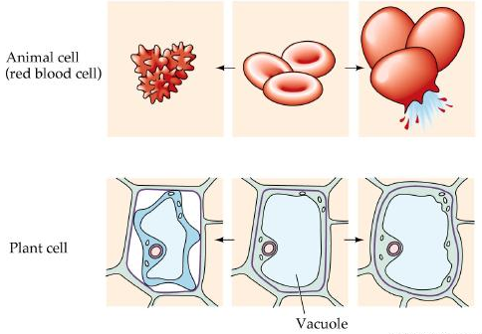
What type of solution are these cells in?
A
B
C
Hypertonic
Isotonic
Hypotonic
Notes:
20

Slide 21
How Organisms Deal with Osmotic Pressure
Salt water fish pump salt out of their specialized gills so they do not dehydrate.
Animal cells are bathed in blood. Kidneys keep the blood isotonic by remove excess salt and water.

