Slide 1
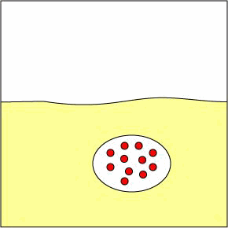
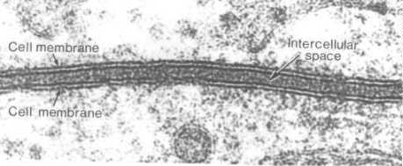
Cellular Transport Notes
Notes:
1

Slide 2
Cell Walls
What is the main function of the cell wall?

Slide 3
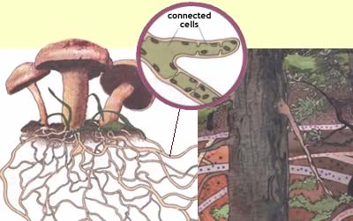
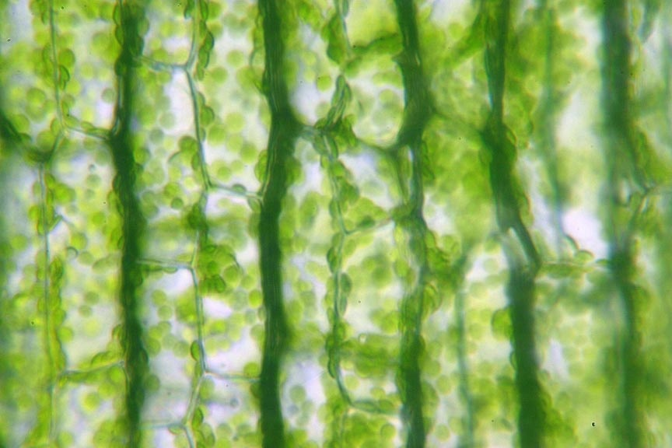
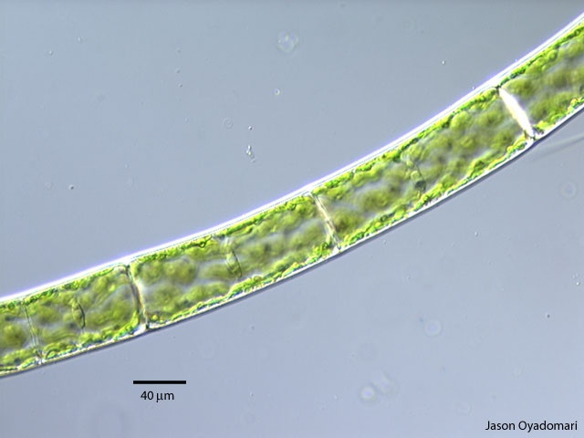
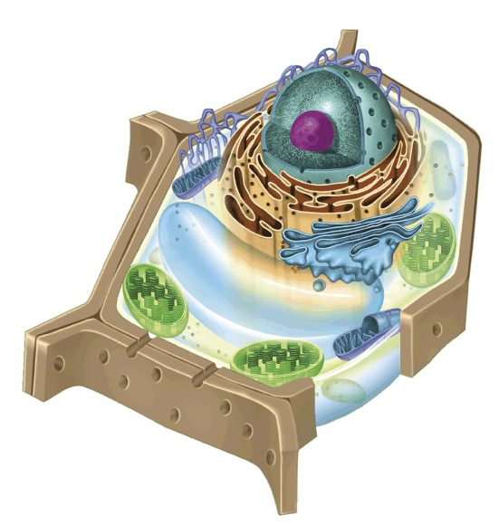
Many cells also produce a strong supporting layer around the membrane known as a cell wall.
Cell walls are found in plants, algae, fungi, some protists and many prokaryotes.

Slide 4
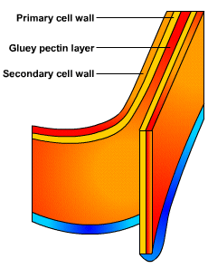
Cell walls have openings or pores to allow water, oxygen, carbon dioxide and other materials to pass through. They lie outside the cell membrane. They give structure and support – the thicker the cell wall the more stiff or rigid the structure will be.

Slide 5
Cell Membrane
Cell Membrane
What is the main function of the cell membrane?

Slide 6
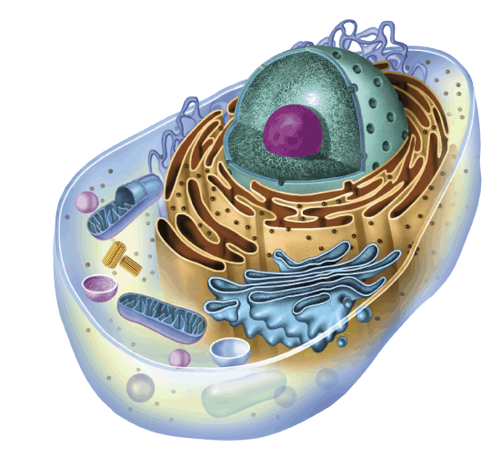
All cells are surrounded by a thin,
flexible barrier known as the
cell membrane.
Functions:
Controls what enters and exits the cell to maintain an internal balance called homeostasis
Provides protection and support for the cell
Recognizes foreign material
Communicates with other cells
Notes:
6

Slide 7
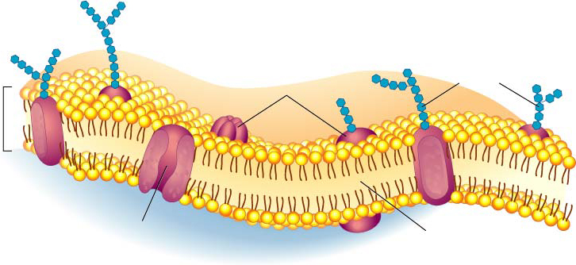
Structure of cell membrane
Lipid Bilayer -2 layers of phospholipids
Phosphate head is polar (water loving) “Hydrophilic”
Fatty acid tails non-polar (water fearing) Hydrophobic”
Proteins embedded
in membrane
Phospholipid
Bilayer
Notes:
7

Slide 8
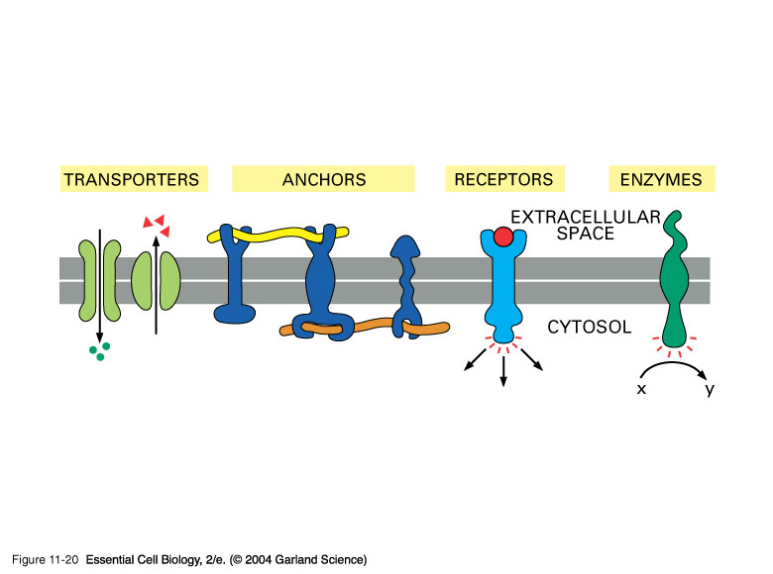
Proteins
Cell-surface markers: (Carbohydrates attached to the proteins act like chemical identification cards) Identify the cell type and help cells work together.
Receptor proteins: Monitor environment
Enzymes: speeds up rate of chemical reactions in cell.
Transport Proteins: (Some proteins form channels and pumps) move materials across bilayer

Slide 9
Polar heads love water & dissolve.
Fluid Mosaic Model of the cell membrane
Non-polar tails hide from water.
Membrane movement animation
Carbohydrate cell markers
Proteins
Notes:
9

Slide 10
Structure of the Cell Membrane
Outside of cell
Carbohydrate
chains
Proteins
Lipid
Bilayer
Transport
Protein
Phospholipids
Inside of cell
(cytoplasm)
Animations
of membrane structure
Go to Section:
Notes:
10

Slide 11
Teach your partner!!
What does selectively permeable mean?

Slide 12
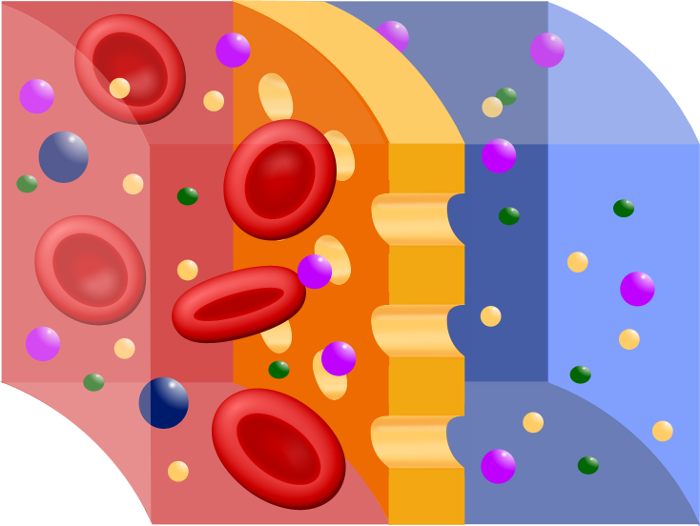
3. Most cells are selectively permeable, meaning that some substances can pass across them and some cannot.

