Slide 1
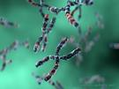
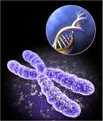
Cell Growth and Division

Slide 2
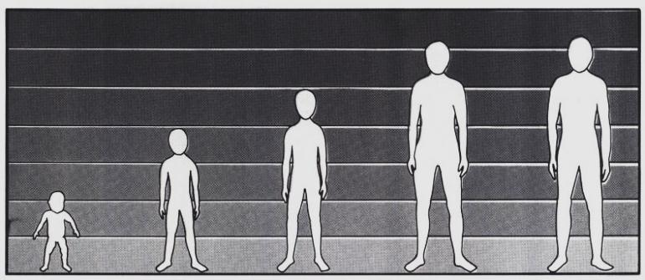
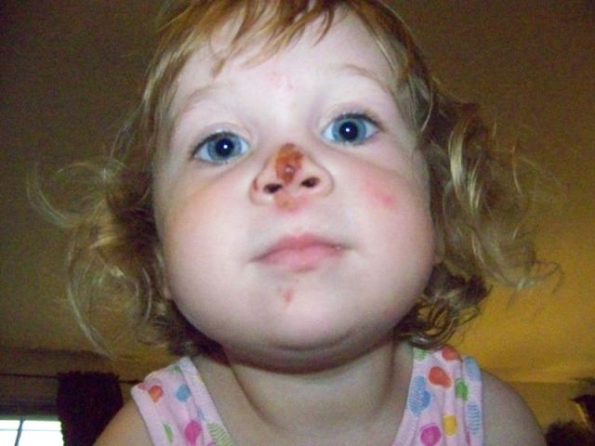
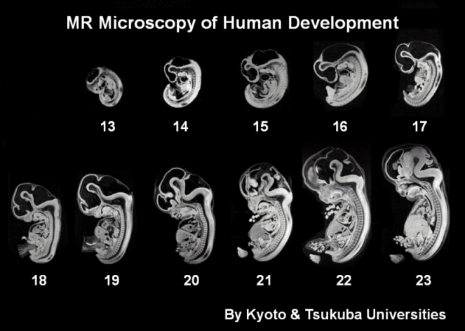
Cell division is needed to…
Grow – most organisms grow by producing more cells
Repair wounds and damaged cells
Develop and change

Slide 3
Growth vs. Division
When an animal or plant grows, what happens to its cells?
Does an animal get larger because each cell increases in size (grows) or because it produces more of them?

Slide 4
Why do cells divide? (aka, why are cells small?)
REASON 1: Not enough DNA!...as the cell increases in size, it keeps the same amount of DNA. Eventually the cell will grow too much for the DNA to control all its activities
Memory Trick: Think of DNA like a library of books. If a town (cell) is too big, people may have to wait for books!

Slide 5
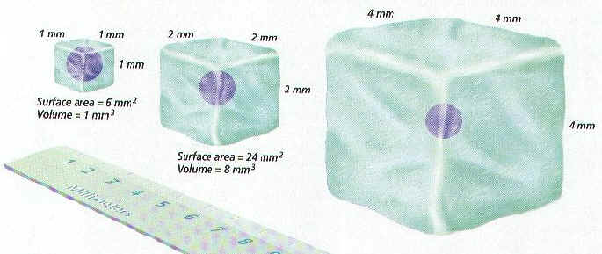
Why do cells divide? (aka, why are cells small?)
REASON #2: Surface area of membrane doesn’t increase as quickly as cell volume
Too little membrane → not enough exchange of materials in and out of the cell

Slide 6
When do cells divide (or stop)?
When cells crowd each other, they stop dividing
When internal factors signal the cell to start or stop dividing
e.g., p53 gene makes sure the cell doesn’t divide until chromosomes have doubled; cyclin enzymes start/stop the cell cycle
When external chemical or physical signals (growth regulators) stimulate or inhibit growth and division
(Cancer is an example of uncontrolled cell growth….we will discuss cancer later in the unit)

Slide 7
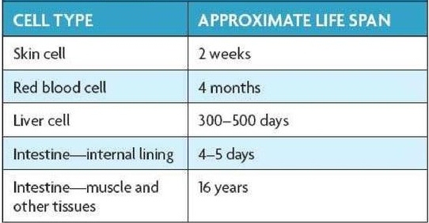
Cells divide at different rates
The rate of cell division varies with the need for the type of cell…

Slide 8
The Solution?
Before a cell becomes too large, it divides to form 2 “daughter cells”.
This process is called cell division
Cell division can only happen once a cell has made a copy of its DNA so that each daughter cell can have a full genetic library

Slide 9
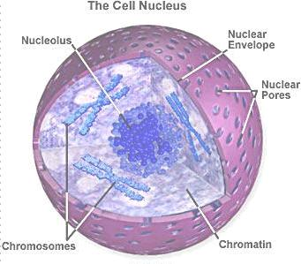
Cell Division in Eukaryotes
DNA is found in the nucleus
Chromatin is DNA & protein threads that coil into chromosomes during cell division.

Slide 10
IT CONDENSES!
When it is time for the cell to copy itself, the DNA is already copied.
The DNA needs to condense to untangle and make it easier to separate.
The DNA coils (or wraps) itself around histones and itself and forms chromosomes.
Let’s see it in action!

Slide 11
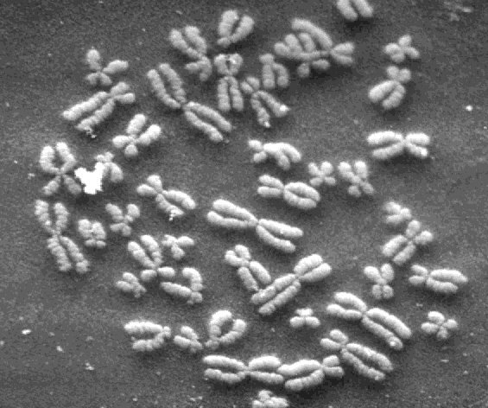
Structure of Chromosomes
Coiled threads of DNA and proteins.
Contains genes (hereditary information)
Must successfully divide for new cells to be made

Slide 12
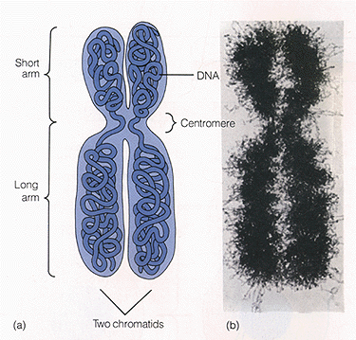
Structure of Chromosome
Chromatids: 2 identical copies
Of DNA that are connected to
Form a chromosome
Centromere: the area where chromatids are attached (usually at the middle of the chromatids)

Slide 13
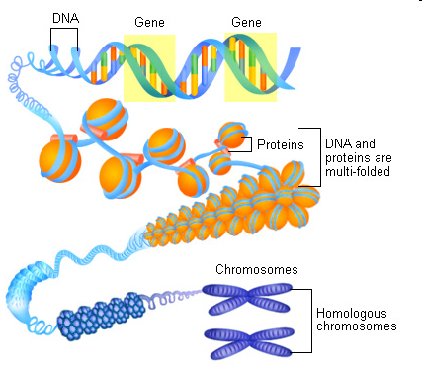

Slide 14
Chromosome #’s
The cells of every organism have a specific number of chromosomes
Cell Type | # of Chromosomes
Fruit Flies | 8
Carrots | 18
Human | 46

Slide 15
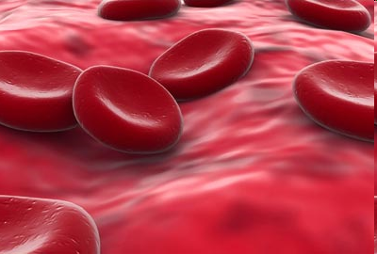
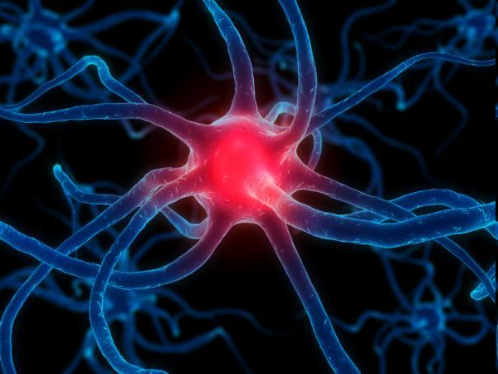
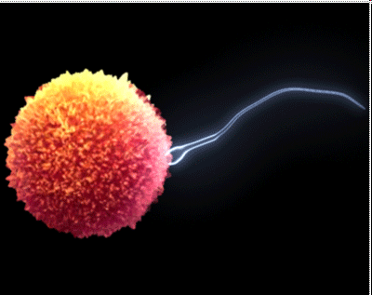
Diploid vs. Haploid Cells
Diploid Cells (2n) = 2 sets of chromosomes…one from each parent (Example: human body cell)
Haploid Cells (n)= only have 1 set of chromosomes (Example: Sperm or Egg Cell)
Notes:
Make sure to talk about sex chromosomes
Sometimes the most complex organism does not have the most chromosomes!

Slide 16
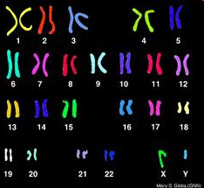
Types of Chromosomes
Sex chromosomes = determine the sex of an organism; either X or Y( xx= girl xy= boy)
Autosomes = all the other chromosomes in an organism
They hold the information for characteristics like hair color and eye color.
Humans have 44 autosome chromosomes.
Notes:
Ear hair
Female: XX
Male: XY

Slide 17
But why did I hear that there are 23 chromosomes?
There are 23 pairs.
Our cells are diploid meaning that the chromosomes are in pairs.
Our sex cells however are haploid meaning that they are not in pairs.
That means that there are only 23 chromosomes in these cells
To repeat!
Sex Cells – 23 chromosomes – no pairs – haploid
Every other cell - 46 chromosomes – 23 pairs – diploid

Slide 18
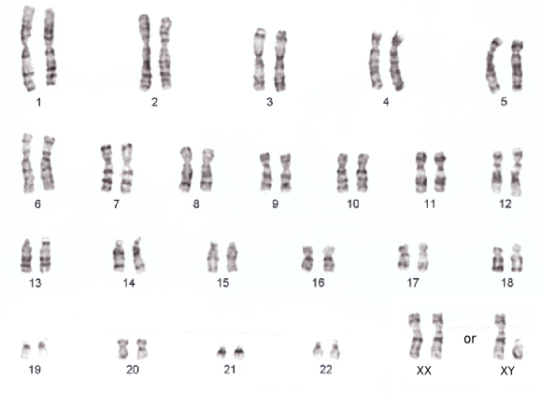
Karyotypes
Visual representation, or picture, of the chromosomes. They are arranged from big to small.

Slide 19
Now lets talk about cell division

Slide 20
Prokaryotes
In Prokaryotes, the cells go through BINARY FISSION
This is when the cell splits into two identical cells.
This means that the cells are asexual.
Let’s see it in action!

Slide 21
But wait…asexual?
Asexual means that the offspring came from one parent.
In the cell cycle, it means that two cells were not need to create a offspring.
Sexual reproduction means that two parents are need to produce an offspring.

Slide 22
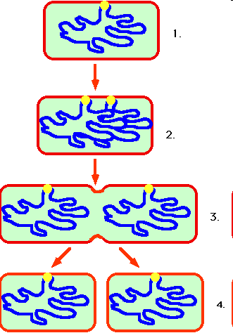
Cell Division in Prokaryotes
DNA is copied and divided into two cells
Creates two identical daughter cells
Process is called Binary Fission
Notes:
Chromosomes attached to inner membrane

Slide 23
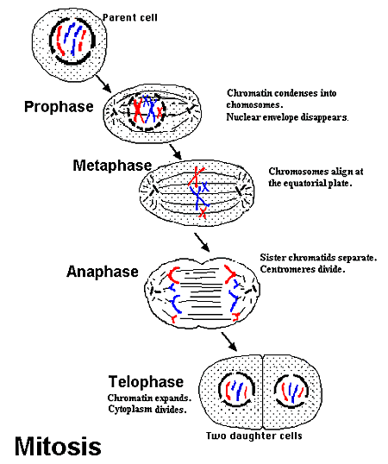
Cell Division or Mitosis
Before a cell gets too big, it splits into daughter cells.
The two daughter cells are identical to each other (they’re like twins!)

Slide 24
Eukaryotes
When Eukaryote cells divide, it is asexual as well.
In the cell cycle, there are two main phases.
Interphase
Cell Division

Slide 25
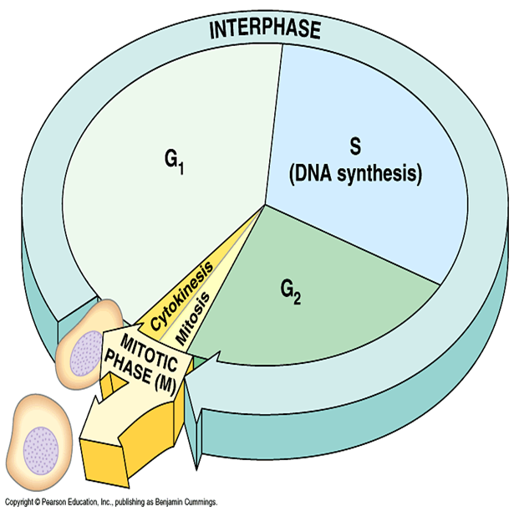
Interphase
This is the time between division
Cell spends about 90% of its life in this phase
Divided into 3 phases
G1 phase (growing and doing everyday activity)
S phase (DNA is copied – doubles the amount)
G2 phase ( Grows more and prepares to divide)

Slide 26
Life Spans of Human Cells
Cell Type | Life Span | Cell Division
Esophagus Lining | 2-3 Days | Yes
Sm. Intestine Lining | 1-2 Days | Yes
Lg. Intestine Lining | 6 Days | Yes
Red Blood Cells | 120 Days | No
White Blood Cells | 10 Days – Decades | Many don’t
Heart Muscle | Long Time | No
Skeletal Muscle | Long Time | No
Nerve Cells | Long Time | No

Slide 27
Questions to think about…
White blood cells help protect the body from infection/disease. How might their function relate to their life span?
10 hrs: common everyday germ
40 years: These cells recognize some bacteria/viruses your whole life and kill them

Slide 28
Questions to think about…
Based on the data, how are the consequences of injuries to the spine and heart similar to each other?
Can’t make new cells
Permanent damage

Slide 29
Questions to think about…
Suggest a hypothesis that explains the life spans of the lining of the esophagus, small intestine and large intestine.
Acid kills some cells
A lot of food passes thru them
Cells are easily damaged

Slide 30
Questions to think about…
Cancer is a disease related to cell life span and cell division. If cancer were added to the data table, predict what would be written under the columns “Life Span” and “Cell Division”
Life Span: long
Cell Division: rapid

Slide 31
Are cells always dividing?
NO!
G0 Phase
Cells will enter a G0 Phase.
Cells stop dividing and stop the process at the first checkpoint.
The cells then get old and die.
Most of our cells are in G0 phase including our nervous system.

Slide 32
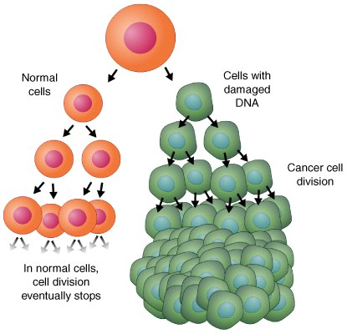
When it all goes wrong…
Sometimes, something causes the cell to uncontrollable divide.
This could lead to cancer.
Mutation in the cell that skips the first checkpoint.
Benign = Tumor NOT cancerous (harmless)
Malignant = Tumor IS cancerous (harmful)

