Slide 1
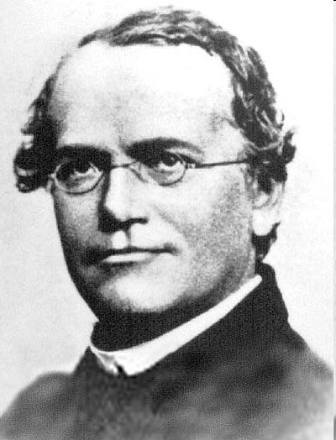
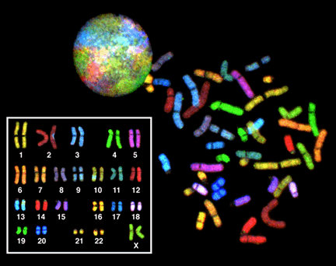
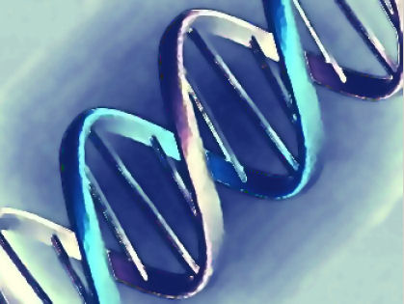
Mendelian Genetics Simple Patterns of Inheritance

Slide 2
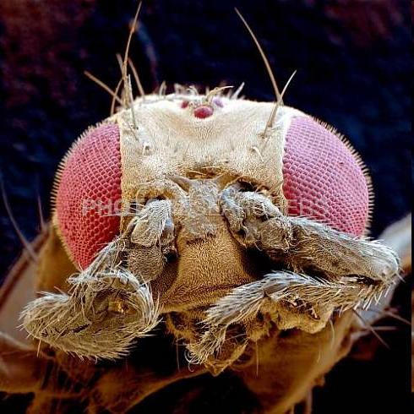
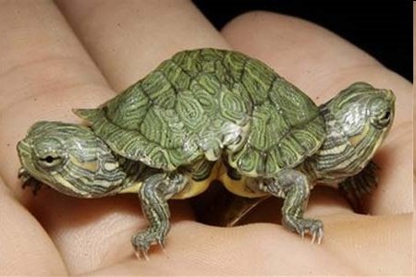
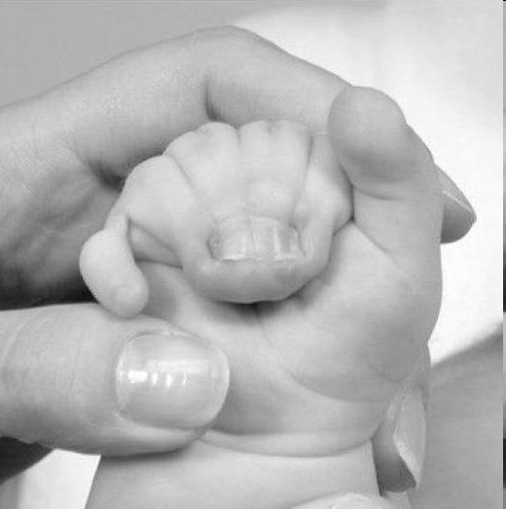
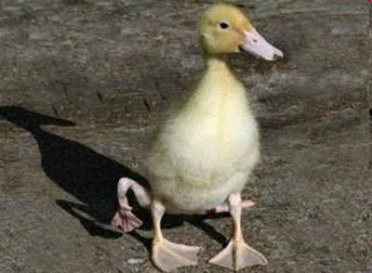
How does this happen?

Slide 3
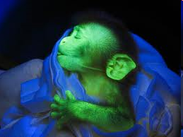
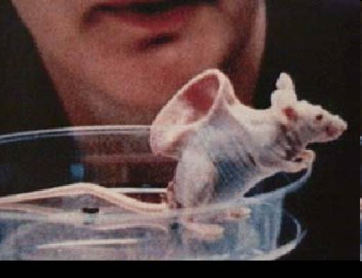
The answer?...GENETICS!

Slide 4
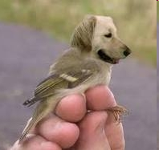
Not sure if I buy this one…

Slide 5
Part A: Mendel and Basic Genetics

Slide 6
Basic Genetics Human Traits
Your physical traits resemble those of your parents.
Genetics = the study of (heredity)how traits are passed from parents to offspring (children)
Heredity: passing of traits from parents to offspring
Trait: any characteristic that can be passed from parents to offspring

Slide 7
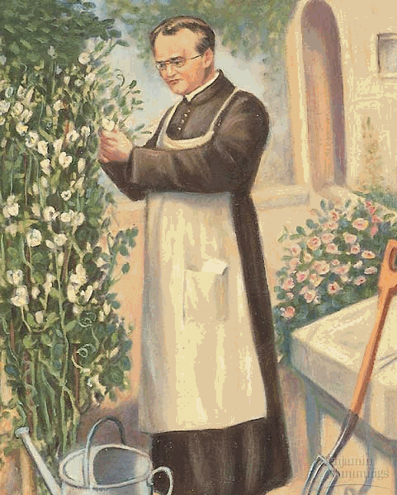
Gregor Johann Mendel
Gregor Mendel = an Austrian monk who worked with garden peas and was the “father of modern genetics”
Developed rules which accurately predict patterns of heredity
Lived from 1822-1884… His work wasn’t recognized until early 1900’s

Slide 8
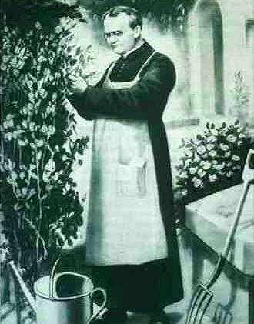
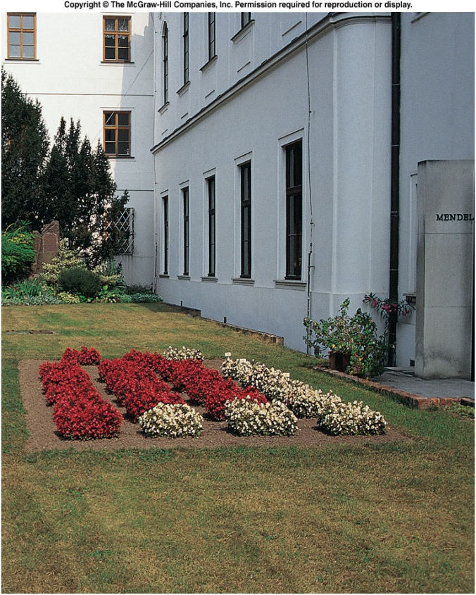
From 1856-1863, Mendel grew and tested 28,000 pea plants
He found that the offspring plants showed some parent traits
Mendel’s garden
In the Czech
Republic

Slide 9
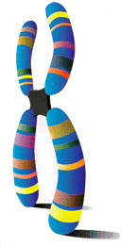
Mendel stated that physical traits (ex: eye color, hair color) were inherited as particles
Today we know that particles are actually chromosomes (super-coiled DNA)

Slide 10
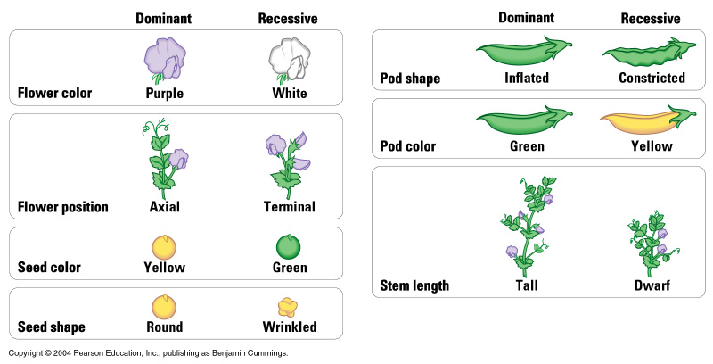
Mendel’s Experiments
Mendel looked at several different pea plants.
Example: plant height, seed color, flower color
WHY Pea Plants:
Many traits have two clearly different forms (no intermediate forms)
Mating can be easily controlled
Self-fertilization
Cross-fertilization
Small, grows easily, matures quickly & produces many offspring
Notes:
Male and female reproductive parts are enclosed in the same flower

Slide 11
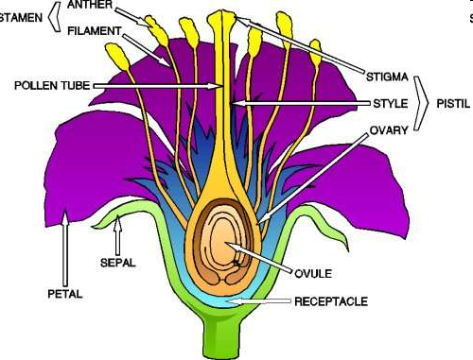
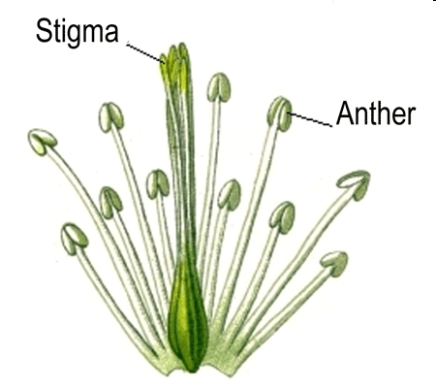
Mendel’s Methods
Carefully controlled flower pollination
Pollination = occurs when pollen grains are transferred from the anthers (male) to stigma (female)

Slide 12
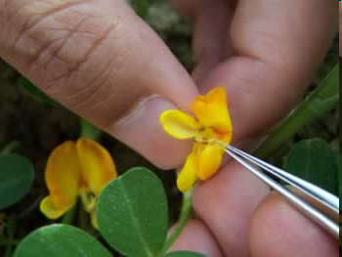
Pollination
Self-pollination = pollen transferred from anthers to stigma of same flower or another flower on same plant
Cross-pollination = involves flowers of two separate plants
Cross = mate or breed
two individuals
Notes:
Pea plants normally self-pollinate but cross pollination can be accomplished manually by removing anthers from a flower and manually transferring the anther of a flower on one plant to the stigma of a flower on another plant

Slide 13
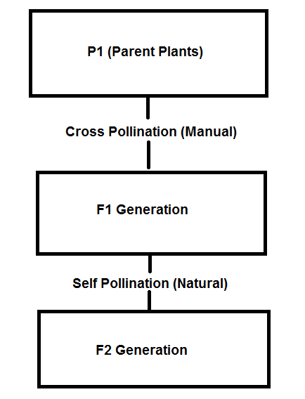
P1 = parental generation
F1 = offspring of P1 generation
F2 = offspring of F1 generation
Notes:
Transferred pollen from the anthers of a plant pure for one trait to the stigma of another plant pure for the contrasting trait
When the plants matured, he recorded the number of each type of offspring
F1 = first fillial generation

Slide 14
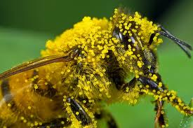
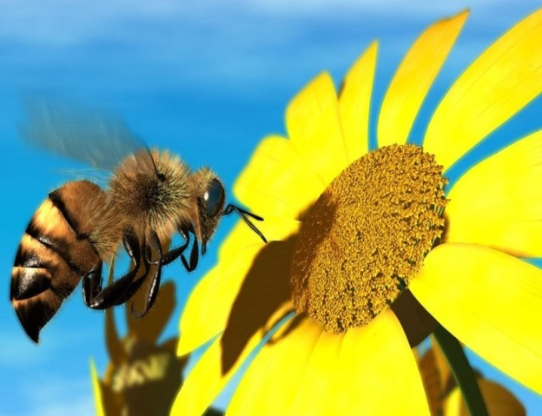
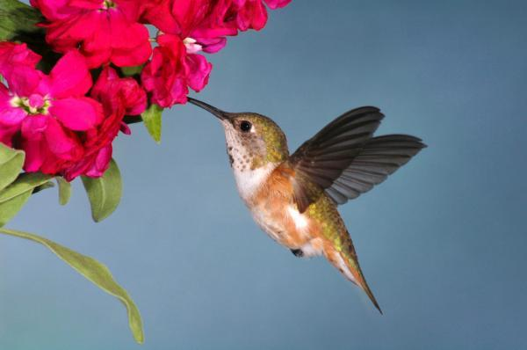
Nature’s Pollinators
Insects (bees)
Vertebrates (birds & bats)
Wind
Water

Slide 15
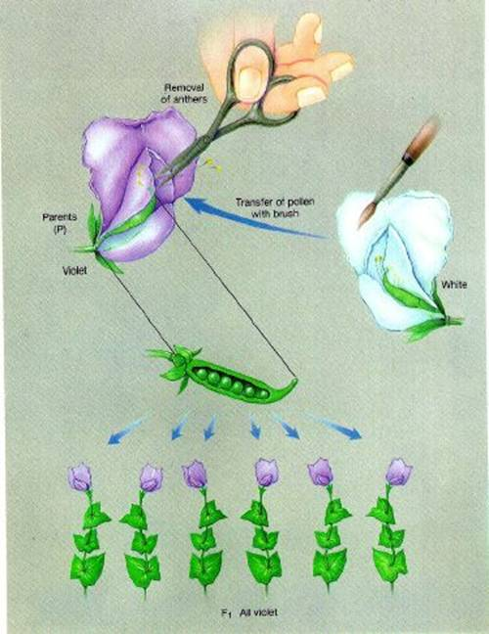
Mendel’s Observations: Traits are Expressed as Simple Ratios
First experiments involved monohybrid crosses
(example: flower color)
Monohybrid cross = a cross that involves one pair of contrasting traits
Notes:
Mendel’

Slide 16
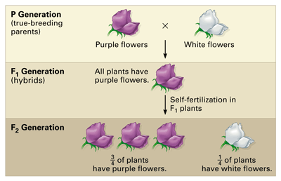
Mendel’s Experiments: Step #1
Self-pollinate each pea plant for several generations
True-breeding= all offspring display only one form of a particular trait
P generation = parental generation, the first two individuals crossed in a breeding experiment

Slide 17
Mendel’s Experiment: Step #2
Cross-pollinate the P generation plants with contrasting forms of a trait
F1 generation = the first filial generation, the offspring of the P generation
Characterize and count plants

Slide 18
Mendel’s Experiment: Step #3
Allow the F1 generation to self-pollinate
F2 generation = the second filial generation, the offspring of the F1 generation plants
Characterize and count plants

Slide 19
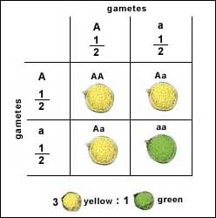
Mendel’s Results
F1 generation showed only one form of the trait (e.g. purple flowers)
The other form of the trait disappeared (e.g. white flowers)
Reappeared in the F2 generation
3:1 ratio of the plants in the F2 generation

Slide 20
Expressing Ratios: Mendel’s F2 Generation
705 purple-flowered plants; 224 white-flowered plants
Reduce the ratio to its simplest form:
705/224 = 3.15 Purple 224/224= 1 White
Ratio can be written in a few different ways:
3:1
3 to 1
3/1

Slide 21
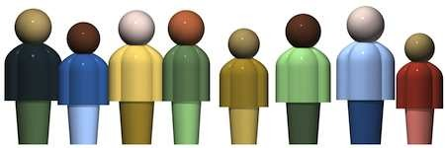
Are offspring simply a blend of their parents’ characteristics?
Before Mendel’s experiment: this was the theory (blending hypothesis)
Ex. Tall x Short = Medium Mendel’s Conclusion
Offspring have two genes for each trait (one gene from each gamete)

Slide 22
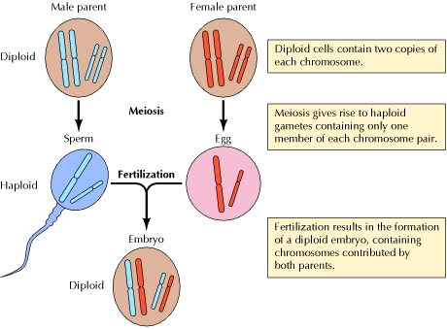
Mendel’s Hypotheses: Hypothesis #1
For each inherited trait, an individual has two copies of the gene
What Are Genes
Genes are short sections of chromosomes (DNA) that “code” for a certain trait.
One gene from each parent

Slide 23
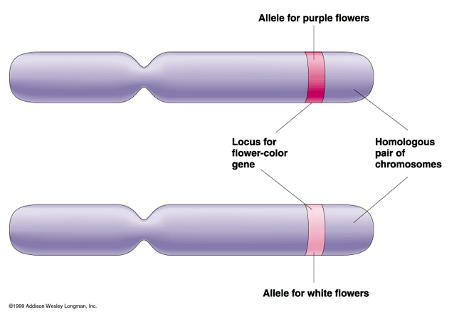
Mendel’s Hypotheses: Hypothesis #2
There are alternative versions of genes
Alleles = different versions of genes; an individual receives one allele from each parent

Slide 24
Mendel’s Hypotheses: Hypothesis #3
When two different alleles occur together, one may be completely expressed, while the other may have no observable effect on the organism’s appearance.
Because we have homologous chromosomes (1 from each parent)… we inherit 2 copies of each gene.
If we inherit two types of alleles…one may be dominant over the other…
What does this mean?

Slide 25
Inheritance of Alleles
Dominant = the expressed form of a trait (the stronger of the two- “masks” the other allele- usually represented by a capital letter)
Recessive = the trait which is not expressed when the dominant form of the trait is present (weaker of the two- is “masked” by the other allele- usually represented by a lowercase letter)

Slide 26
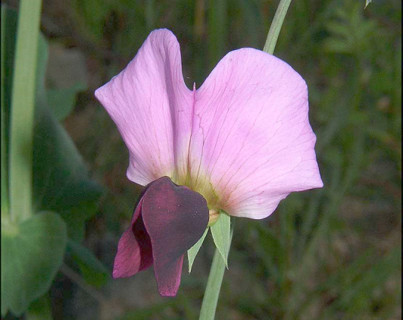
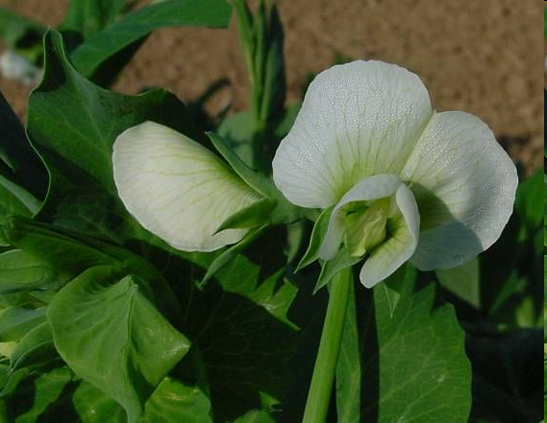
Dominant Allele: stronger of the two alleles, “masks” the other allele…usually represented by an uppercase letter
Ex: R stand for purple flower color
Recessive Allele: weaker of the two alleles…usually represented by a lowercase letter
Ex: r stands for white flower color

Slide 27
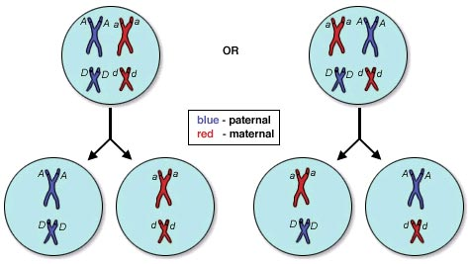
Mendel’s Hypotheses: Hypothesis #4
When gametes are formed, the alleles for each gene in an individual separate independently of one another.
Gametes = one allele for each inherited trait
Fertilization – each gamete contributes one allele

Slide 28
Different Genotypes
Homozygous = when an organism has two ALIKE alleles for a trait
RR = homozygous dominant
rr = homozygous recessive
Heterozygous = when an organism has two UNLIKE alleles for a trait
Rr = heterozygous

Slide 29
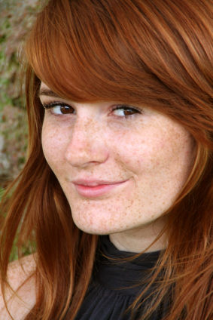
Heterozygous Alleles - Ff
Only the dominant allele is expressed
Recessive allele is present but not expressed
Example: Freckles
Freckles, F = Dominant allele
No Freckles, f = Recessive allele
Individuals who are heterozygous for freckles (Ff) have freckles

Slide 30
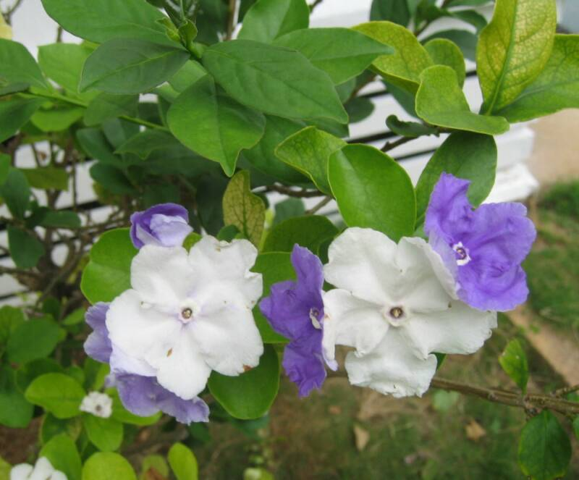
Say you have a plant with the following allele combinations for flower color. What flower color would you see?
Key…… R(Purple) and r(white)
RR → ________?
Rr → ________? rr → ________?

Slide 31
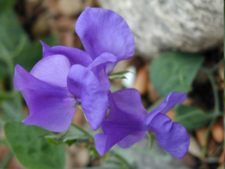
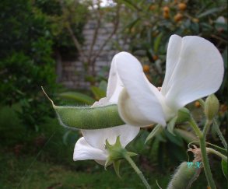
Examples
Genotype gene combination for a trait | Phenotype the physical trait that results from the genotype
RR | Purple Flowers
Rr | Purple Flowers
rr | White Flowers
Remember: Dominant Alleles → capital letters (Example: P)
Recessive Alleles → lowercase letters (Example: p)

Slide 32
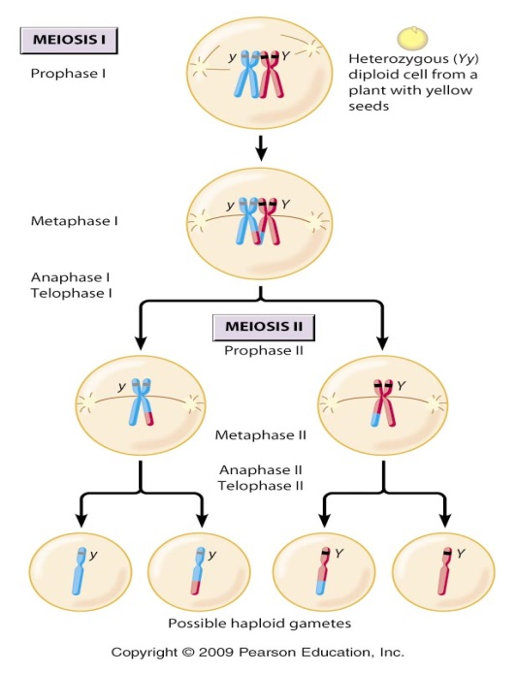
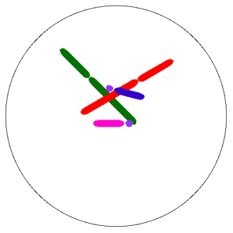
Mendel’s Laws of Heredity:
Law of Dominance: one allele can “mask” the other
Law of Segregation: the (homologous chromosomes)
two alleles for a trait segregate (separate) when gametes are formed

Slide 33
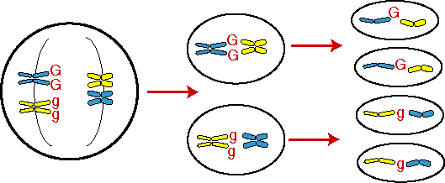
Mendel’s Laws of Heredity:
Law of Independent Assortment : the alleles of different genes separate independently of one another during gamete formation
Example: alleles for plant height separate independently of the alleles for flower color
Applies to:
Genes on different chromosomes
Genes that are far apart on the same chromosome
http://www.sumanasinc.com/webcontent/animations/content/independentassortment.html

Slide 34
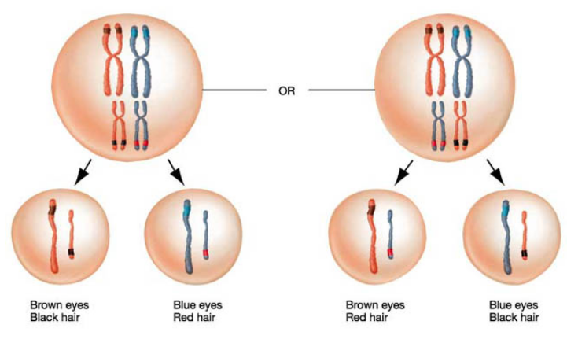
Remember… during meiosis homologous chromosomes separate!
Notes:
When gametes combine in fertilization, the offspring receives one allele for a given trait from each parent
During meiosis I, tetrads can line up two different ways before the homologs separate

Slide 35
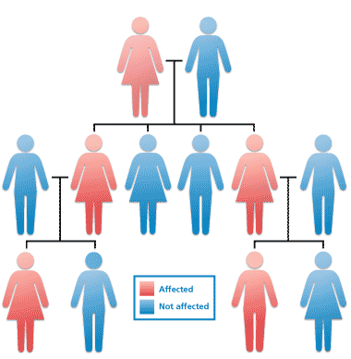
Punnett Squares & Probabilities

Slide 36
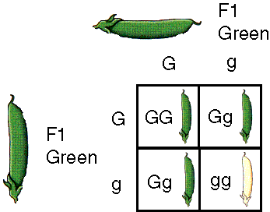
Punnett Squares: Predicting Expected Results in Crosses
Punnett Square = a diagram (tool) that predicts the expected outcome of a genetic cross by considering all possible combinations of gametes in the cross

Slide 37
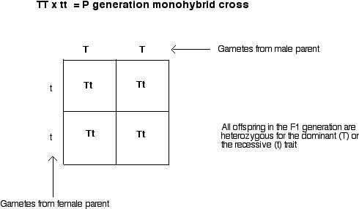
Punnett Squares
Possible gametes from one parent are written along the top of the square
Possible gametes from the other parent are written along the left side of the square
Letters inside the boxes = possible genotypes of the offspring

Slide 38
Part B: Genetic Crosses

Slide 39
Monohybrid Cross a cross between parents that involve ONE trait.
Example 1: Homozygous x Homozygous
Situation: One parent is homozygous for green pods(GG) and the other parent is homozygous for yellow pods(gg).
Parent Genotypes: GG X gg
Offspring Ratios
-Genotype: 100% Gg (4 Gg)
-Phenotype: 100% green
(4green)
G
G
g
Gg
Gg
g
Gg
Gg

Slide 40
Monohybrid Cross a cross between parents that involve ONE trait.
Example 2: Homozygous X Heterozygous
Situation: One parent is homozygous for green pods, and the other parent is heterozygous.
Parent Genotypes: GG x Gg
Offspring Ratios
-Genotype: 50% GG, 50% Gg
(2GG : 2Gg)
-Phenotype: 100% green
(4 green)
G
G
G
GG
GG
g
Gg
Gg

Slide 41
Monohybrid Cross a cross between parents that involve ONE trait
Example 3: Heterozygous X Heterozygous
Situation: Both parents are heterozygous for pod color
Parent Genotypes: Gg x Gg
Offspring Ratios
-Genotype: 25% GG
50% Gg
25% gg
(1GG: 2Gg: 1gg)
-Phenotype: 75% green, 25% yellow (3green : 1yellow)
g
G
G
GG
Gg
g
Gg
gg

Slide 42
Example 4: Testcross
Testcross = cross between an unknown dominant genotype (could be homozygous or heterozygous) and a homozygous recessive genotype
Result: find out whether the dominant genotype is homozygous or heterozygous

Slide 43
Example 4: Testcross
Situation: a green-podded plant with an unknown genotype is crossed with a yellow-podded plant. The offspring genotype ratios are given below.
Genotype Ratio: 50% Gg, 50% gg
Question: What was the genotype of the parent green-podded plant? Gg
?
?
Gg
gg
g
g
Gg
gg
Notes:
Could be given genotype or phenotype ratio.

Slide 44
Probabilities Can Also Predict the Expected Results of Crosses
Probability = the likelihood that a specific event will occur
Words – 1 out of 1
Decimal – 1
Percentage – 100%
Fraction – 1/1
Probability = number of one kind of possible outcome ÷ total number of all possible outcomes

