Slide 1
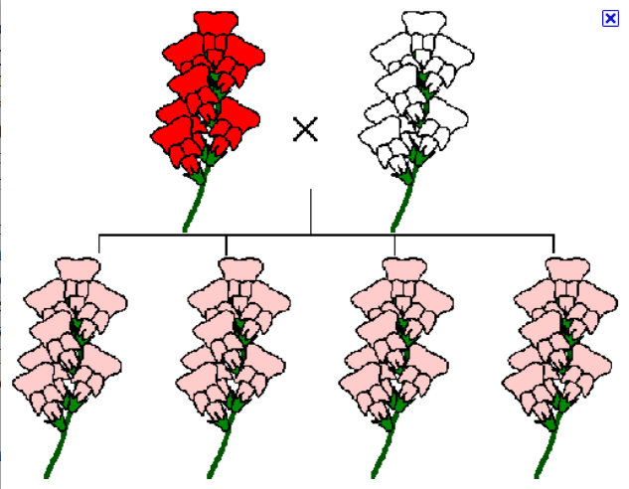
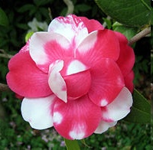
Exceptions to Simple Dominance
Incomplete Dominance: alleles “blend” (ex: pink flowers)
Codominance: both alleles show up in their “pure form” (ex: red and white splotchy flowers)
Notes:
Incomplete dominance is also called blending inheritance

Slide 2
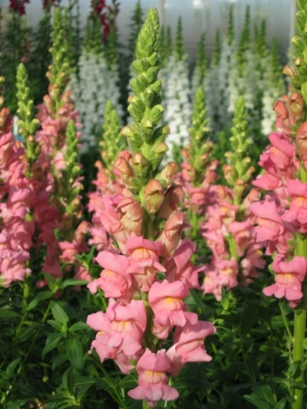
Example 5: Incomplete Dominance
Situation: If red and white flower alleles
show incomplete dominance, what
offspring ratios will you see if you cross a
Red-flowered plant with a
white-flowered plant?
Parent Genotypes: RR x rr
Offspring Ratios
-Genotype: 100% Rr
-Phenotype: 100% Pink
R
R
r
Rr
Rr
r
Rr
Rr

Slide 3
Example 6: Codominance
Situation: If red and white horse alleles show
codominance, what offspring ratios will you see if you
cross a red horse with a white horse?
Parent Genotypes: RR x rr
Offspring Ratios
-Genotype: 100% Rr
-Phenotype: 100% Roan
R
R
r
Rr
Rr
r
Rr
Rr

Slide 4
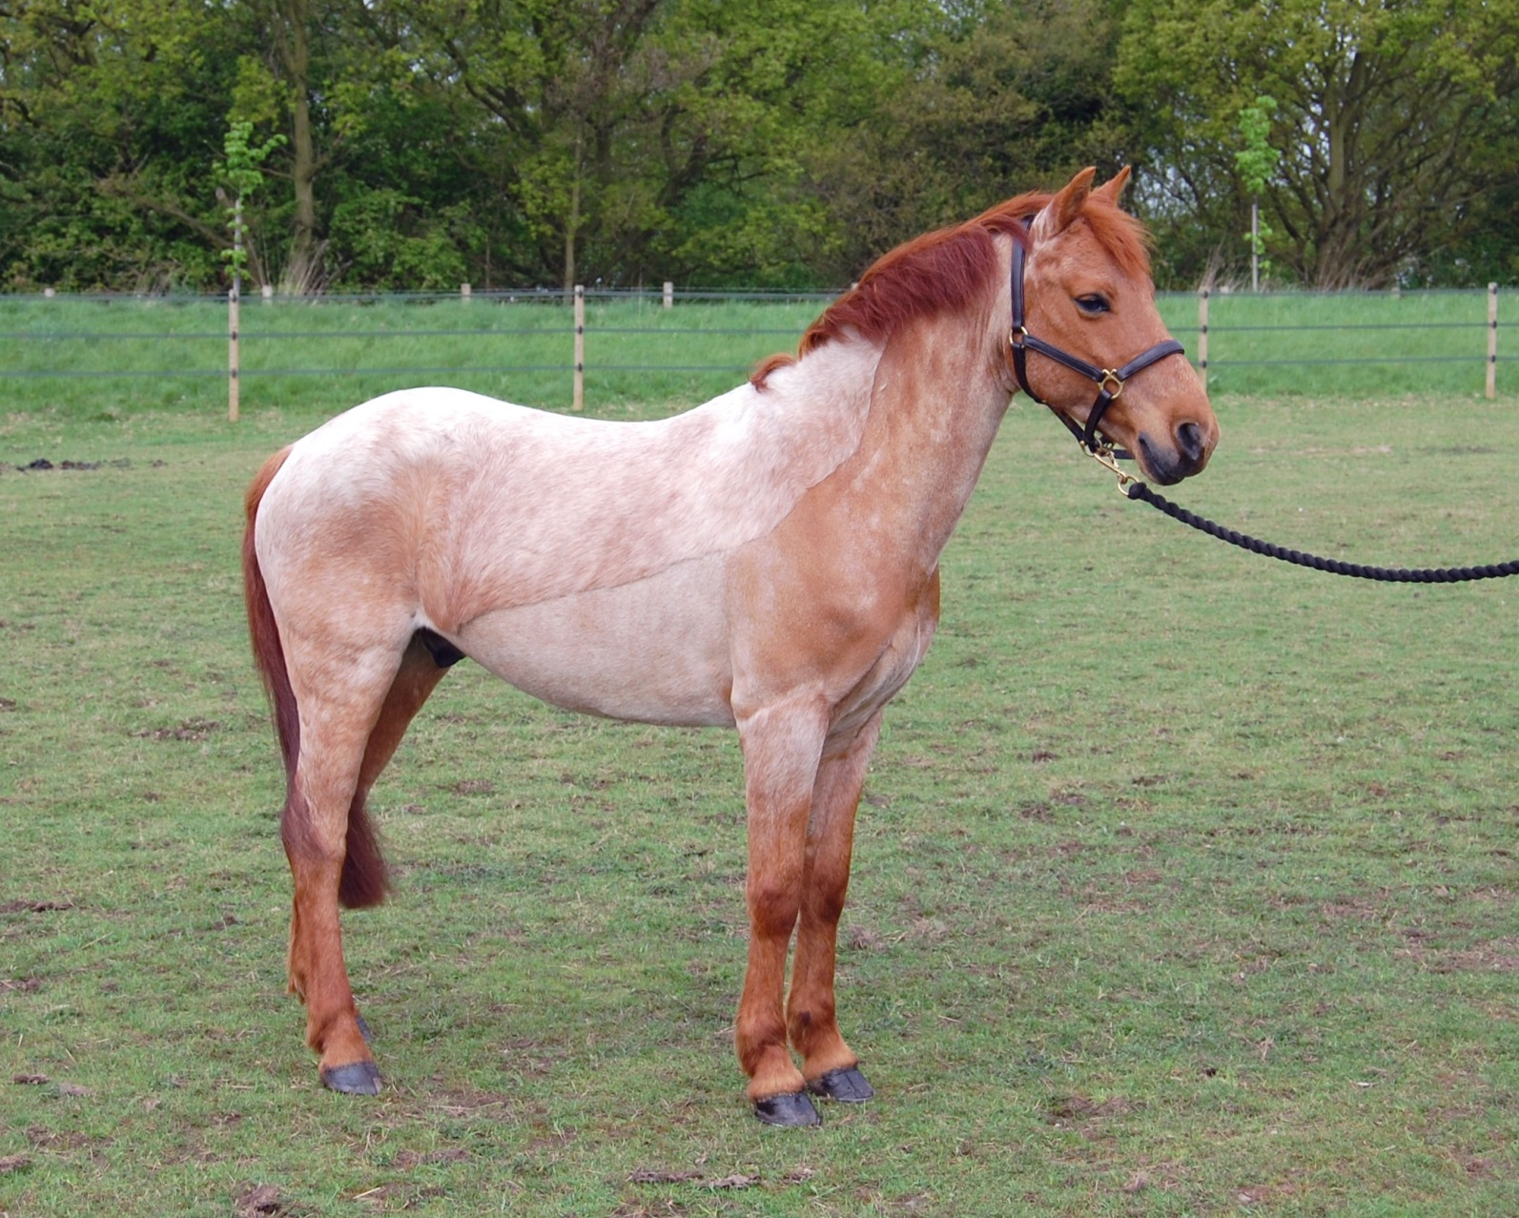
Roan Horse - Heterozygous

Slide 5
Traits Controlled By Genes With Three or More Alleles
Example 7: Blood Types (Multiple Alleles and Codominance)
Sometimes there are more than two alleles for a particular gene. We call this inheritance pattern multiple alleles. For example, there are three alleles controlling human blood type—A, B, and O.
I^{A} and I^{B} = Dominant to i;
A & B are two
carbohydrates on the
surface of red blood cells
i = Recessive
When I^{A} and I^{B} are present together = Codominant
Allele | Symbol
A | I^{A}
B | I^{B}
O | i

Slide 6
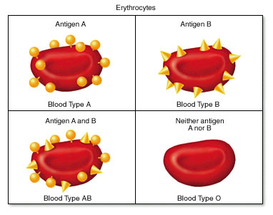

Slide 7
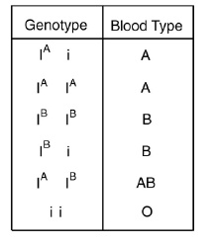
Because the A and B alleles are both dominant to O, the following genotypes will produce the following phenotypes:
Genotype | Phenotype
AA | Blood Type A
AO | Blood Type A
BB | Blood Type B
BO | Blood Type B
OO | Blood Type O

Slide 8
The A and B alleles are codominant to one another. Remember, codominance occurs when both alleles are expressed in their pure form. In this case, that means that A and B type proteins are both found on the surface of the red blood cells in individuals who have the genotype AB. Genotype AB corresponds to the blood type AB.
Genotype | Phenotype
AB | Blood Type AB

Slide 9
Genetics of Blood type
pheno-type | genotype | antigen on RBC | antibodies in blood | donation status
A | I^{A} I^{A or} I^{A} i | type A antigens on surface of RBC | anti-B antibodies | __
B | I^{B} I^{B or} I^{B} i | type B antigens on surface of RBC | anti-A antibodies | __
AB | I^{A} I^{B} | both type A & type B antigens on surface of RBC | no antibodies | universal recipient
O | i i | no antigens on surface of RBC | anti-A & anti-B antibodies | universal donor

Slide 10
Situation: If two parents with blood type AB have children, what offspring ratios will you see?
Parent Genotypes:
Offspring Ratios
-Genotype:
-Phenotype

Slide 11
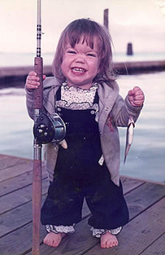
Inheritance pattern of Achondroplasia
Aa x aa
Aa x Aa
dominant inheritance
a
a
A
a

A
Aa
Aa
A
AA
Aa
dwarf
dwarf
lethal
a
aa
aa
a
Aa
aa
50% dwarf:50% normal or 1:1
67% dwarf:33% normal or 2:1

Slide 12
Dihybrid Crosses
Dihybrid Crosses: a cross between individuals that involves two traits (e.g., pod color and plant height)
Tall = H, Short = h…. Green = G, Yellow = g
Example:
1) Parent 1: HHGG → Tall, Green
2) Parent 2: hhgg → Short, Yellow

Slide 13
Finding the Gametes for Dihybrid Crosses
Remember, each gamete must have ONE COPY of the two genes
To find possible gametes for each parent, use the FOIL method
(x + 3)(x + 4) =
x² + 4x + 3x +12

Slide 14
FirstOuterInnerLast
RrGg
STEP 4

Slide 15
Homozygous X Homozygous
Possible Gametes:
HG
HG
HG
HG
Parent 1: H H G G
Parent 2: h h g g
Possible Gametes:
hg
hg
hg
hg

Slide 16
Homozygous x Homozygous
Parent Genotypes: HHGG x hhgg
HG
HG
HG
HG
Offspring Ratios
-Genotype:
100% HhGg
-Phenotype:
100% Tall +
Green
hg
HhGg
HhGg
HhGg
HhGg
hg
HhGg
HhGg
HhGg
HhGg
hg
HhGg
HhGg
HhGg
HhGg
hg
HhGg
HhGg
HhGg
HhGg

Slide 17
Another Example: Heterozygous x Heterozygous
Possible Gametes:
HG
Hg
hG
hg
Parent 1: H h G g
Parent 2: H h G g
Possible Gametes:
HG
Hg
hG
hg

Slide 18
Heterozygous x Heterozygous
Parent Genotypes: HhGg x HhGg
Hg
hG
hg
HG
Offspring Ratios
-Genotype: too complicated!
-Phenotype:
Next Slide!
HG
HHGG
HHGg
HhGG
HhGg
Hg
HHGg
HHgg
HhGg
Hhgg
hG
HhGG
HhGg
hhGG
hhGg
hg
HhGg
Hhgg
hhGg
hhgg

Slide 19
Another Example: Heterozygous x Heterozygous
Parent Genotypes: HhGg x HhGg
Phenotype:
9: 3: 3: 1
9 Tall, Green
3 Tall, Yellow
3 Short, Green
1 Short, Yellow
Hg
hG
hg
HG
HG
HHGG
HHGg
HhGG
HhGg
Hg
HHGg
HHgg
HhGg
Hhgg
hG
HhGG
HhGg
hhGG
hhGg
hg
HhGg
Hhgg
hhGg
hhgg

Slide 20
Question: How many gametes will be produced for the following allele arrangements?
Remember: 2^{n} (n = # of heterozygotes)
1. RrYy
2. AaBbCCDd
3. MmNnOoPPQQRrssTtQq

Slide 21
Answer:
1. RrYy: 2^{n} = 2² = 4 gametes
RY Ry rY ry
2. AaBbCCDd: 2^{n} = 2³ = 8 gametes
ABCD ABCd AbCD AbCd
aBCD aBCd abCD abCD
3. MmNnOoPPQQRrssTtQq: 2^{n} = 2⁶ = 64 gametes

