Slide 1
Types of Cellular Transport
Active Transport
cell does use energy
Proteins transport substances against concentration gradient (low → high conc.)
Protein Pumps
Endocytosis
Exocytosis
This is gonna be hard work!!
high
low
Notes:
1

Slide 2
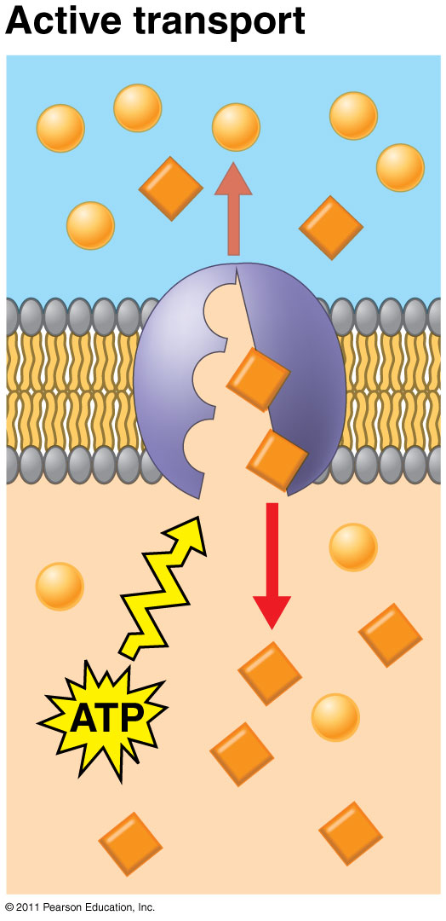
Active Transport
Requires ENERGY (ATP)
Proteins transport substances against concentration gradient (low → high conc.)
Eg. Na⁺/K⁺ pump, proton pump

Slide 3
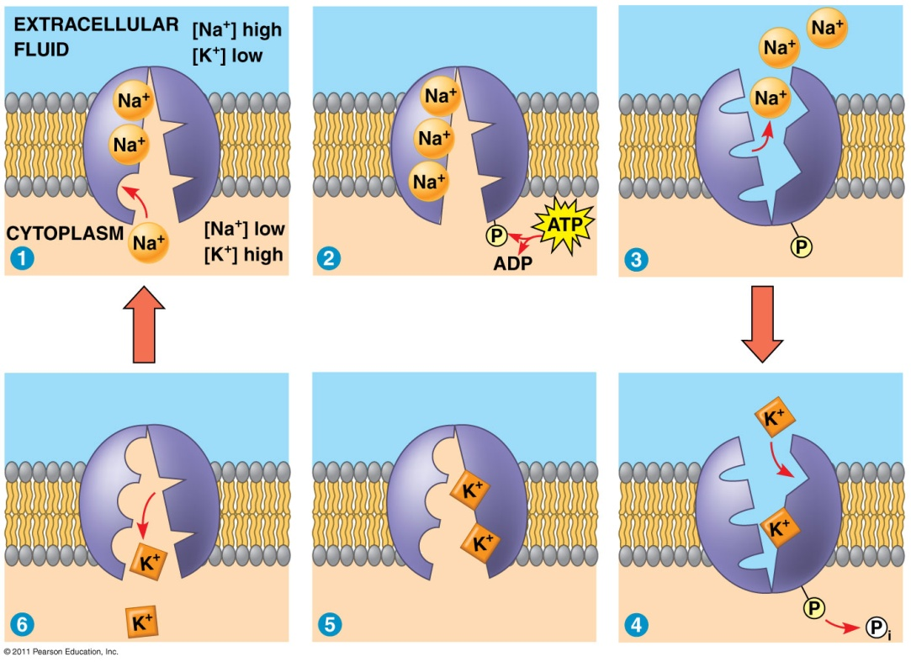
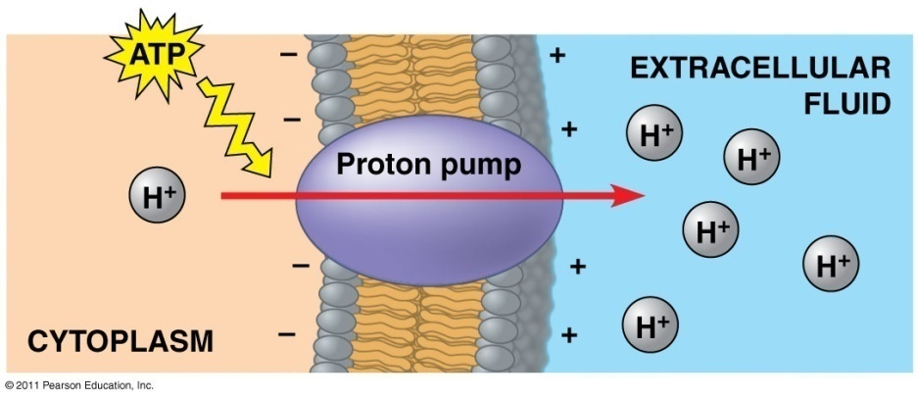
Electrogenic Pumps: generate voltage across membrane
Na⁺/K⁺ Pump
Proton Pump
Pump Na⁺ out, K⁺ into cell
Nerve transmission
Push protons (H⁺) across membrane
Eg. mitochondria (ATP production)

Slide 4
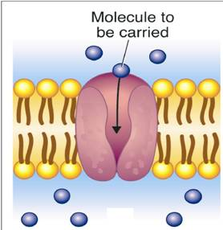
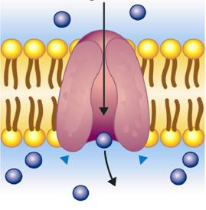
Active Transport
Molecular Transport
Molecule to be carried
Active Transport
Notes:
Active transport of particles against a concentration difference requires transport proteins and energy.

Slide 5
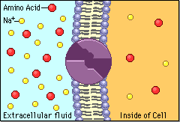
Types of Active Transport
Sodium Potassium Pumps (Active Transport using proteins)
Protein Pumps -transport proteins that require energy to do work
Example: Sodium / Potassium Pumps are important in nerve responses.
Protein changes shape to move molecules: this requires energy!
Notes:
5

Slide 6
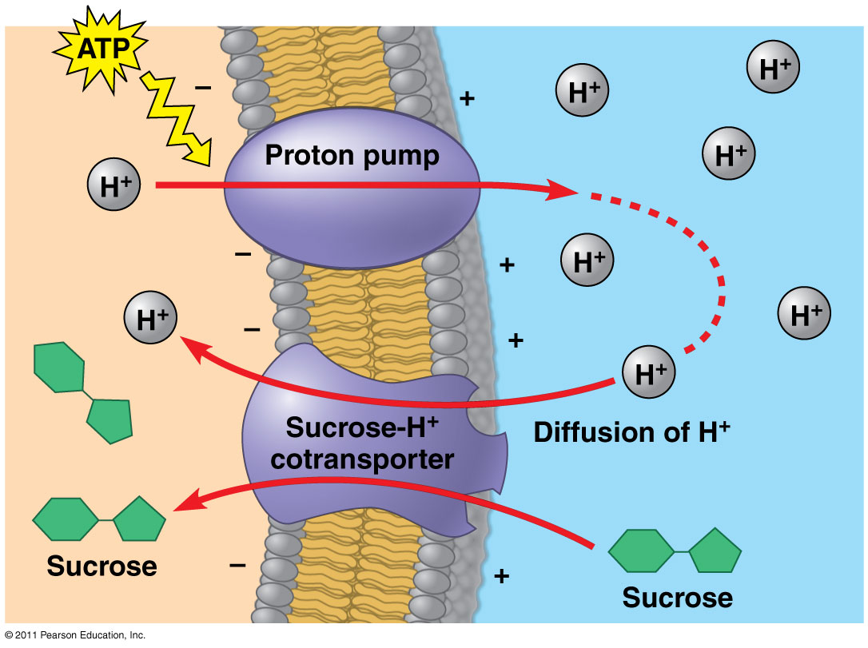
Cotransport: membrane protein enables “downhill” diffusion of one solute to drive “uphill” transport of other
Eg. sucrose-H⁺ cotransporter (sugar-loading in plants)

Slide 7
Passive vs. Active Transport
Little or no Energy
High → low concentrations
DOWN the concentration gradient
eg. diffusion, osmosis, facilitated diffusion (w/transport protein)
Requires Energy (ATP)
Low → high concentrations
AGAINST the concentration gradient
eg. pumps, exo/endocytosis

Slide 8
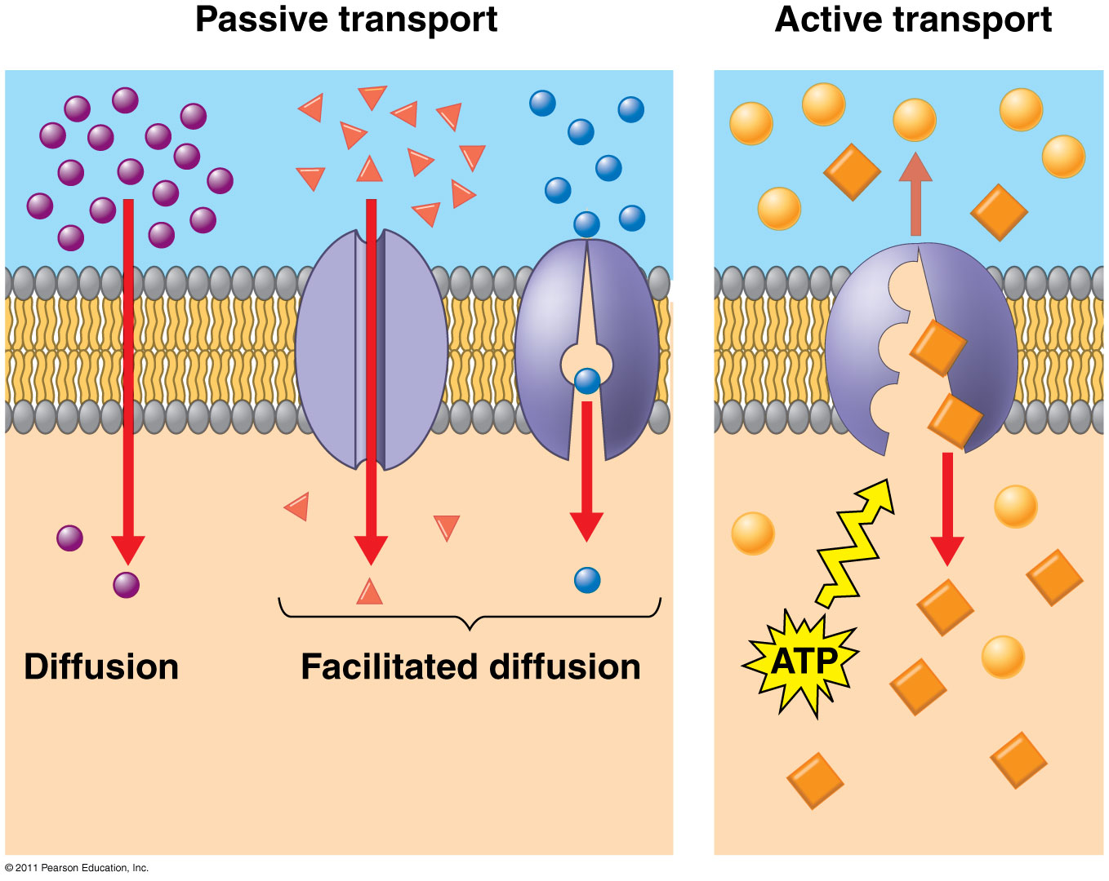

Slide 9
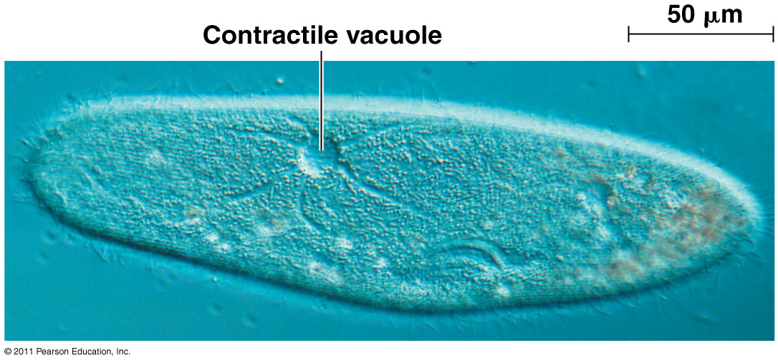
Osmoregulation
Control solute & water balance
Contractile vacuole: “bilge pump” forces out fresh water as it enters by osmosis
Eg. paramecium caudatum – freshwater protist

Slide 10
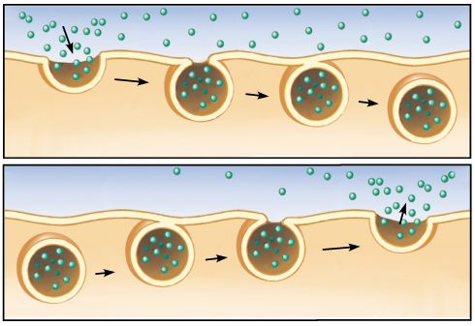
Bulk Transport
Transport of proteins, polysaccharides, large molecules
Endocytosis: take in macromolecules, form new vesicles This is how white blood cells eat bacteria!
Exocytosis: vesicles fuse with cell membrane, expel contents. Cell changes shape – requires energy
EX: Hormones or wastes released from cell
Endocytosis & Exocytosis animations

Slide 11
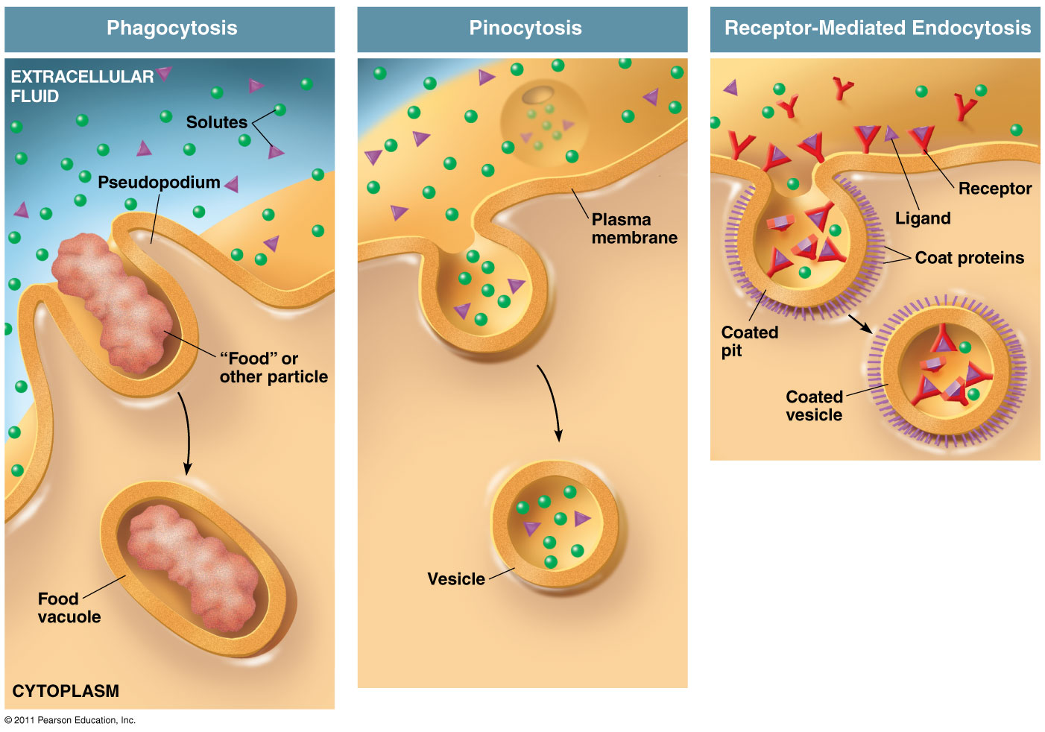
Types of Endocytosis
Phagocytosis:
“cellular eating” - solids
Pinocytosis:
“cellular drinking” - fluids
Active Transport
Receptor-Mediated Endocytosis:
Ligands bind to specific receptors on cell surface

