Slide 1
Warmup
How many games are played in the NCAA tournament?
Assuming predicting the winner is a coinflip, what are the odds of having a perfect bracket?
Assuming you know basketball and can predict with 90% accuracy, what are the odds of having a perfect bracket?

Slide 2
Exponents
63 games played
(1/2)*(1/2)*(1/2)… 63 times
=(1/2)^63
=1 in 9.22*10^18 (1 in 9,223,372,000,000,000,000)
Or 0.0000000000000000001 (1.08*10^-19)
90% accuracy = 0.9*0.9 63 times = 0.9^63= 0.0013 or 1/763
Even with 99% accuracy your odds would only be 1/1.88

Slide 3
Agenda
Population Ecology
Study time
Population Ecology Study Guide
Population Growth Formulas Reading/Questions
Review MC or Free Response from Unit Test\
Planet Earth?

Slide 4
Population Ecology
How Individuals of One Species Interact

Slide 5
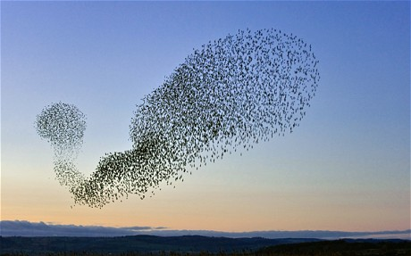
What is a Population?
Group of individuals of same species living together

Slide 6
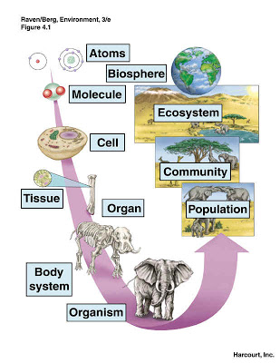
Levels of Structure
Atom
Molecule
Organelle
Cell
Tissue
Organ
Organ System
Organism
Population
Community
Ecosystem
Biosphere

Slide 7
Members of a Population Affect Each Other in Many Ways
Beneficial
Harmful
Help care for young
Help find food
Help protect individuals as a group
Signal when danger is near
Share living spaces (i.e. hives or nests)
Sexual reproduction
Competition
For food
For mates
For resources
Can spread diseases
Can destroy environment

Slide 8
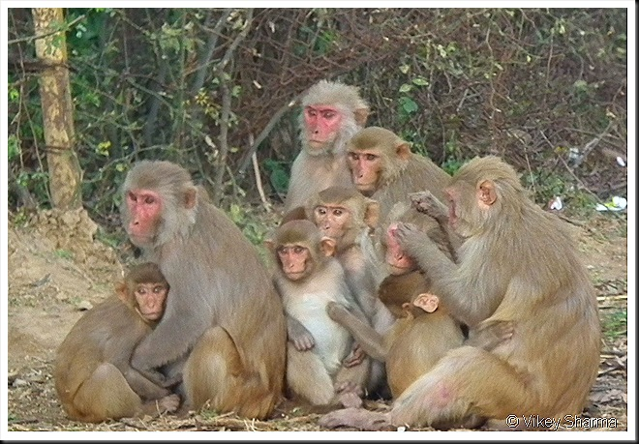
Monkeys Caring for Young

Slide 9
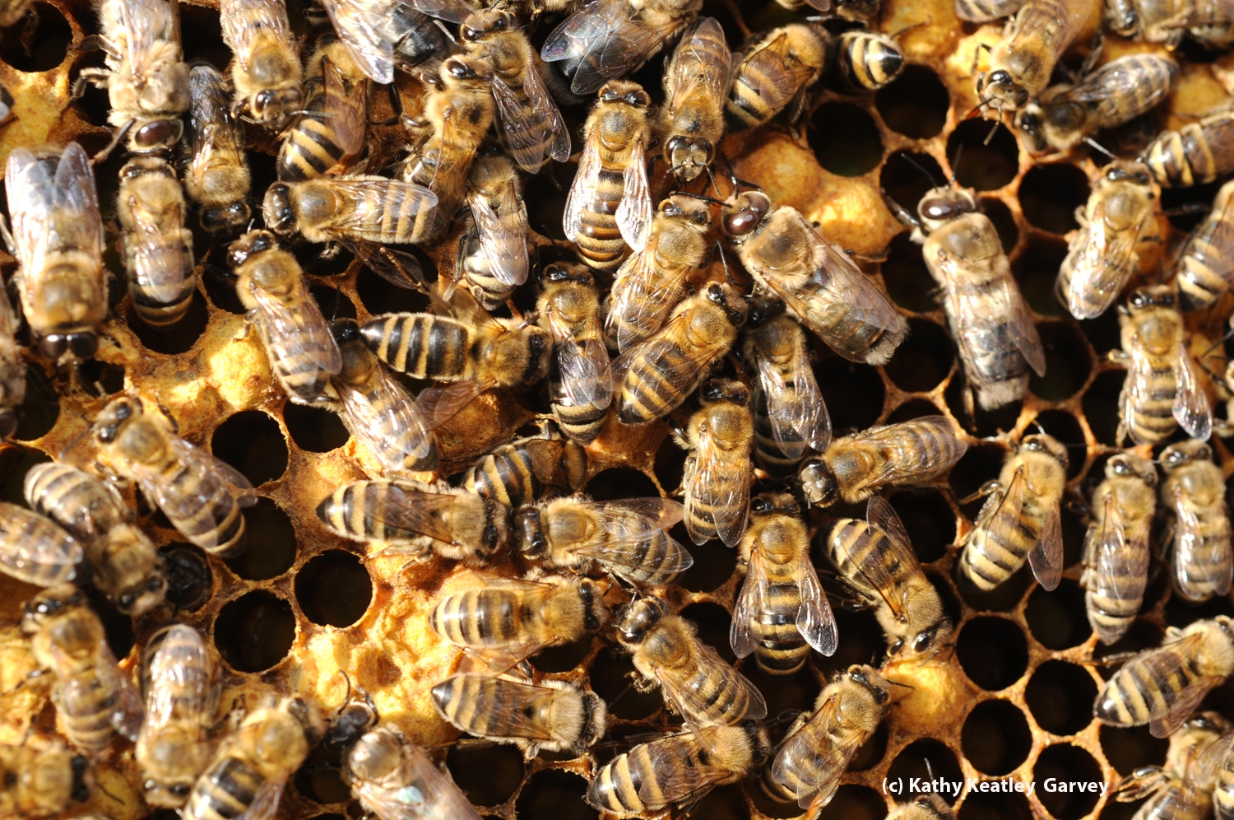
Bees Take Care of Queen’s Young

Slide 10
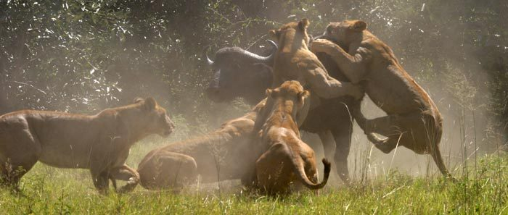
Lions Hunting Together

Slide 11
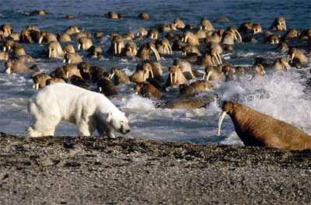
Walruses Defend Themselves

Slide 12
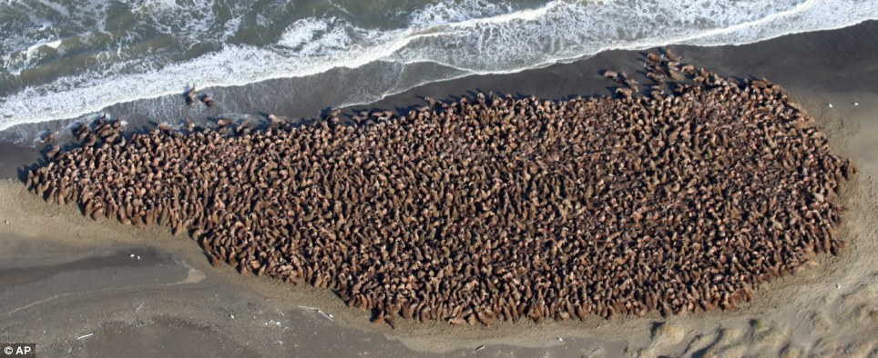
Walruses Defend Themselves

Slide 13
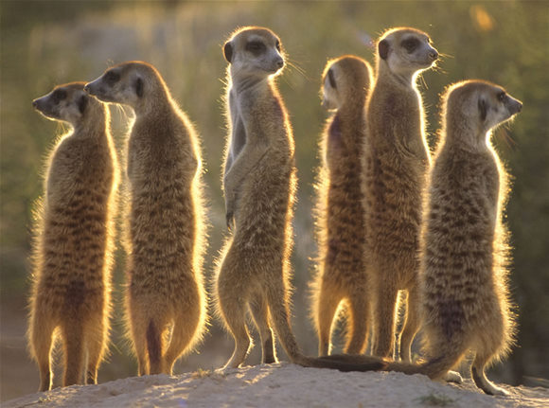
Meerkats Warn of Predators

Slide 14
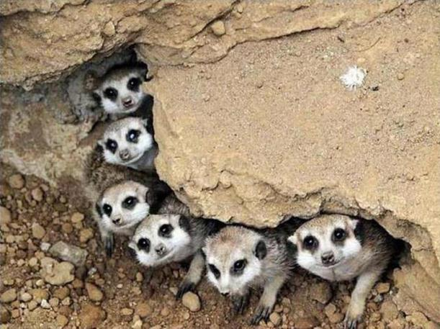
So Other Meerkats Can Hide

Slide 15
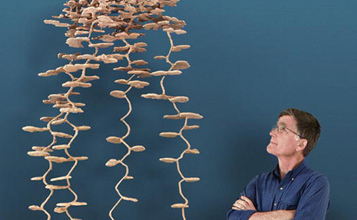
Complex Ant Nest

Slide 16
Plants Compete for Sunlight

Slide 17
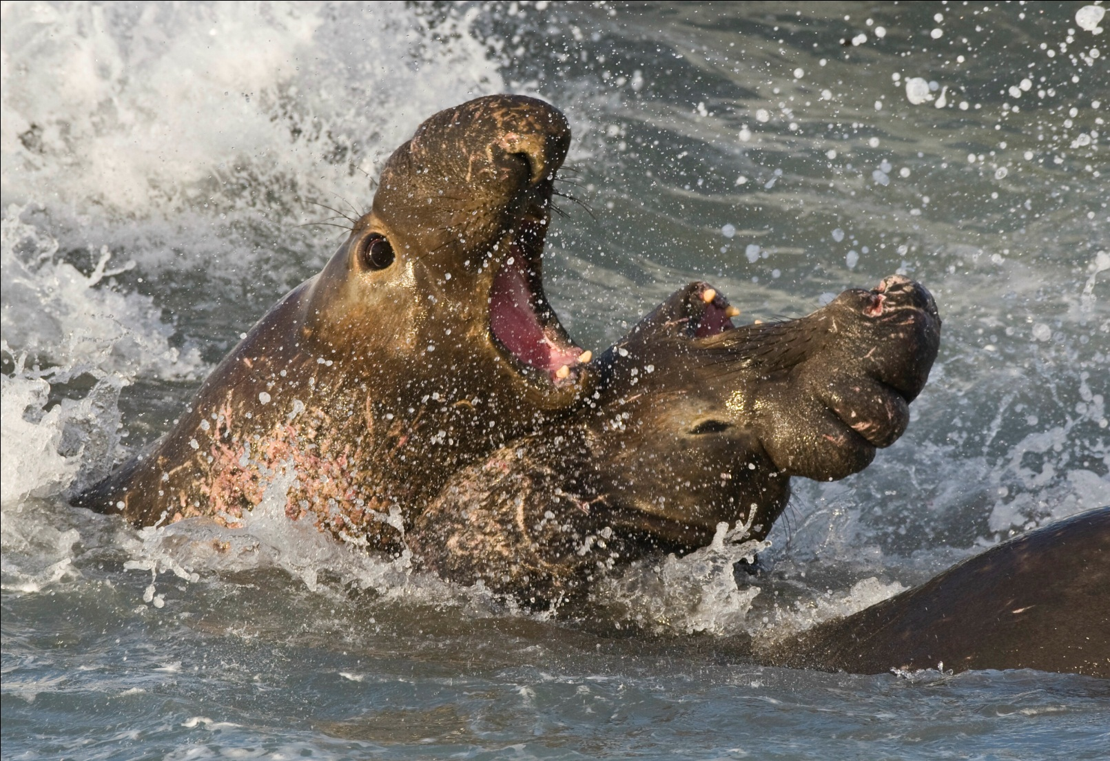
Elephant Seals Fight for Mates

Slide 18
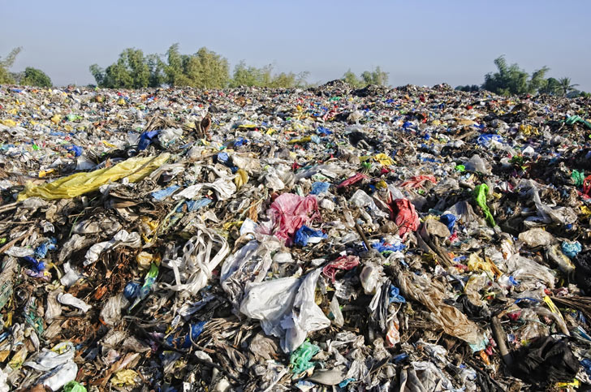
Waste Buildup in India

Slide 19
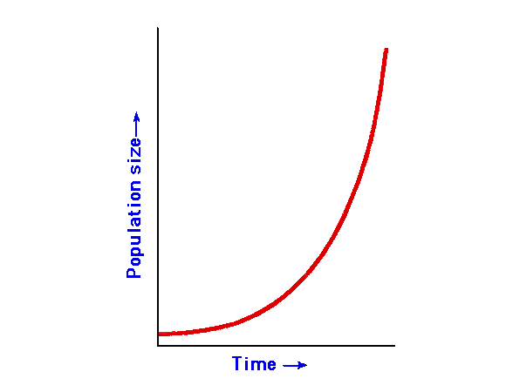
Growth of Populations
Under ideal conditions is always exponential
But there is always a maximum population that resources can sustain
Carrying Capacity

Slide 20
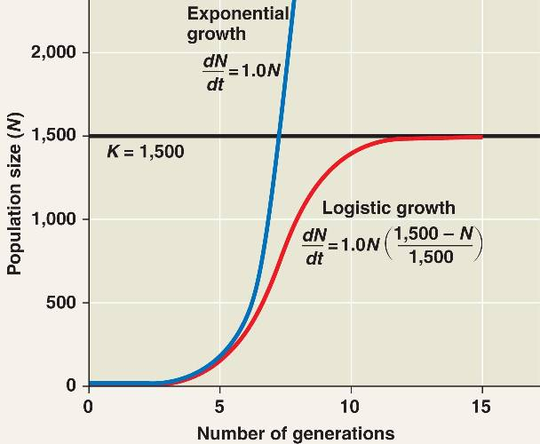
Logistic Growth
As a population gets bigger there are more limits on growth
Most populations tend to stop growing after a while due to density-dependent limiting factors

Slide 21
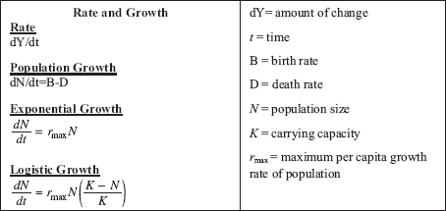
Calculating Growth
E.g. Human population is around 7 Billion with a growth rate of 1.1% So in a year the population will increase by around 0.011*7 Billion or 77 million people

Slide 22
Logistic v. Exponential
Exponential- growth continues indefinitely
Logistic growth – what happens as N approaches K?

Slide 23
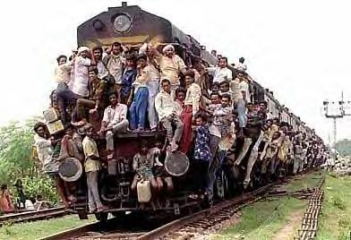
Density-Dependent Limiting Factors
As population increases there is more:
Competition for resources (food, space, water etc.)
Prevalence of disease as wastes build up
Prevalence of predators as their population grows larger

Slide 24
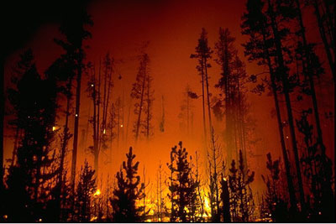
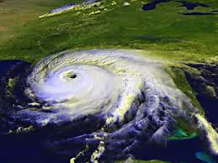
Density-Independent Limiting Factors
Environmental Catastrophes
E.g. forest fires, earthquakes, tornadoes, hurricanes all can “reset” populations

Slide 25
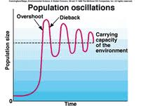
Population May Stabilize Around the Carrying Capacity
Carrying capacity = max population the environment can hold

Slide 26
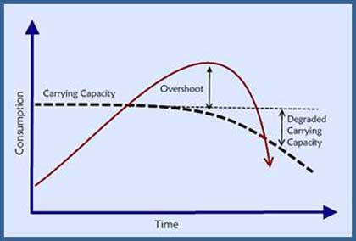
If Population Growth Doesn’t Slow Down…
The population usually destroys its resources and crashes
May lower the carrying capacity

Slide 27
Population Strategies
R-STRATEGIst
K sTRATEGIST
Many offspring
Short gestational period
Reproduce often
Very little, if any, parenting
One or a few offspring
Longer gestational periods
Few reproductive episodes
More focus on parenting

Slide 28
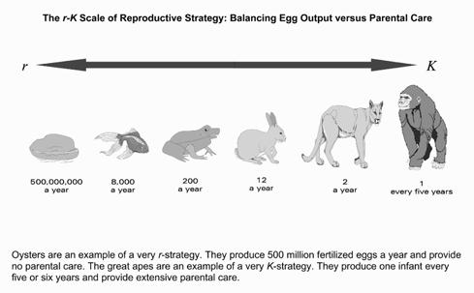
A Continuum

Slide 29
When is each beneficial?
R-Strategist
K-Strategist
New environment, little competition
Reproduce quickly and move on
Stable environment, competition builds up
Success in the long haul

Slide 30
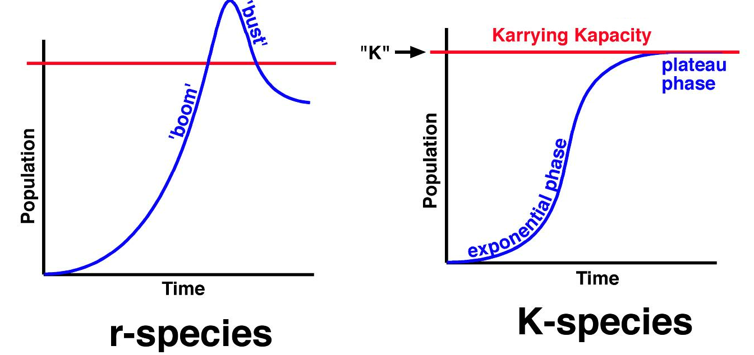
Growth Curves
R-strategist
K-Strategist
Exponential, boom-bust
Logistic

Slide 31
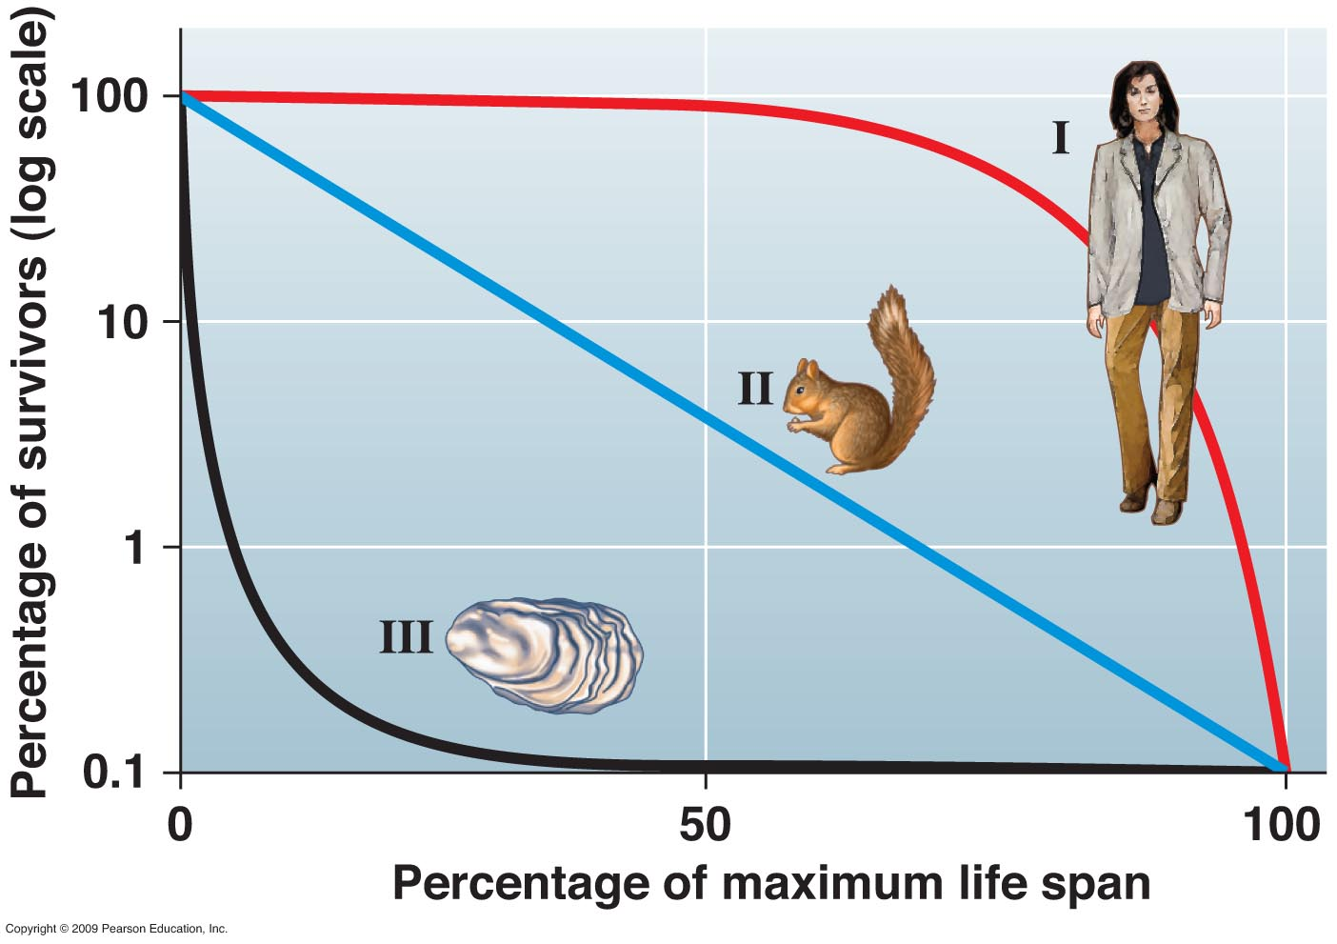
Survivorship Curves
Very k-selected
Very r-selected

