Slide 1
Community Ecology

Slide 2
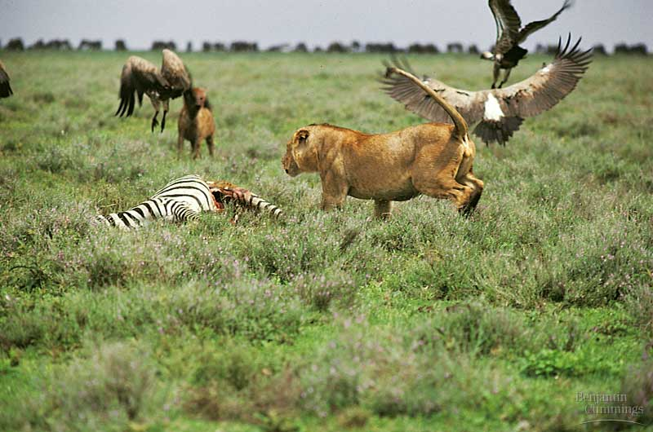
What is a Community?
All of the populations that live together in the same environment

Slide 3
Main Point 1
Populations interact with each other

Slide 4
Population Interactions
Predator/prey
Mutualism
Commensalism
Parasitism
Competition

Slide 5
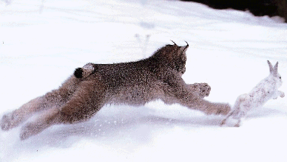
Predator-Prey
Populations of predators affect populations of prey and vice versa.

Slide 6
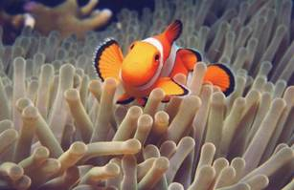
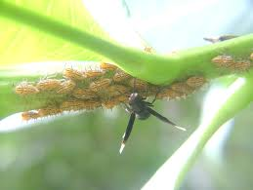
Mutualism
Both populations benefit from a long term interaction

Slide 7
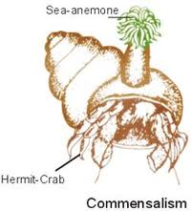
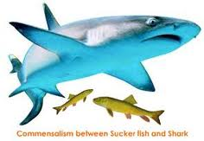
Commensalism
One population benefits without harming the other

Slide 8
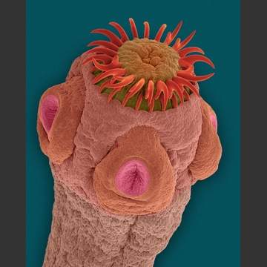
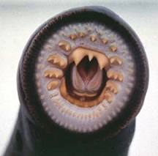
Parasitism
One population benefits at the expense of the other

Slide 9
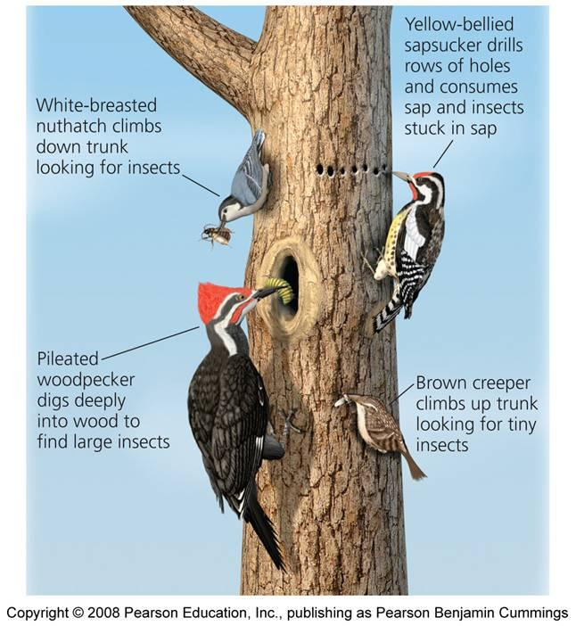
Competition
Presence of one population affects growth of the other
Either limits population growth or forces a population to use new

Slide 10
Main Point 2
The flow of energy has a major impact on species composition in a community
Communities rely on producers to begin energy flow

Slide 11
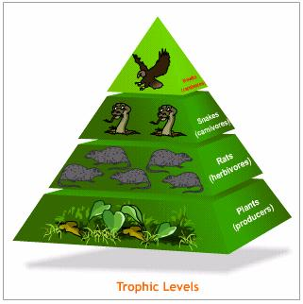
Flow of Energy
Starts with the producers
Passes on up the trophic levels
Travels one way
Due to entropy, less energy available at the top

Slide 12
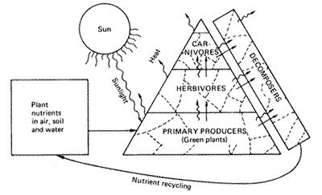
Energy Flows, Nutrients Recycle

Slide 13
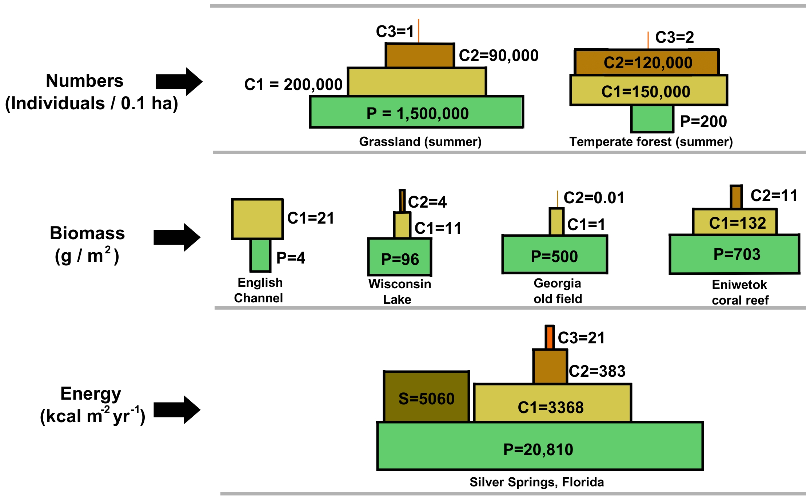
Examples

Slide 14
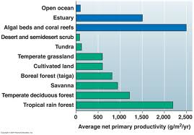
The Ecosystem Depends on Producers

Slide 15
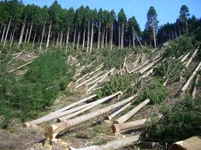
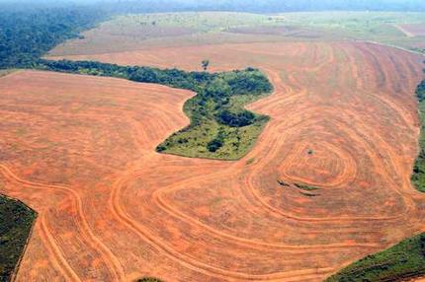
Humans are Destroying Producers
Logging forests, clearing land for cattle and agriculture

Slide 16
Human Population Growth
As the human population grows- we need more resources!
Human population growth is occurring in parts of the world with the last intact ecosystems

Slide 17
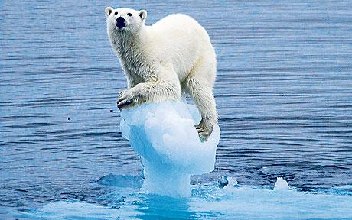
Climate Change
As global climates are shifted it may change the dynamics in local communities
I.e. increased production in some places, decreased production in others

Slide 18
Main Point 3
Sometimes one species has an especially large effect on a community

Slide 19
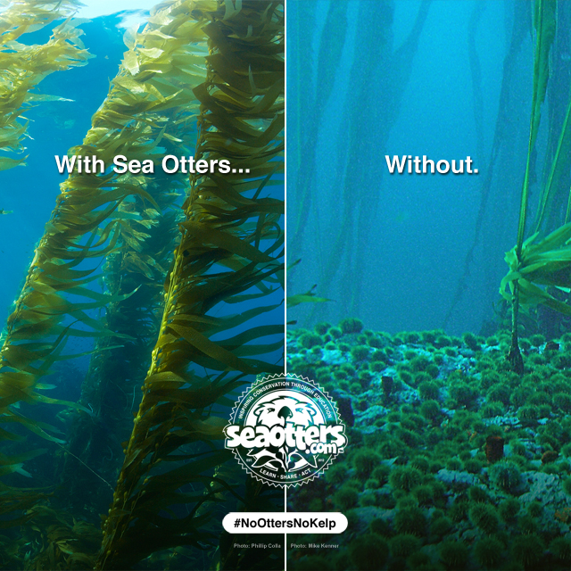
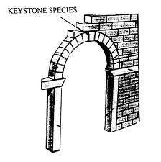
Keystone Species
Removal of one species can affect the entire community
Often keep herbivores in check

Slide 20
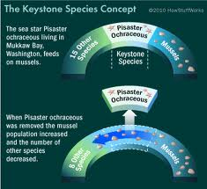
Example

Slide 21
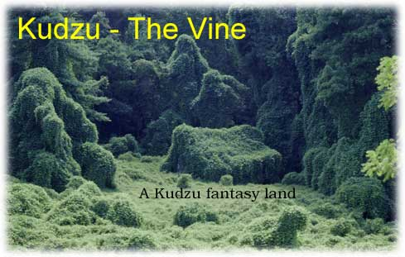
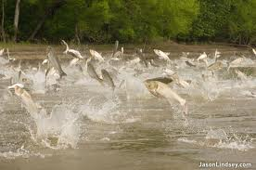
Invasive Species
Humans introduce new species which impact existing species in the community

Slide 22
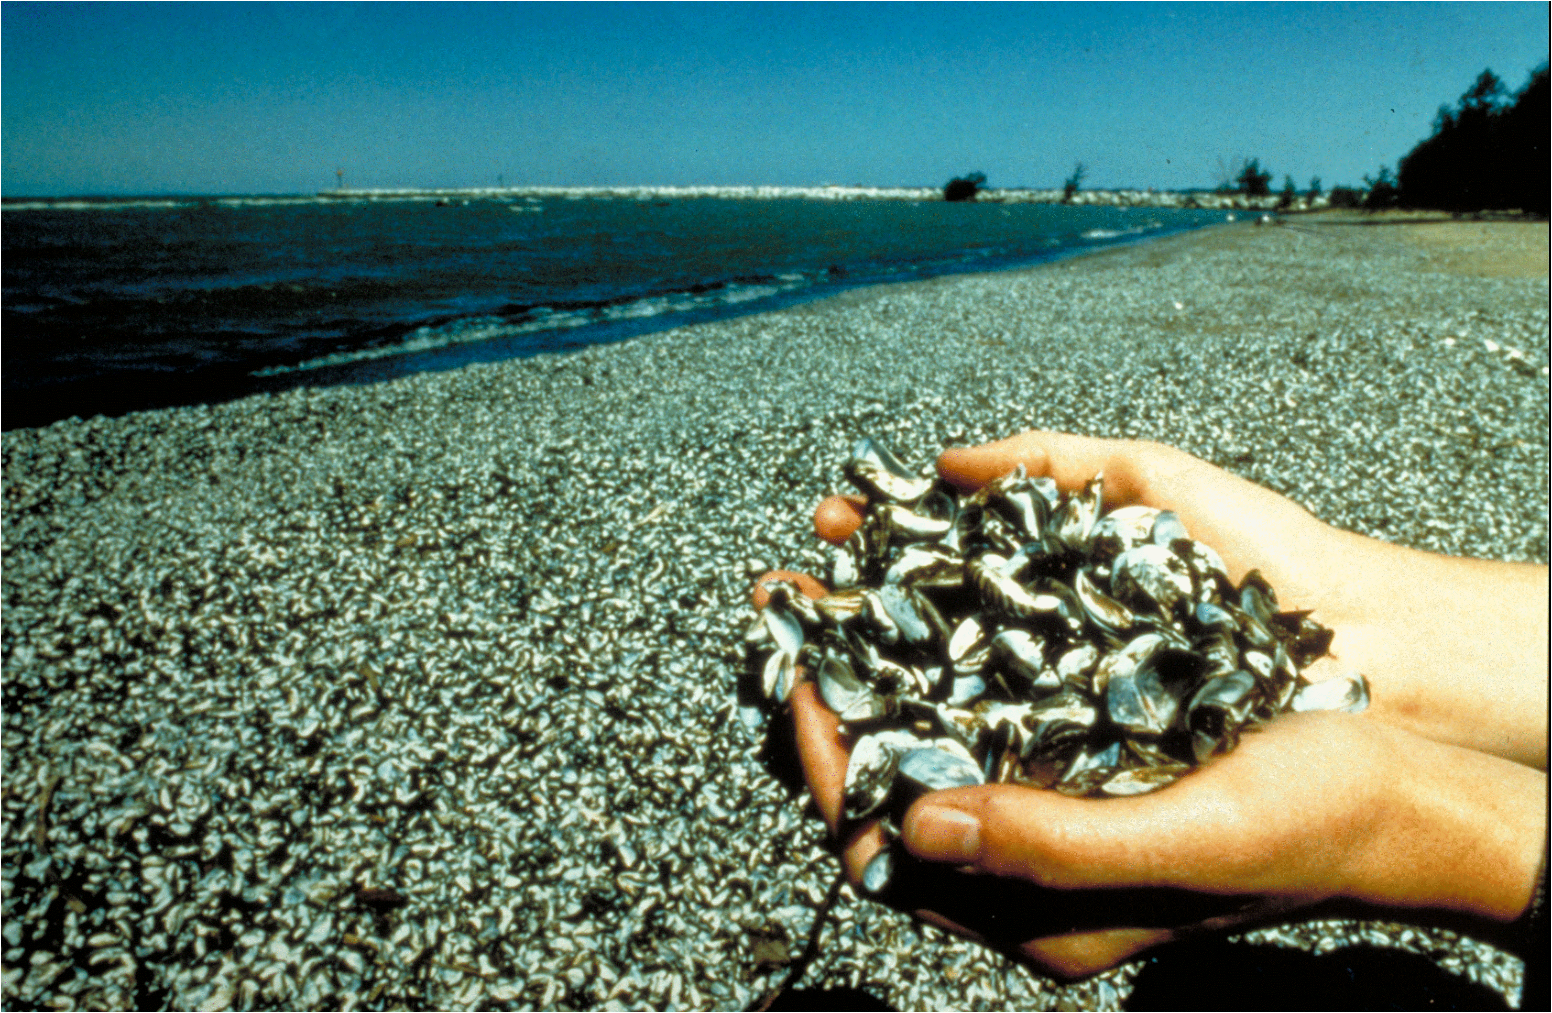

Slide 23
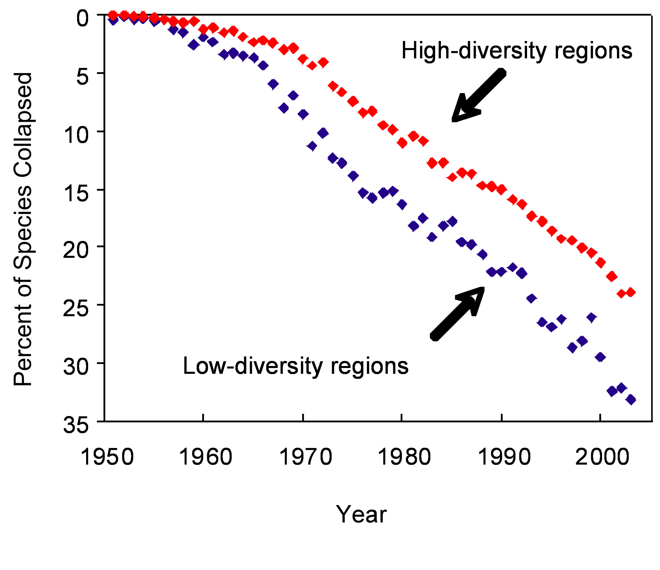
Diversity in Communities
The more diverse the populations – the more likely the community as a whole is to survive
Can adapt to new food sources, new climates, new conditions etc.
Called biodiversity – and its rapidly decreasing
http://www.newswise.com/articles/accelerating-loss-of-ocean-species-threatens-human-well-being

Slide 24
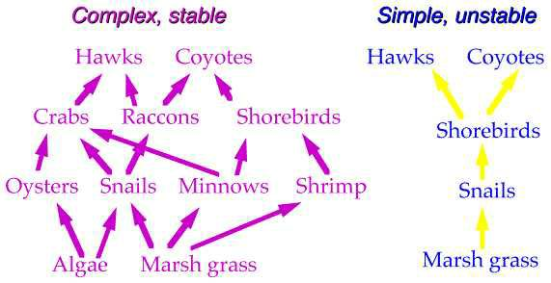
Example

Slide 25
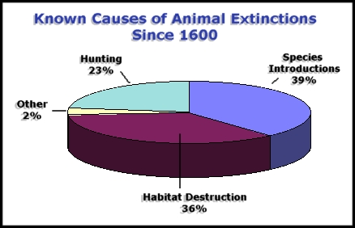
What’s Causing the Drop in Biodiversity?
http://naturanaute.com/2012/02/17/tiger-or-earth-worm-the-dilemma-of-conservation/

Slide 26
Main Point 4
Species composition of a community changes over time

Slide 27
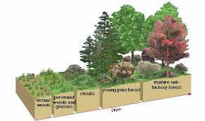
Communities Change over Time
Succession

Slide 28
When New Land is Available….
“Pioneer” species tend to enter first (r-selected))
Over time more stable species (K-selected) become more dominant

Slide 29
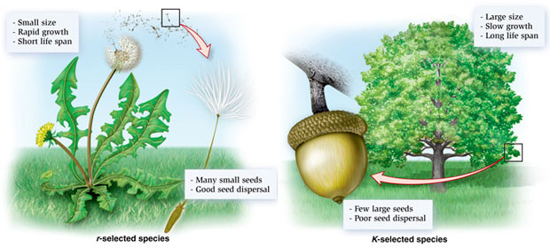
Example

Slide 30
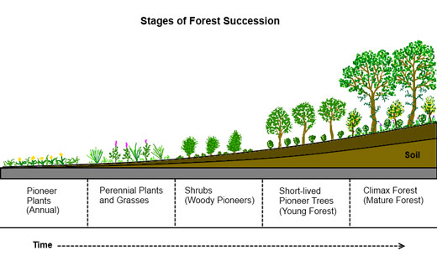
Pioneer → Climax

Slide 31
Posters
In groups of 3, you will make a poster of one concept from community ecology
Sketch (or print) examples of the concept
If applicable, sketch or print a way of graphically displaying the concept somewhere on the poster

