Slide 1
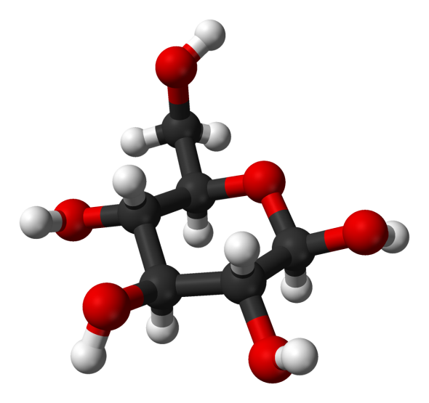
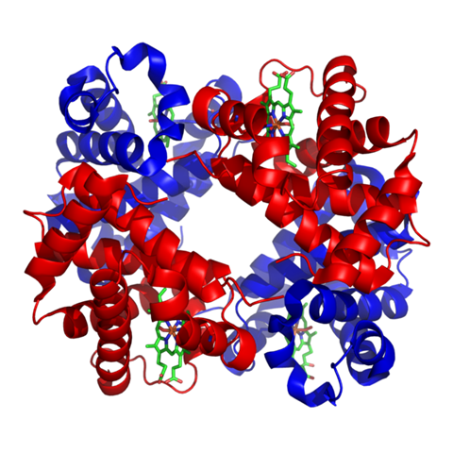
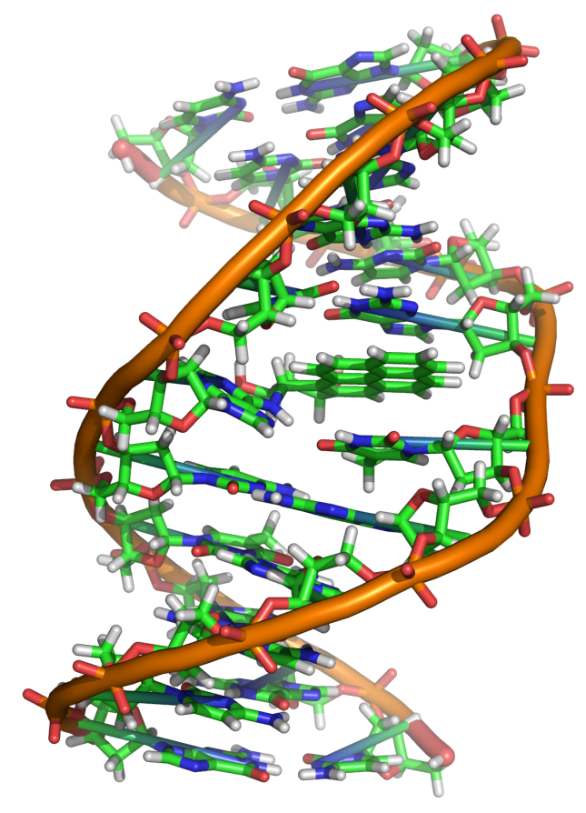
Macromolecules

Slide 2
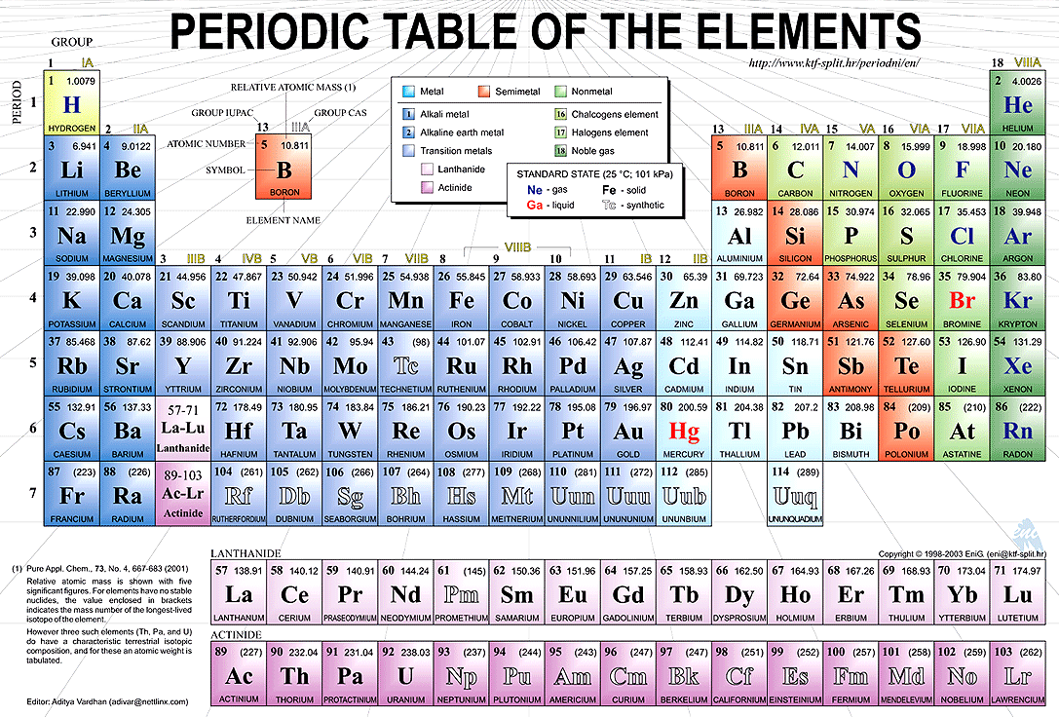
What elements are most common in our cells?
Carbon, Hydrogen, Nitrogen, Oxygen, Phosphorus, and Sulfur.
Remember CHNOPS!

Slide 3
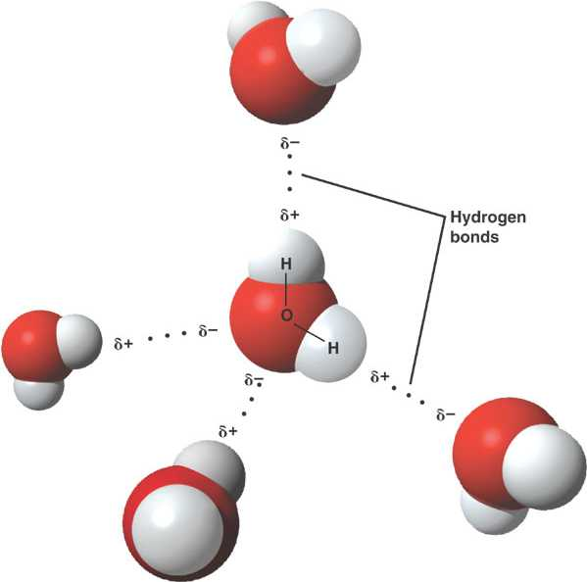
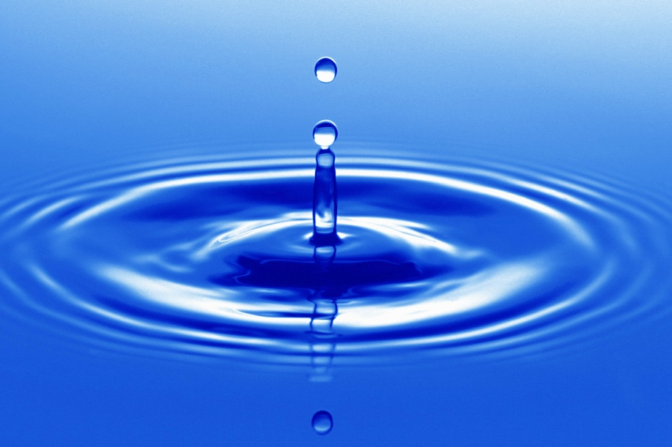
What have we already talked about?
Water…which elements are found in water?

Slide 4
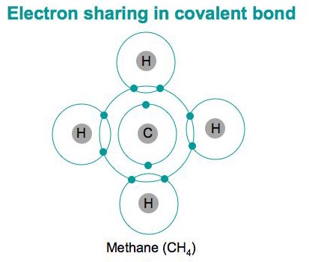
Carbon Compounds
A carbon atom can form four covalent bonds with other atoms

Slide 5
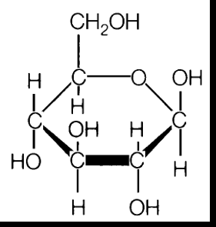
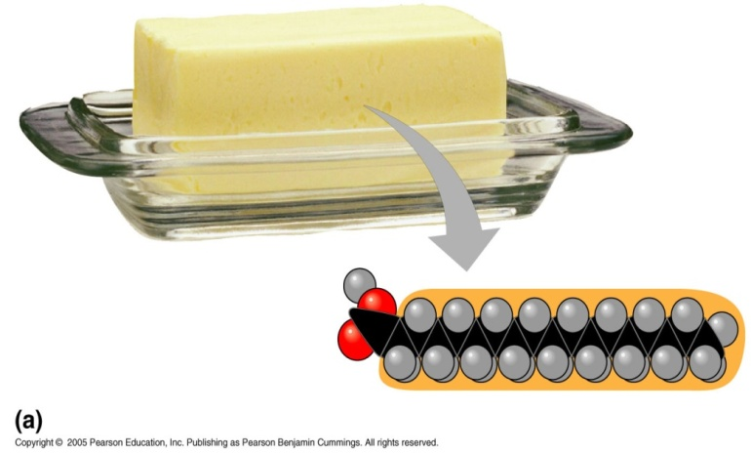
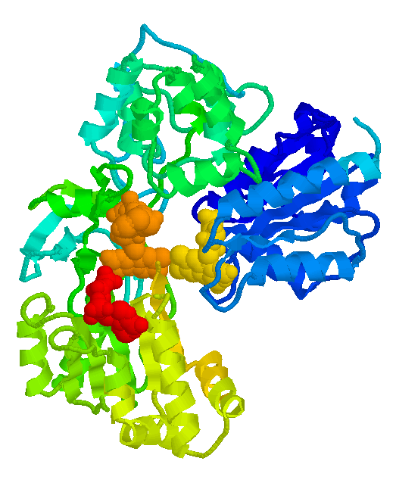
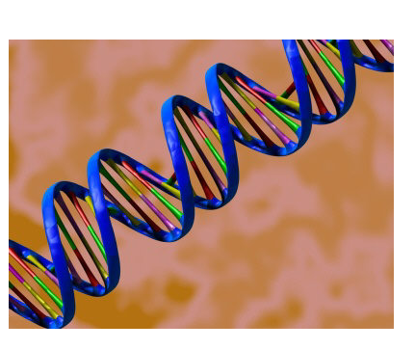
Carbon Compounds
Organic chemistry is the study of all compounds that contain bonds between carbon atoms.
Lipids (Fats)
Nucleic Acids (DNA)
Carbohydrates
Proteins

Slide 6
Carbon Compounds
monomer: a small molecules (building block) that can join together with other small molecules to form a polymer
polymer: forms when many smaller molecules (called monomers) bond together, usually in long chains
macromolecules: large molecules formed by process called polymerization

Slide 7
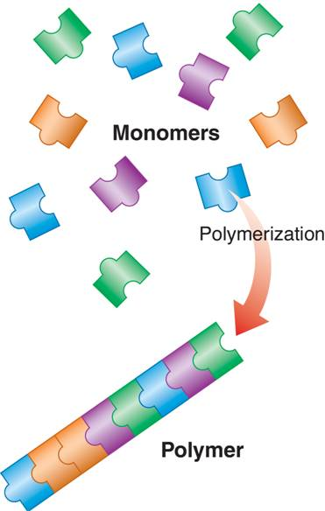

Slide 8
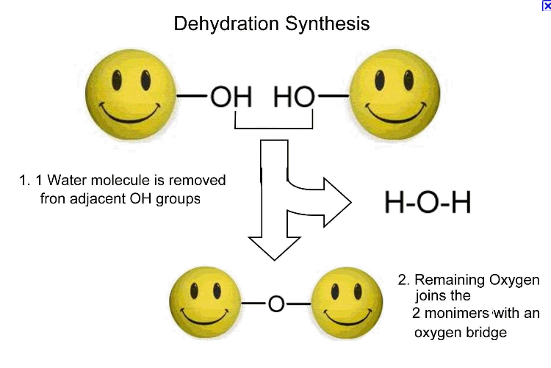
Building and Breaking Down Molecules
Dehydration/Condensation Reaction: monomers are joined to form a polymer; molecules of water are released

Slide 9
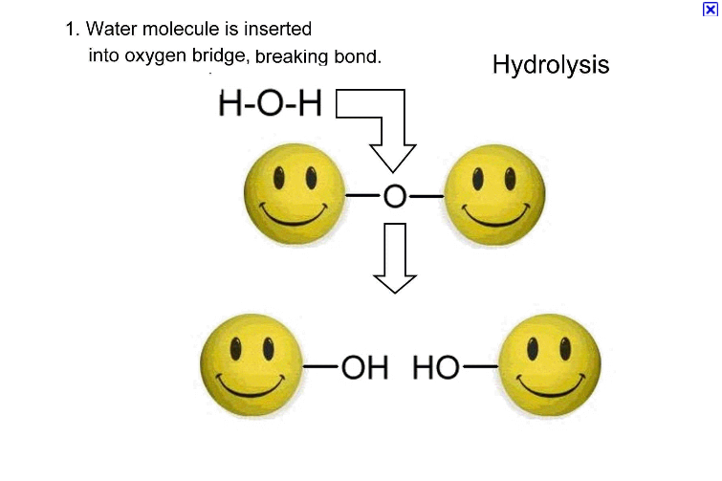
Hydrolysis: a polymer is broken into monomers when water molecules are added

Slide 10
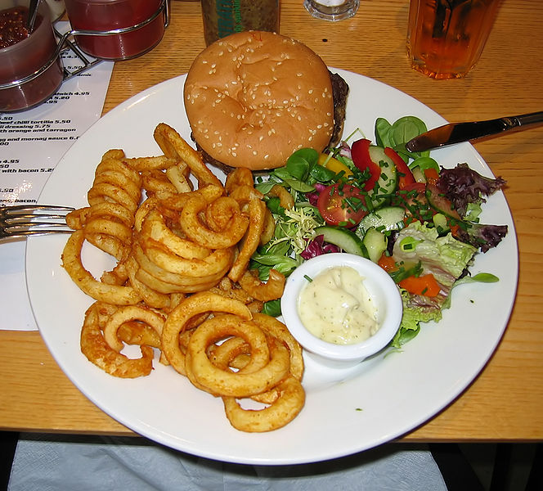
Why do we eat food?

Slide 11
OK, so what exactly is in the stuff the lunch lady is feeding me?
When we eat, our bodies break up the food into tiny particles called organic molecules
There are four kinds of organic molecules:
Carbohydrates
Lipids (also called fats)
Proteins
Nucleic acids
Each of these has different functions in the body

Slide 12
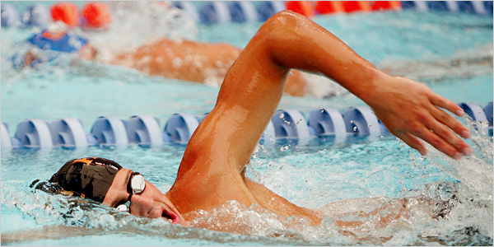
Jamie has swim practice later today, what should he eat for lunch to prepare?
What do you think?
Whole grain pasta
A big salad
Steak

Slide 13
Jamie has swim practice later today, what should he eat for lunch to prepare?
What do you think?
Whole grain pasta
A big salad
Steak

Slide 14
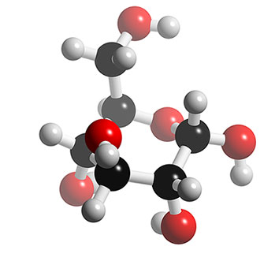
CARBOHYDRATES –what purpose do they serve?
Carbohydrates are the body’s primary source of fuel
They are found in bread, cake, potatoes, pasta…
They are also called ‘sugars’ because they are made of glucose, a sugar molecule

Slide 15
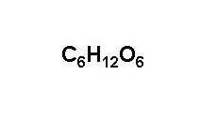
Carbohydrates
Functions: source of energy; also used to maintain plant structure
Made of: Carbon, Hydrogen, Oxygen
(1 C: 2 H: 1 O)
C₅H₁₀O₅
Glucose

Slide 16
Carbohydrates (Sugars)
monosaccharide: carbohydrate monomer, simple sugars
Example: glucose and fructose
disaccharide: 2 monosaccharides form 2-sugar carbohydrate
Example: sucrose
“-ose” means sugar
oligosaccharide: 10-100 sugars
polysaccharide: many sugars

Slide 17
What would we see if we put a Hershey’s bar under a microscope?
A chocolate bar is made up of simple carbohydrates, those carbohydrates are actually small molecules called GLUCOSE.
Simple carbohydrates are called monosaccharides.
Mono means 1 glucose molecule
Therefore, they are an immediate source of energy. Think of them like a bunch of M&Ms spilled on a table. They are all loose and can be eaten immediately. That’s how monosaccarides are like, they are an immediate source of energy.

Slide 18
Carbohydrates
polysaccharide: carbohydrate polymer (forms when sugars join together in a long chain)
Bonds that hold sugars together: glycosidic bond.
Examples:
1) starch: used as food storage by plants
2) glycogen: form in which animals store food
3) cellulose: cell walls in plants

Slide 19
What would we see if we put a baked potato under a microscope?
A potato is a Complex Carbohydrate or “starch” that is made up of polysaccharides
Poly means more than 1 glucose molecule
Think about it like a candied necklace. The glucose are the candies that create a long chain. You would have to break it to be able to eat the candies, just like how you would have to break down the starch to get your energy.
So potatoes (plants)store their energy as the complex carbohydrate called starch.
Plants can also have a complex carbohydrate called cellulose.
We call cellulose fiber when we eat it.

Slide 20
How come we hear that we can lose weight by eating fewer carbs?
If there are not enough carbohydrates in your body, then large amounts of fats that we have stored in us are used for energy.
Once carbs are broken down into glucose, insulin converts it into glycogen which is stored in our liver and muscles.
So animals store energy in complex carbohydrates known as GLYCOGEN.
When we have too much glucose to be converted into glycogen (when our body doesn’t have room for any more glycogen) then the remainder is stored as FAT.

Slide 21
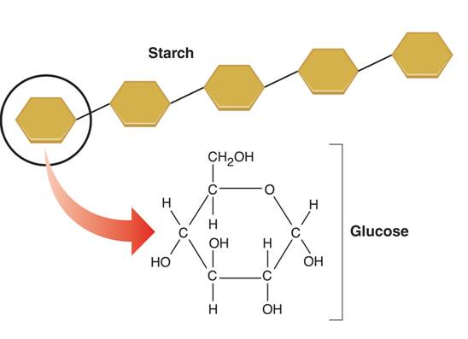

Slide 22
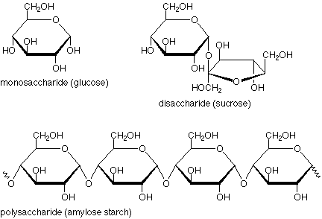
Simple carbs have one ring – monosaccharides Carbs with two rings joined together - disaccharides Multiple rings – polysaccharides Saccharide = sugar

Slide 23
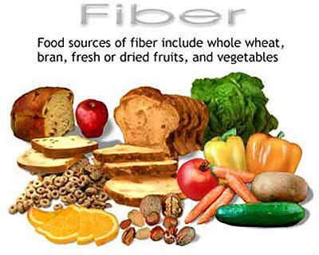
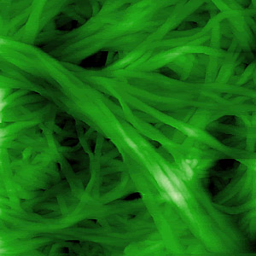
Plants also have complex carbohydrates in the form of….
Cellulose! This is another complex carbohydrate that functions as structural support for plants. Fiber (what we call cellulose when it is eaten) is indigestible to humans!

Slide 24
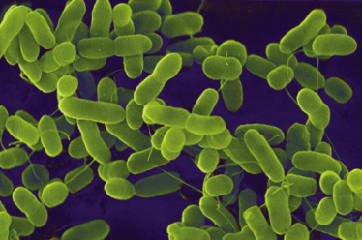
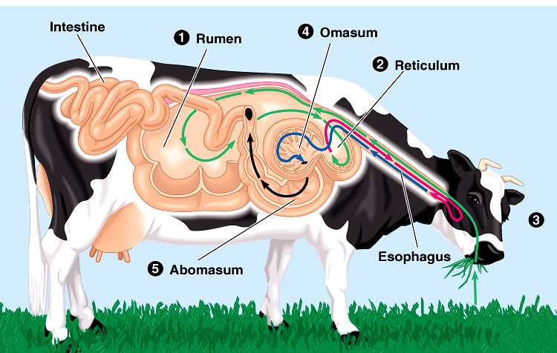
Cellulose
Most abundant organic compound on Earth
herbivores have evolved a mechanism to digest cellulose
most carnivores have not
that’s why they eat meat to get their energy & nutrients
cellulose = undigestible roughage
How can herbivores digest cellulose so well?
BACTERIA live in their digestive systems & help digest cellulose-rich (grass) meals

Slide 25
What about energy drinks? What is in those that makes them so special?
RED BULL: it gives you wiiings!!!. But it’s definitely not good for your body
Red bull is FULL of simple sugars. Since it is a prime source for energy as it is directly in our blood, it feels great.
But what happens after you have used up all the sugar in your from the red bull?

Slide 26
CRRAASHH!!!!!!
When the sugar levels in our blood fluctuate, they lead us to feeling fatigue and exhaustion.
Moreover, the more sugar we take in, the more unbalanced our blood glucose becomes, and the more sugar our body craves in order to fix the imbalance it perceives because we are using up the sugar so quickly since it is already broken down for us.

Slide 27
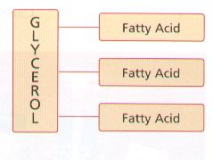
LIPIDS - FATS –What you might eat alone on a Saturday night in your pjs, watching Netflix.
Just as carbohydrates are made of glucose, fats or Lipids, are made up of FATTY ACIDS.
Made of C, H and few O Hydrocarbons= long chains of C & H
Hydrophobic, non-polar, long energy

Slide 28
Lipids (Fats)
Made of: Carbon and Hydrogen (with a few Oxygen)
Functions: long-term energy storage, insulation, protective coatings (Some lipids are important parts of biological membranes and waterproof coverings.)
Examples: fats, oils, and waxes - insoluble in water
Steroids are also lipids. Many steroids serve as chemical messengers.

Slide 29
Lipids
Structure: Usually 3 fatty acids (carbon-hydrogen chains) bonded to 1 glycerol molecule

Slide 30
Good Fats Versus Bad Fats Fatty Acid Structure:
SATURATED: meaning that each bond is completely filled with hydrogens. They are SOLID at room temperature.
UNSATURATED: are not completely filled with hydrogen- there is at least one carbon double bonded, making them “kinked”. They are LIQUID at room temperature.

Slide 31
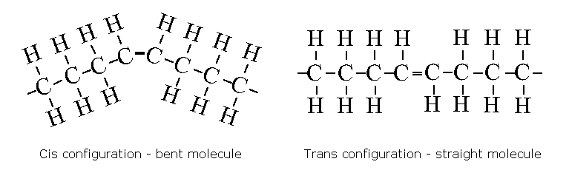
Trans-fatty acids have straightened double bonds and thus act like saturated fat.

Slide 32
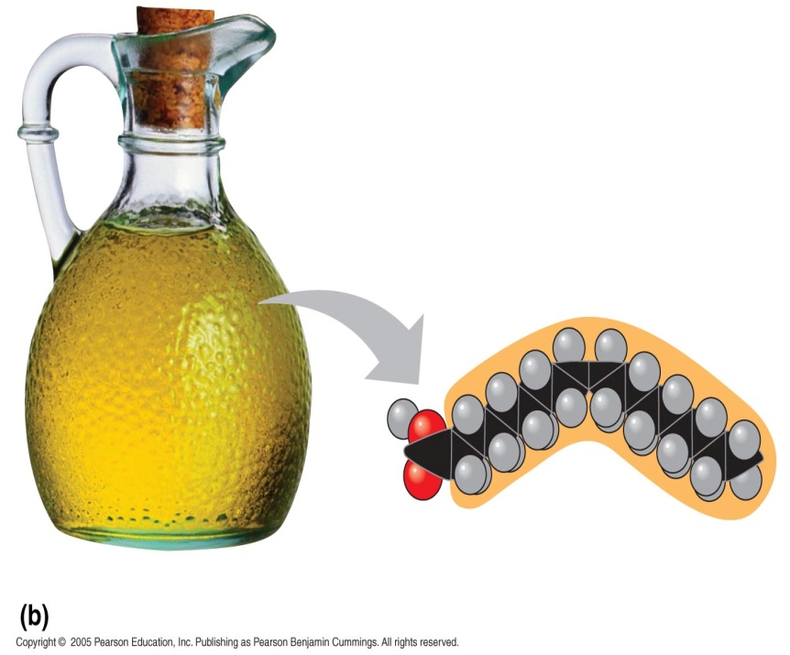
2. Lipids
Saturated vs. Unsaturated Fat…which is “worse” for you and why?
Saturated Fat (Butter)
Unsaturated Fat (Oil)

Slide 33
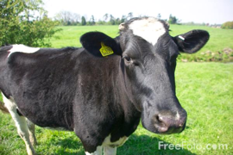
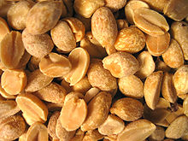
PLANT FAT VS. ANIMAL FAT
PLANT FAT
Plant oils are usually unsaturated fats
Because of their structure, they bend and so cannot line up together to form solids.
These are more healthy for you because they do not come together and get stuck.
They are LIQUID at room temperature
ANIMAL FAT
Animal fats are usually saturated fats
These line up together very well which is why they are solid at room temperature
This makes it easy to clog blood vessels and organs
They are SOLID at room temperature

Slide 34
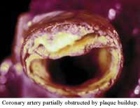
What too much fat can do to you…
Too much fat can clog your arteries leading to fatal cases such as a heart attack or a stroke or Coronary Heart Disease
This is because clogged arteries may lead to a blood clot. Therefore, it will block the flow of blood to your heart.

Slide 35
What about Fish?
Recent studies have said that eating fish, such as salmon, is healthy
This is because of the specific type of fats in fish: Omega 3s
These fats are unsaturated because the most fish live in cooler temperatures and solid fats would get harder and decrease mobility

Slide 36
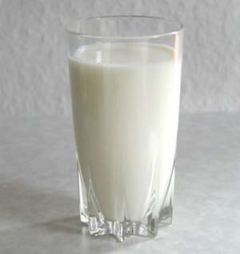
PROTEINS
Made up of long chains of amino acids
Our muscles are made out of proteins. Just like cows and chickens have muscles. The meat we eat from them are their muscles.

Slide 37
Putting grilled chicken under a microscope…
Chicken is made up of proteins. Proteins are made up of long chains of amino acids. It’s kind of like a really long pearl necklace. Each pearl is an amino acid held by a tight bond (called a peptide bond) between each one.

Slide 38
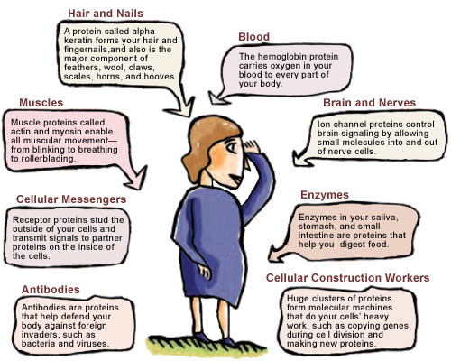

Slide 39
Proteins are found in our cells
Make up over half the dry weight of the cell.
They act out various functions in the body including, building DNA , enzymes, and building muscles

Slide 40
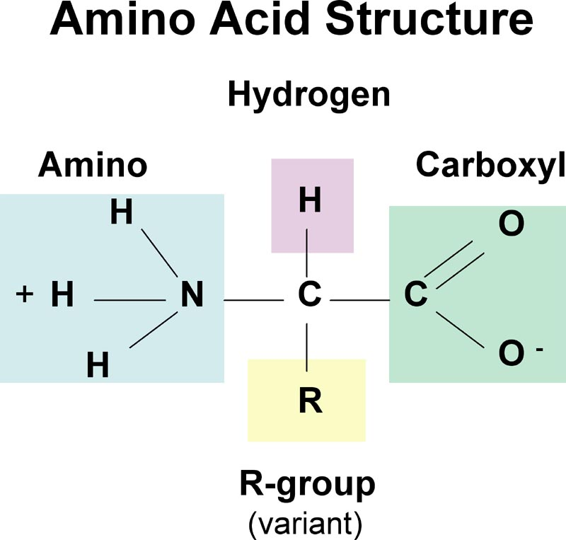

Slide 41
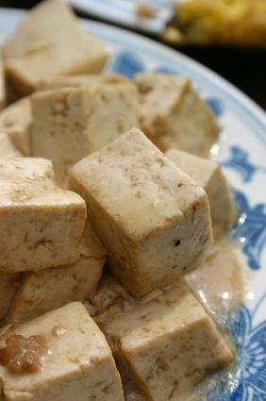
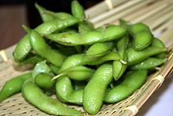
How do vegetarians get proteins? We’ve heard that meat has protein in it, but plants also contain protein in their seeds. This is because the seeds were originally nutrient sources for the plant embryo within the seed (like the simple carbohydrates)
==>

Slide 42
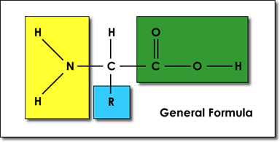
Proteins
Amino Acids : Monomers of proteins; 20 common amino acids ; Consists of a central Carbon atom bonded to 4 groups
4 Groups
1) Hydrogen Atom
2) Amino Group
3) Carboxyl Group
4) R group (changes in each Amino Acid!)

Slide 43
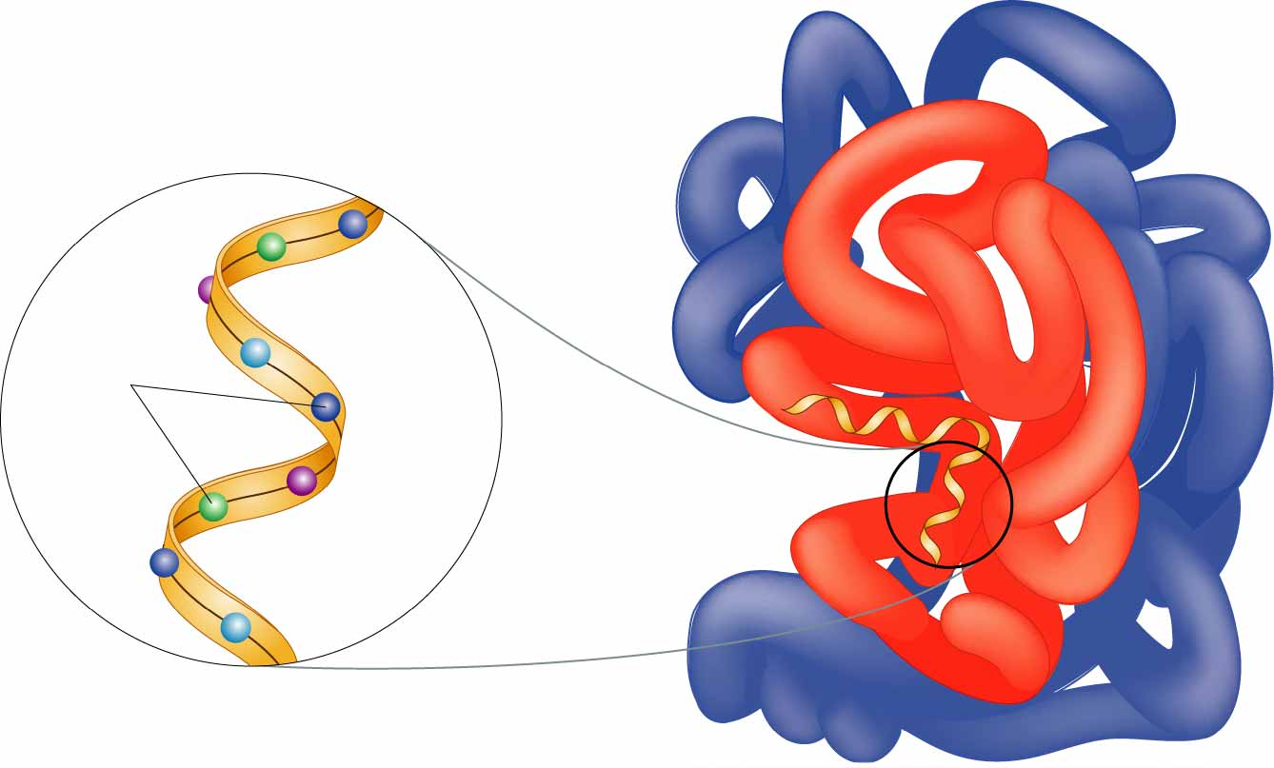
Proteins
Polypeptide: polymer; one chain of amino acids
Proteins: several polypeptides folded into complex structures.

Slide 44
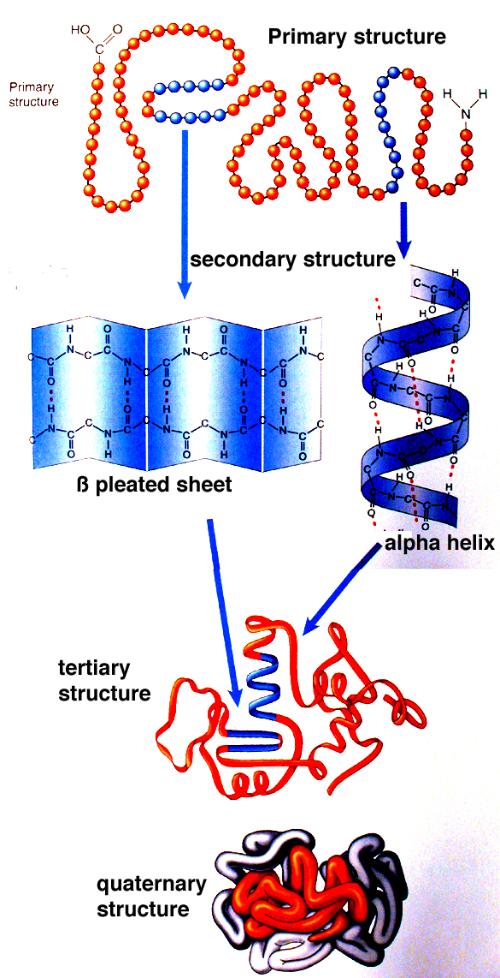
4. Proteins
Four Levels of Protein Structure
1) Primary
2) Secondary
3) Tertiary
4) Quaternary
..\..\..\Downloaded Videos\Protein Structure.avi

Slide 45
How do we Exist????
The nucleic acids are the building blocks of living organisms.
DNA is just one type of nucleic acid. Nucleic acids work together to help cells replicate and build proteins.

Slide 46
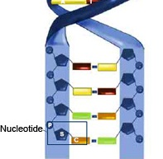
Nucleotides make up nucleic acids!

Slide 47
Nucleic Acids
Made of: C, H, O, N, and P
Functions: store & transmit information in cells in form of a code
Nucleotide: monomer of a nucleic acid ; 3 parts (nitrogen base, 5 carbon sugar, and phosphate group)
DNA or RNA: polymers made by liking nucleotides in a chain

Slide 48
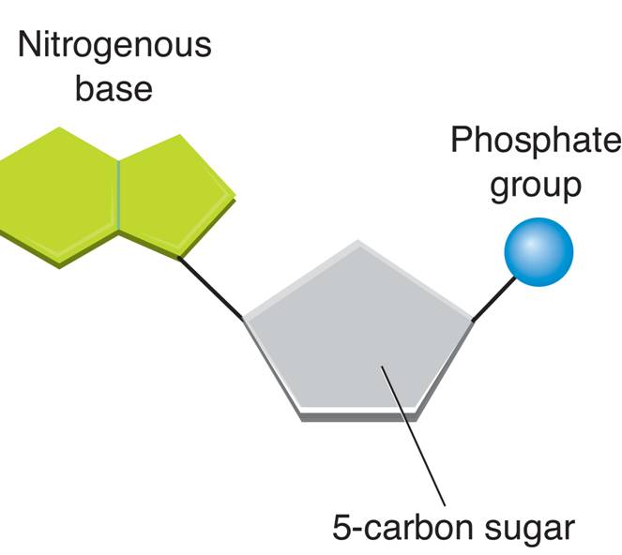
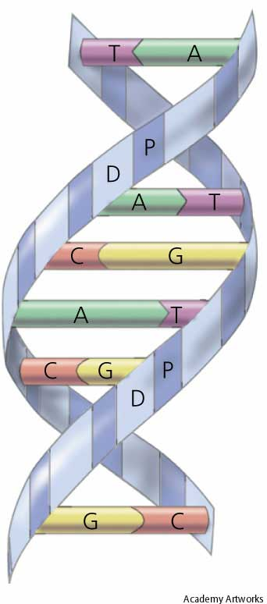
Nucleic Acids
Nucleotide
DNA

Slide 49
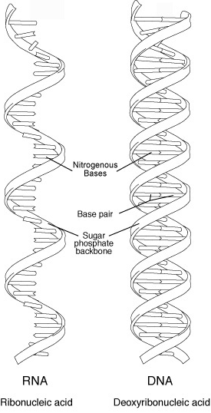
Nucleic Acids
DNA : deoxyribonucleic acid; master copy of organism's genetic code
RNA: ribonucleic acid; forms copy of DNA; used to make proteins (protein synthesis)

