Slide 1
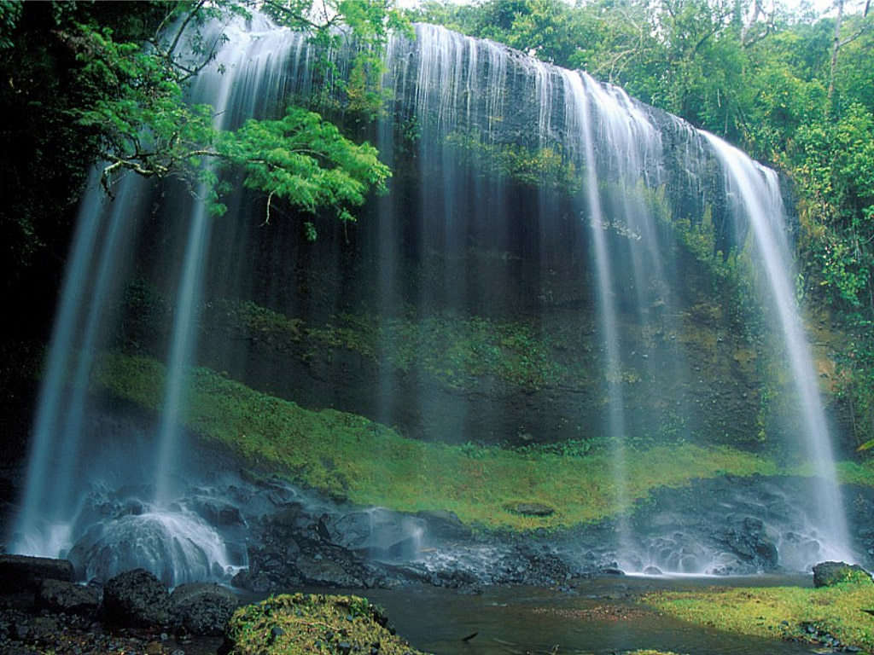
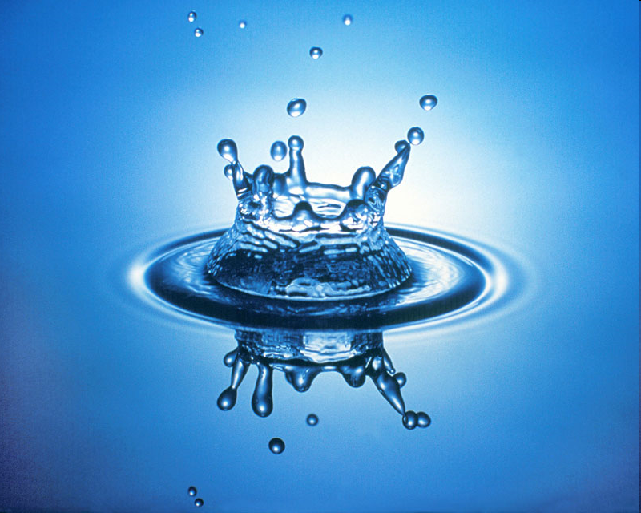
Properties of Water!
Why Water is Special

Slide 2
Properties of water
Emergent Properties of water contribute to Earth’s fitness for life
Cohesion/Adhesion
Surface tension
Specific Heat
Solution
pH
http://www.sumanasinc.com/webcontent/animations/content/propertiesofwater/water.html

Slide 3
Homeostasis
Ability to maintain a steady state despite changing conditions
Water is important to this process because:
a. Makes a good insulator
b. Resists temperature change
c. Universal solvent
d. Coolant
e. Ice protects against temperature extremes (insulates frozen lakes)
The Essential Substance of Life- video
Notes:
4

Slide 4
Acids and Bases
Dissociation of water molecules leads to acidic and basic conditions that affect living organisms
Organisms must maintain homeostasis in the pH of their internal and external environments

Slide 5
Effects of Changes in pH
Water can dissociate into hydronium ions (H+ or H₃O+) and hydroxide (OH-) ions
Changes in the concentration of these ions Can have a great affect on pH in living organisms
+
–
H
H
H
H
+
Figure on p. 53 of water dissociating
H
H
H
H
Hydronium
ion (H₃O⁺)
Hydroxide
ion (OH–)

Slide 6
Acids and Bases
H₂O H⁺ + OH⁻
(gains proton) H⁺ + H₂O → H₃O⁺ (hydronium ion)
(loses proton) H₂O – H⁺ → OH⁻ (hydroxide ion)

Slide 7
Acids, Bases and pH
One water molecule in 10 million naturally dissociates into a Hydrogen Ion (H+) and a Hydroxide Ion (OH-)
Hydrogen Ion Hydroxide Ion
Acid Base
H₂O  H⁺ + OH⁻

Slide 8
Acids and Bases
+
–
H
H
H
H
+
H
H
H
An acid- (sour)
Is any substance that increases the hydrogen ion (H+) concentration of a solution
A base- (bitter/slippery)
Is any substance that reduces the hydrogen ion concentration of a solution (more OH- ions)
H
Hydronium
ion (H₃O⁺)
Hydroxide
ion (OH–)
+
–
H
H
H
H
+
H
H
H
H
Hydronium
ion (H₃O⁺)
Hydroxide
ion (OH–)

Slide 9
Acids and Bases
Acid = increases H⁺ concentration (HCl)
Base = reduces H⁺ concentration (NaOH)
Most biological fluids are pH 6-8
Acidic
Basic
0
7
14
pH Scale

Slide 10
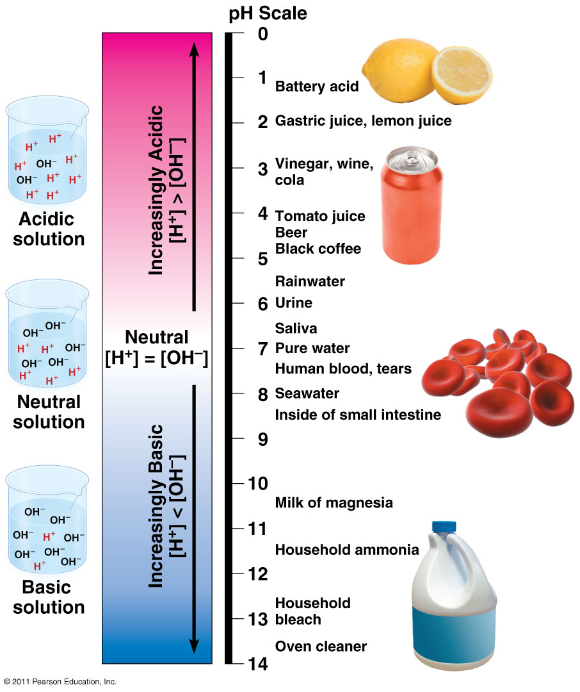
Figure 3.10 The pH scale and pH values of some aqueous solutions

Slide 11
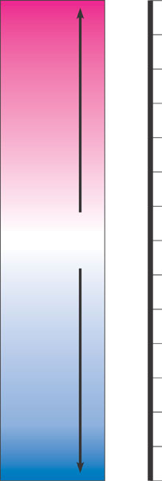
The pH Scale
Scale goes from 0-14 with 7 neutral
The pH of a solution Is determined by the relative concentration of hydrogen ions
Difference of 10X in hydrogen ion concentration between any two pH values
Each pH unit represents a factor of 10X change in concentration
pH 3 is 10 x 10 x 10 (1000) stronger than a pH of 6
Acids have a higher number of H+ ions than a base
Acids produce H+ ion in solution
Bases produce OH- ions in solution
pH Scale
0
1
Battery acid
2
Digestive (stomach)
juice, lemon juice
Increasingly Acidic
[H⁺] > [OH–]
3
Vinegar, beer, wine,
cola
4
Tomato juice
5
Black coffee Rainwater
6
Urine
Neutral
[H⁺] = [OH–]
7
Pure water
Human blood
8
9
Seawater
Increasingly Basic
[H⁺] < [OH–]
10
Milk of magnesia
11
Household ammonia
12
13
Household bleach
Figure 3.8
Oven cleaner
14

Slide 12
Example:
For a neutral solution:
[H⁺] is 10⁻⁷
or - log 10⁻⁷
or - (-7)
or 7
Acids: pH <7 etc.
Bases: pH >7 etc.
Each pH unit is a 10x change in H⁺
[H⁺] + [OH⁻] = 14
Therefore, if you know the concentration of one ion, you can easily calculate the other.

Slide 13
Calculating pH
[H⁺][OH⁻] = 10⁻¹⁴
pH = -log [H⁺]
If [H⁺] = 10⁻²
-log 10⁻² = -(-2) = 2
Therefore, pH = 2
If [OH⁻] = 10⁻¹⁰
[H⁺] = 10⁻⁴
-log 10⁻⁴ = -(-4) = 4
Therefore, pH = 4

Slide 14
Buffers
The internal pH of most living cells
Must remain close to pH 7
Buffers
Are substances that minimize changes in the concentrations of hydrogen and hydroxide ions in a solution
Consist of an acid-base pair that reversibly combines with hydrogen ions
Made by organisms

Slide 15
Acids and Bases
Buffers: minimize changes in concentration of H⁺ and OH⁻ in a solution (weak acids and bases)
Buffers keep blood at pH ~7.4
If blood drops to 7 or up to 7.8, then death
Carbonic Acid – Bicarbonate System: important buffers in blood plasma
H₂CO₃ (carbonic acid) → HCO₃⁻ (bicarbonate) + H⁺

Slide 16
The Threat of Acid Precipitation
Acid precipitation
Refers to rain, snow, or fog with a pH lower than pH 5.6
Is caused primarily by the mixing of different pollutants with water in the air

Slide 17
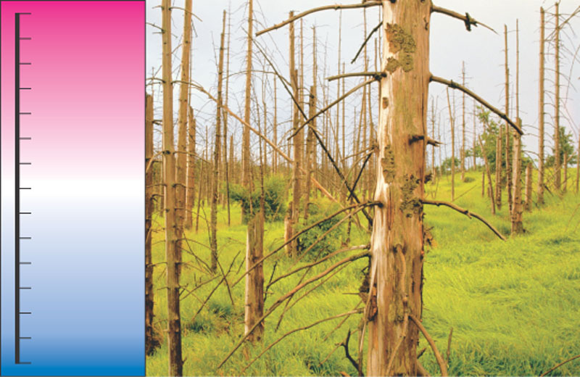
Acid precipitation
Can damage life in Earth’s ecosystems
0
1
More acidic
2
3
Acid rain
4
5
Normal rain
6
7
8
9
10
11
12
13
More basic
14
Figure 3.9
Acids, Bases and pH
Bozeman Biology – Acids, Bases and pH

Slide 18
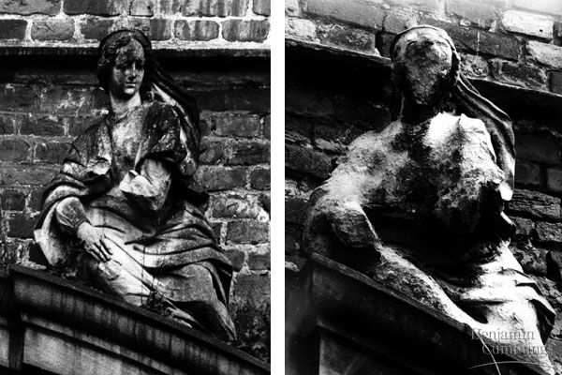
Acid Rain

Slide 19
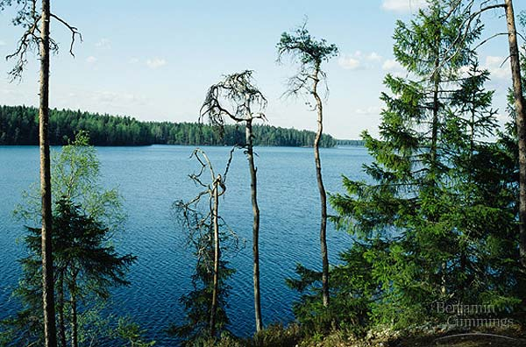
The effects of acid precipitation on a forest

Slide 20
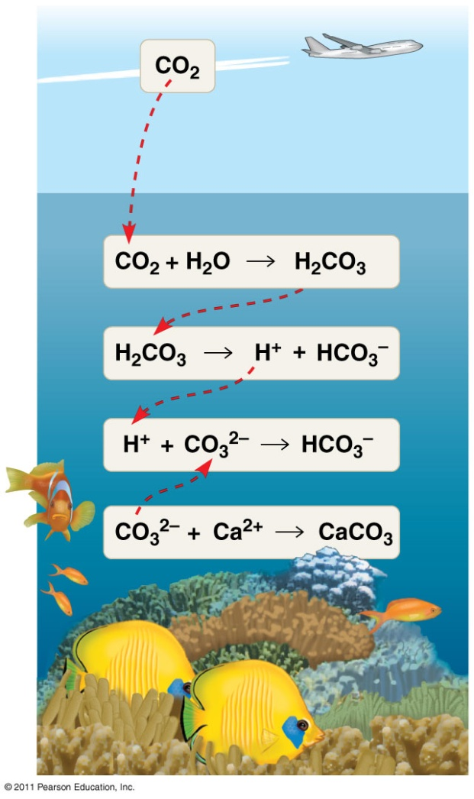
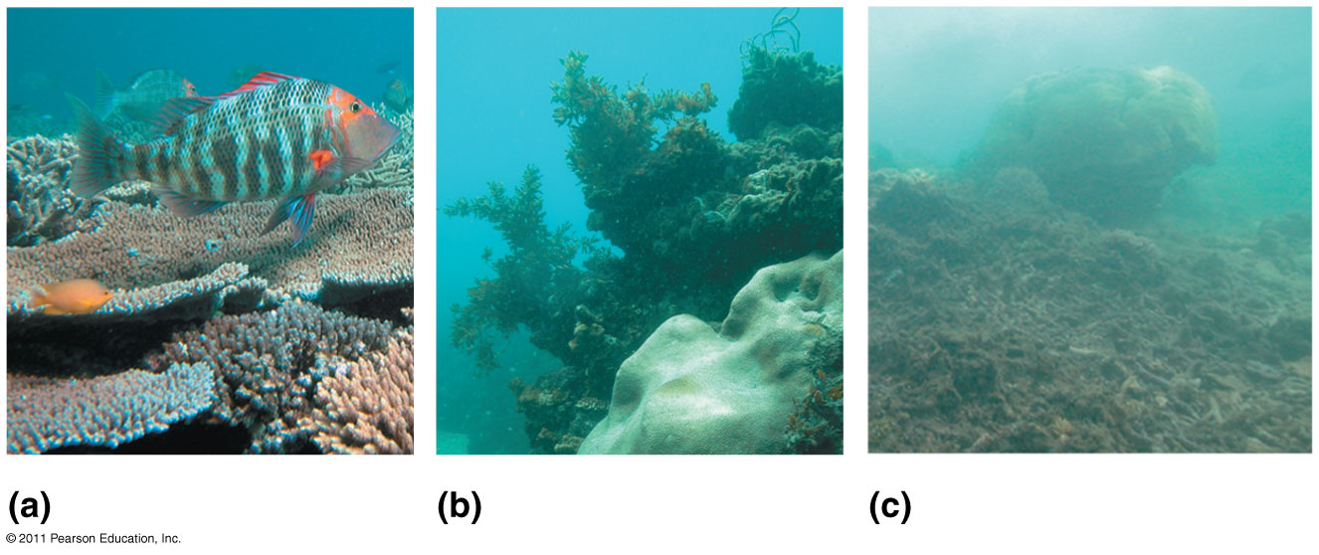
Ocean acidification threatens coral reef ecosystems
CO₂ mixed with seawater → Carbonic acid (lowers ocean pH)

